Slide 1

An Introduction to Generalized Linear Models for MIP
Brooke Anderson

Slide 2
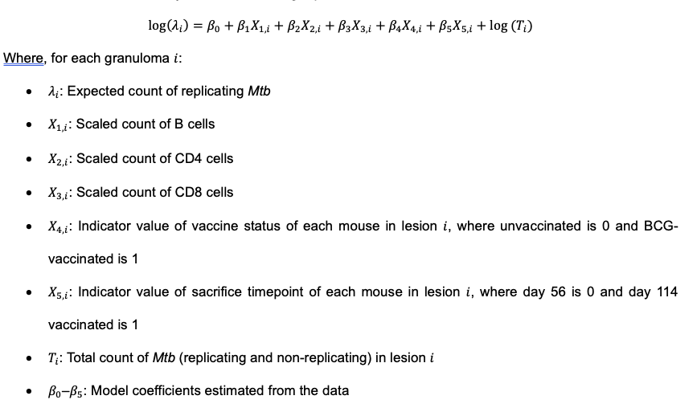

Slide 3
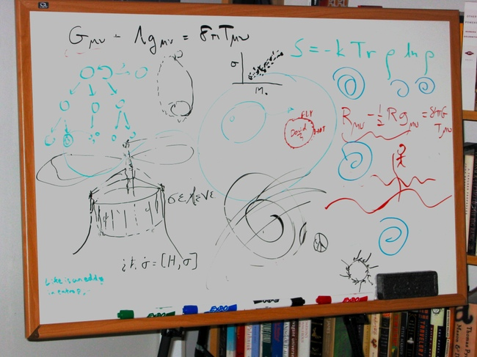
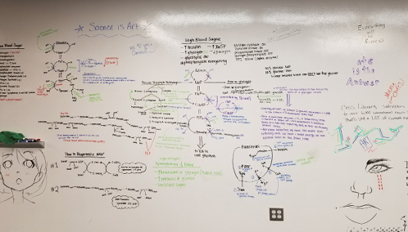
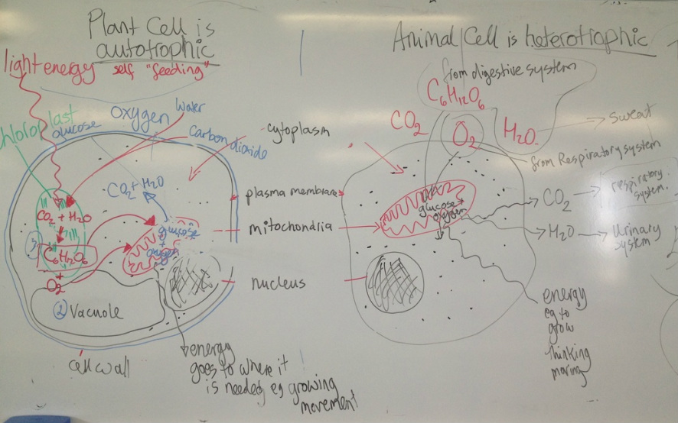
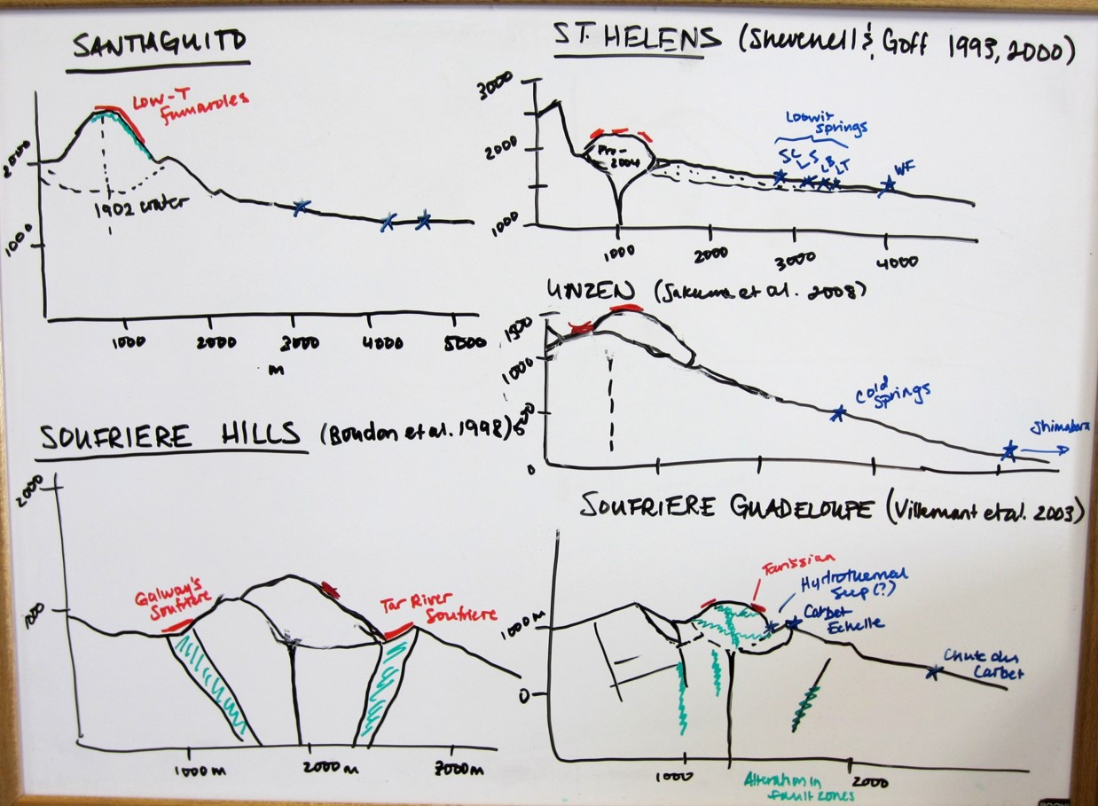

Slide 5
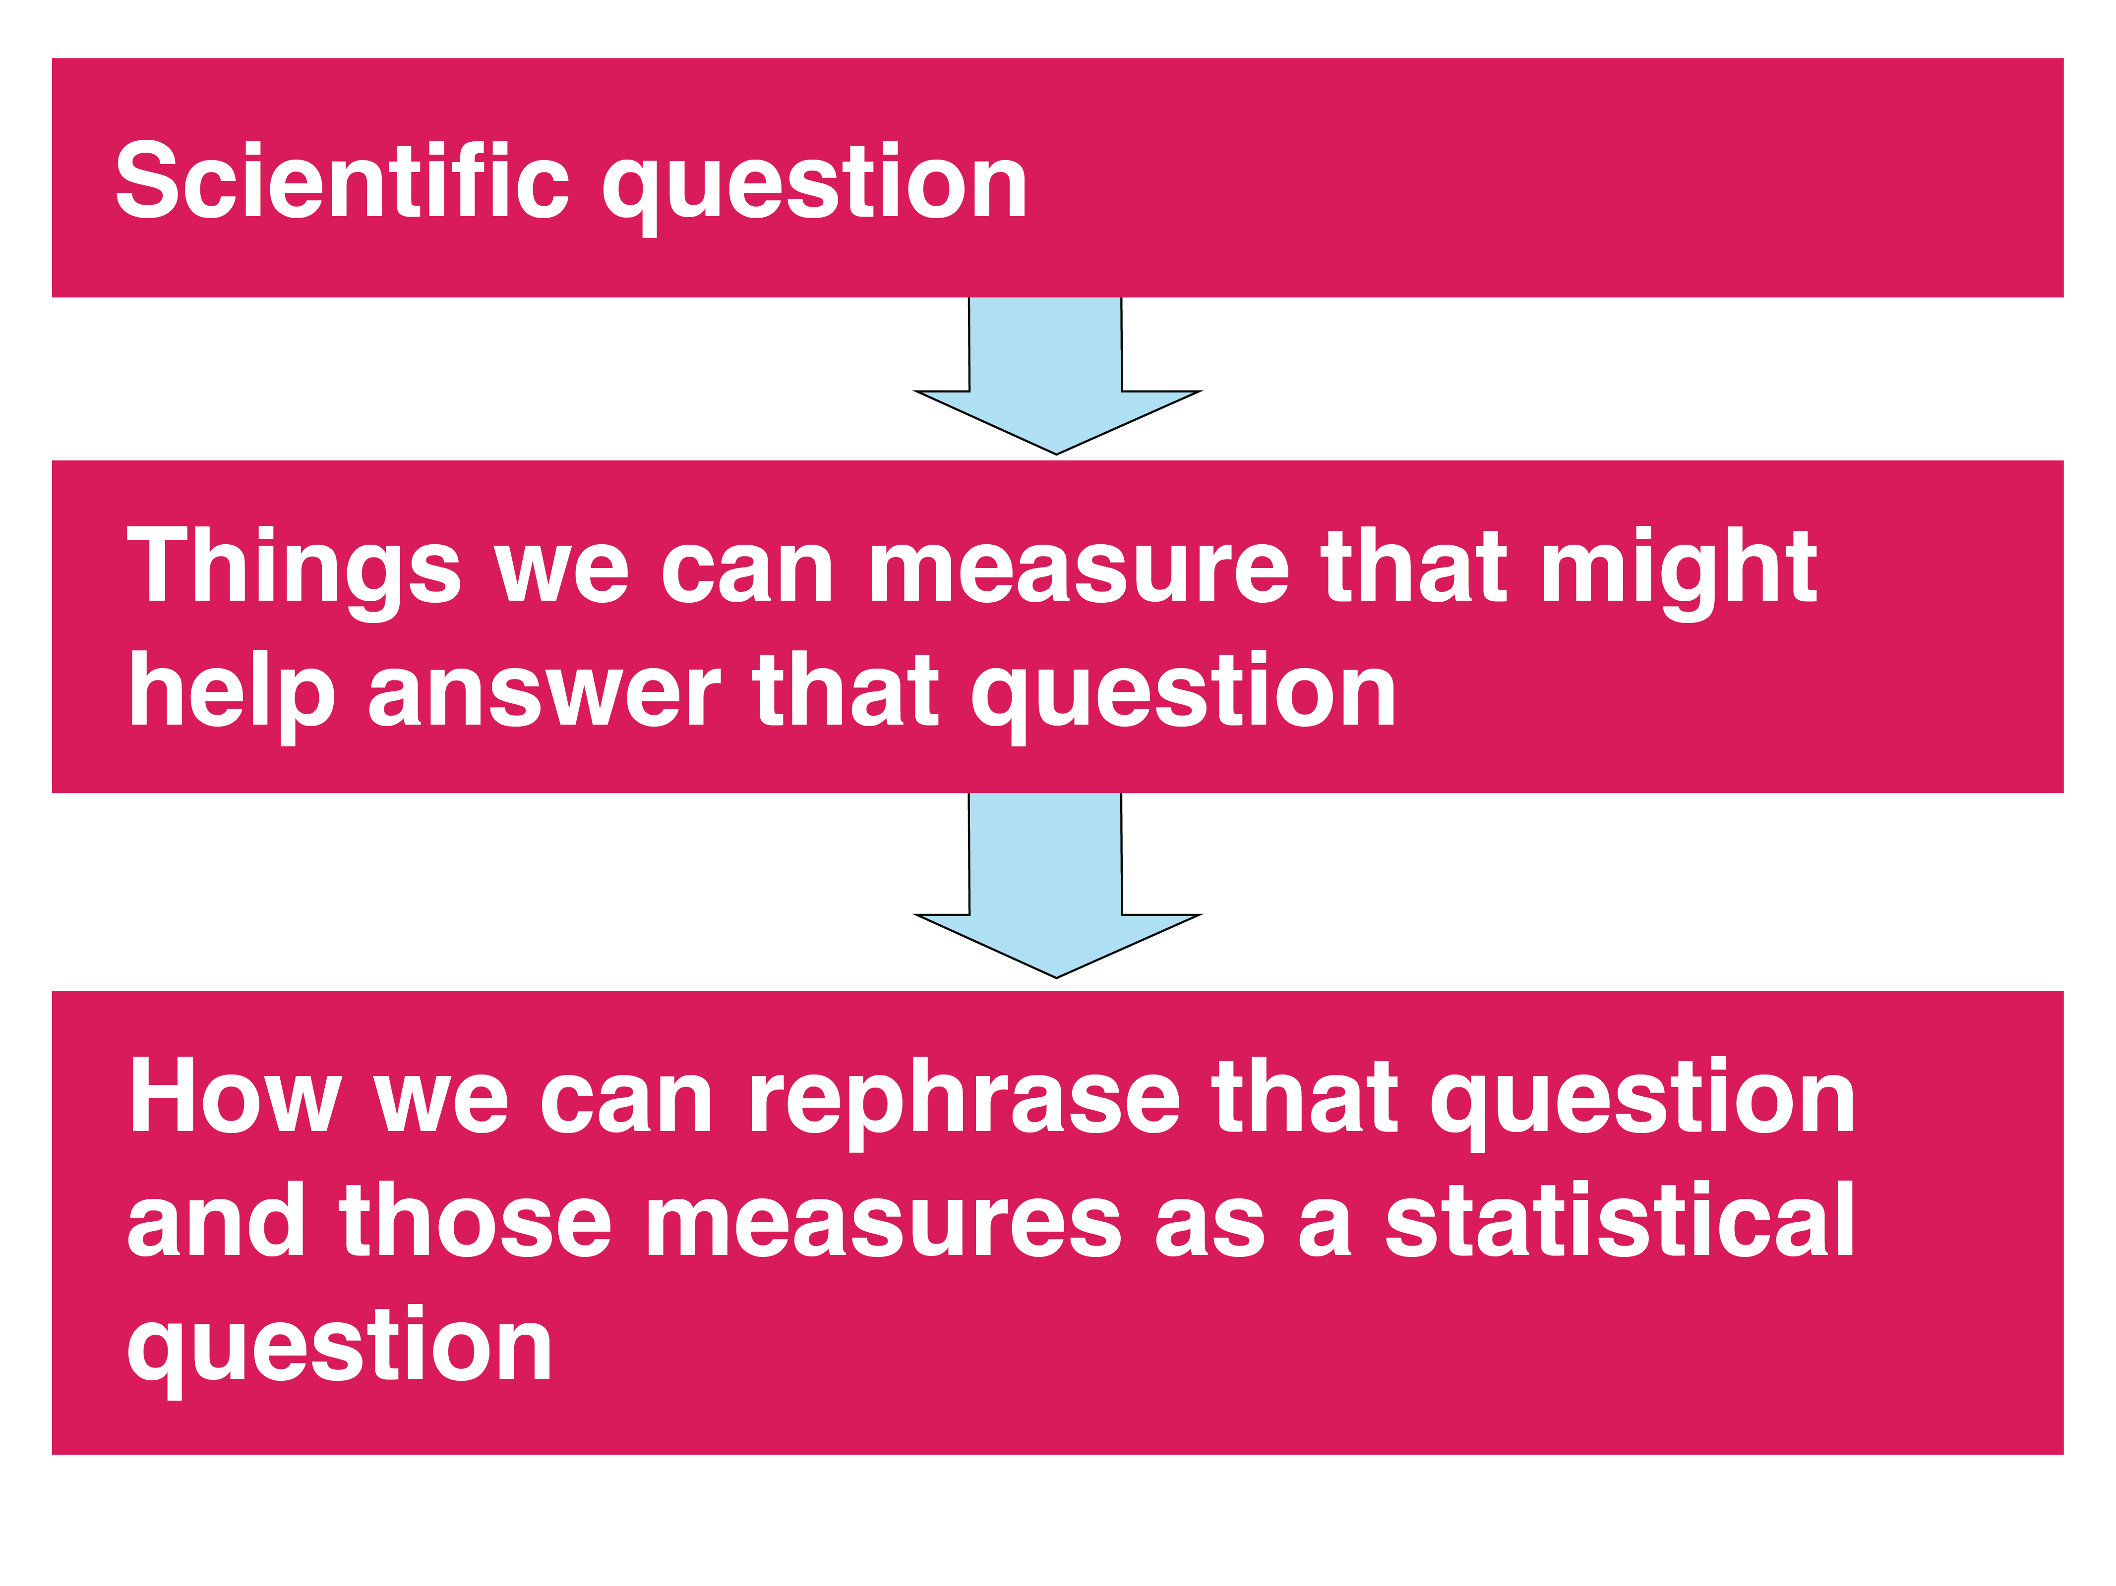

Slide 6
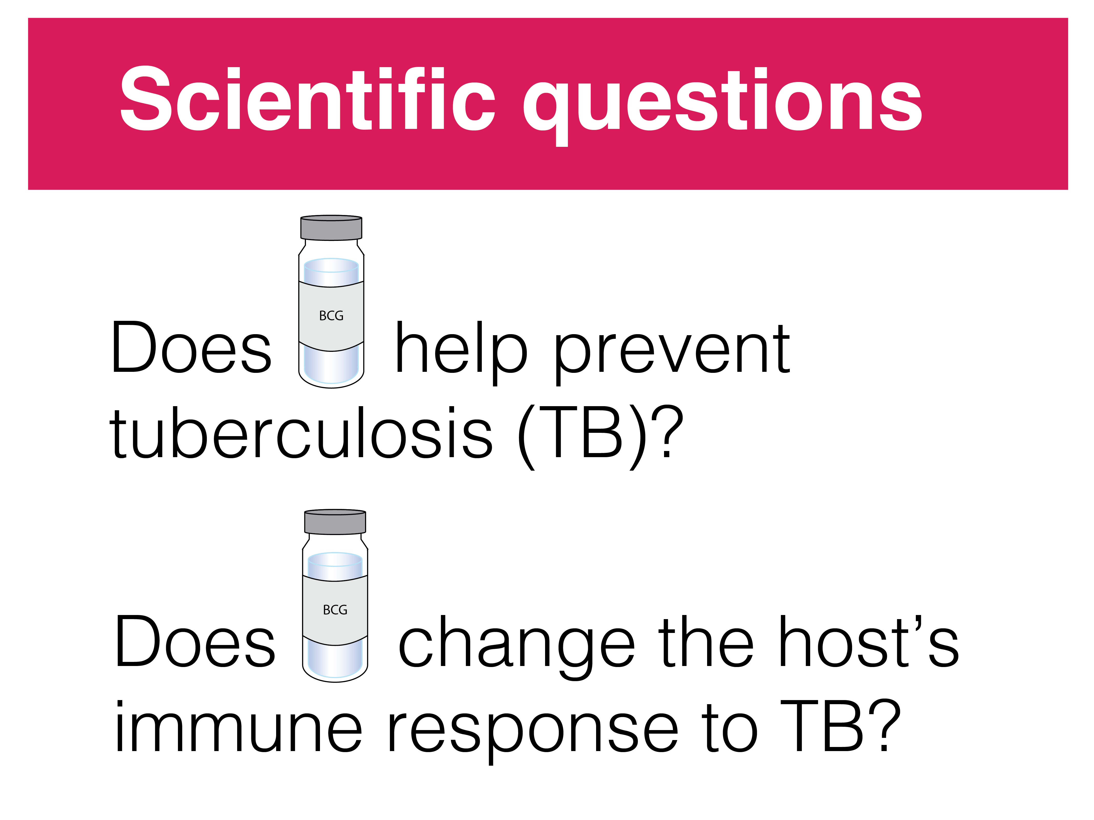

Slide 7
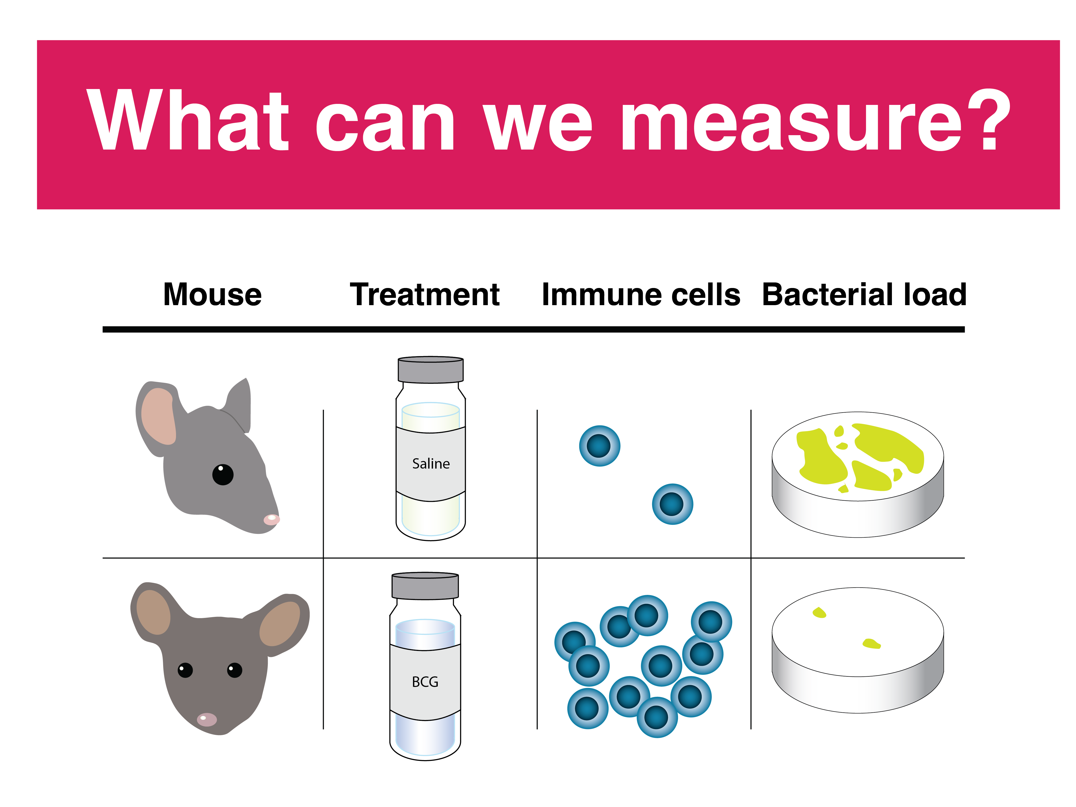

Slide 8
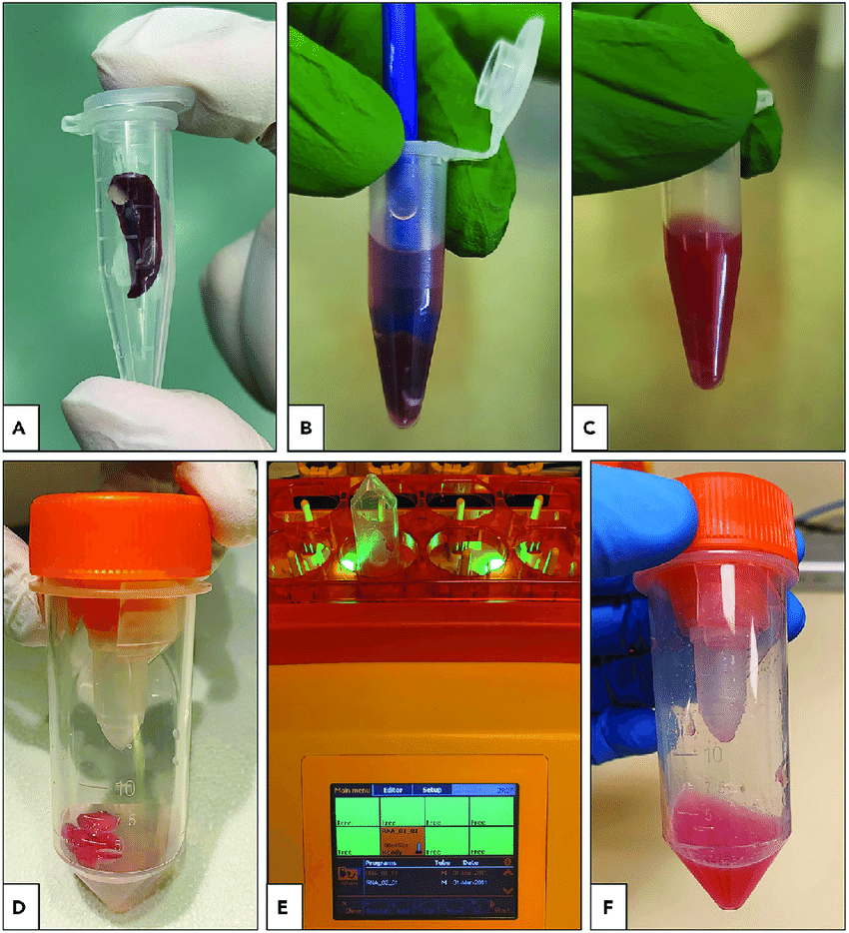
Homogenizing samples to count colony-forming units (CFUs)
Source: Liang et al., 2022. STAR Protocols.

Slide 9
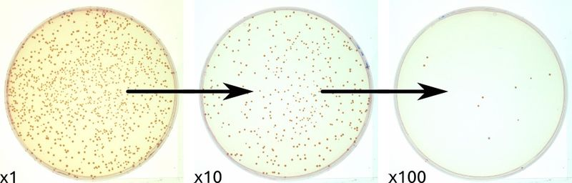
Plating samples to count CFUs
Source: Quentin Geissmann

Slide 10
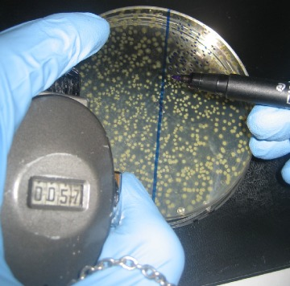
Counting CFUs
Source: Quentin Geissmann

Slide 11
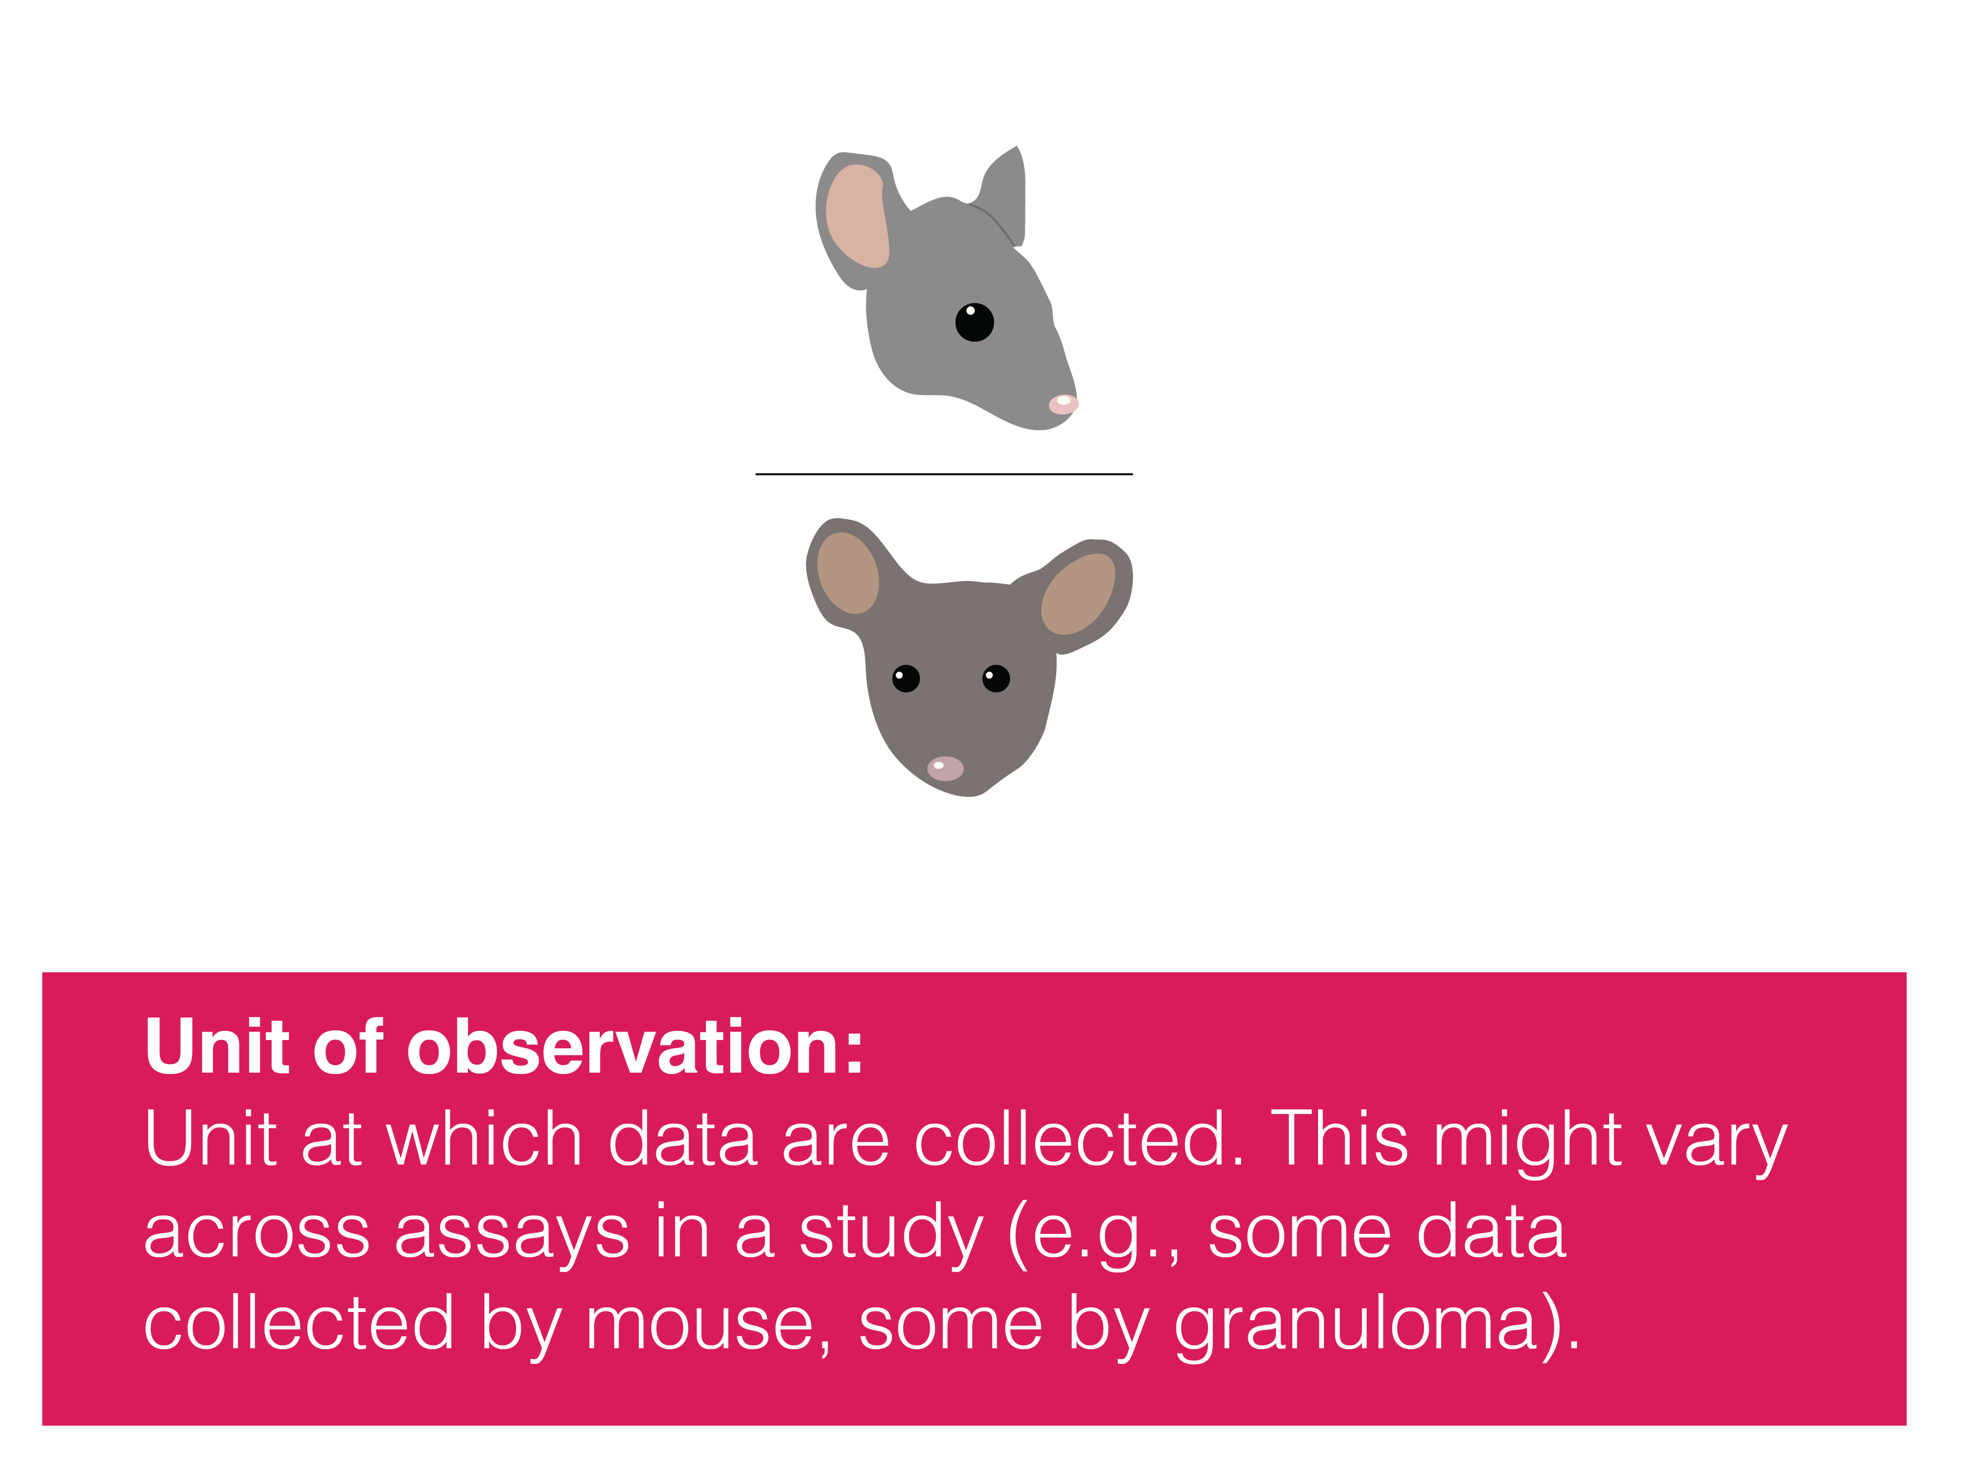

Slide 12
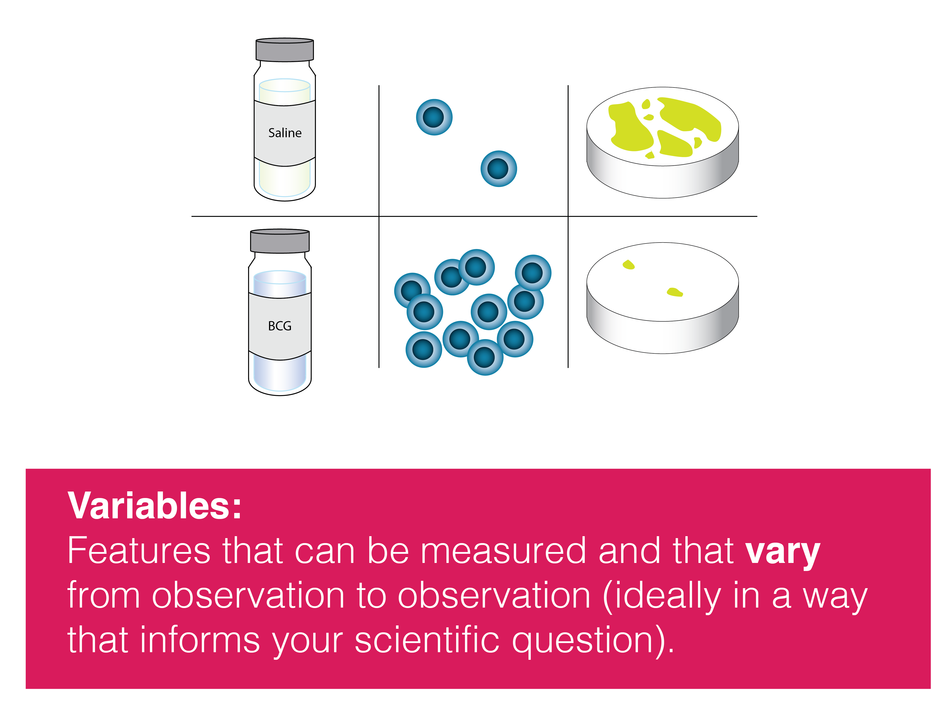

Slide 13
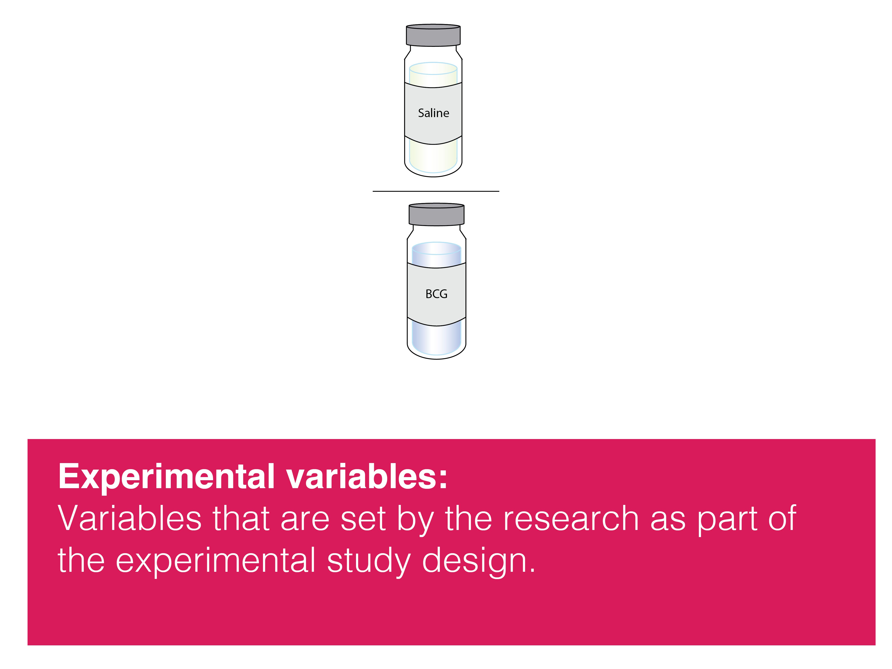

Slide 14
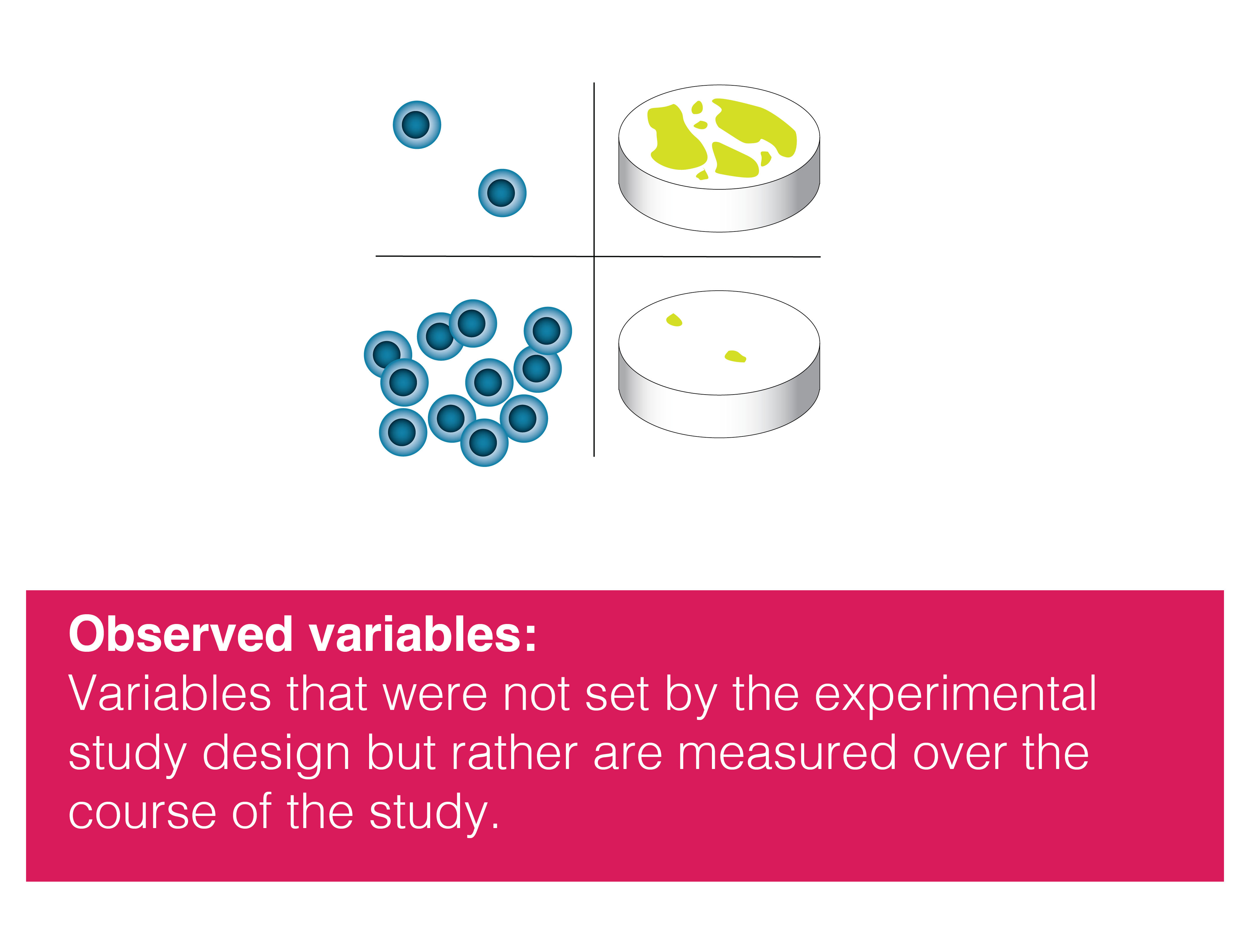

Slide 15
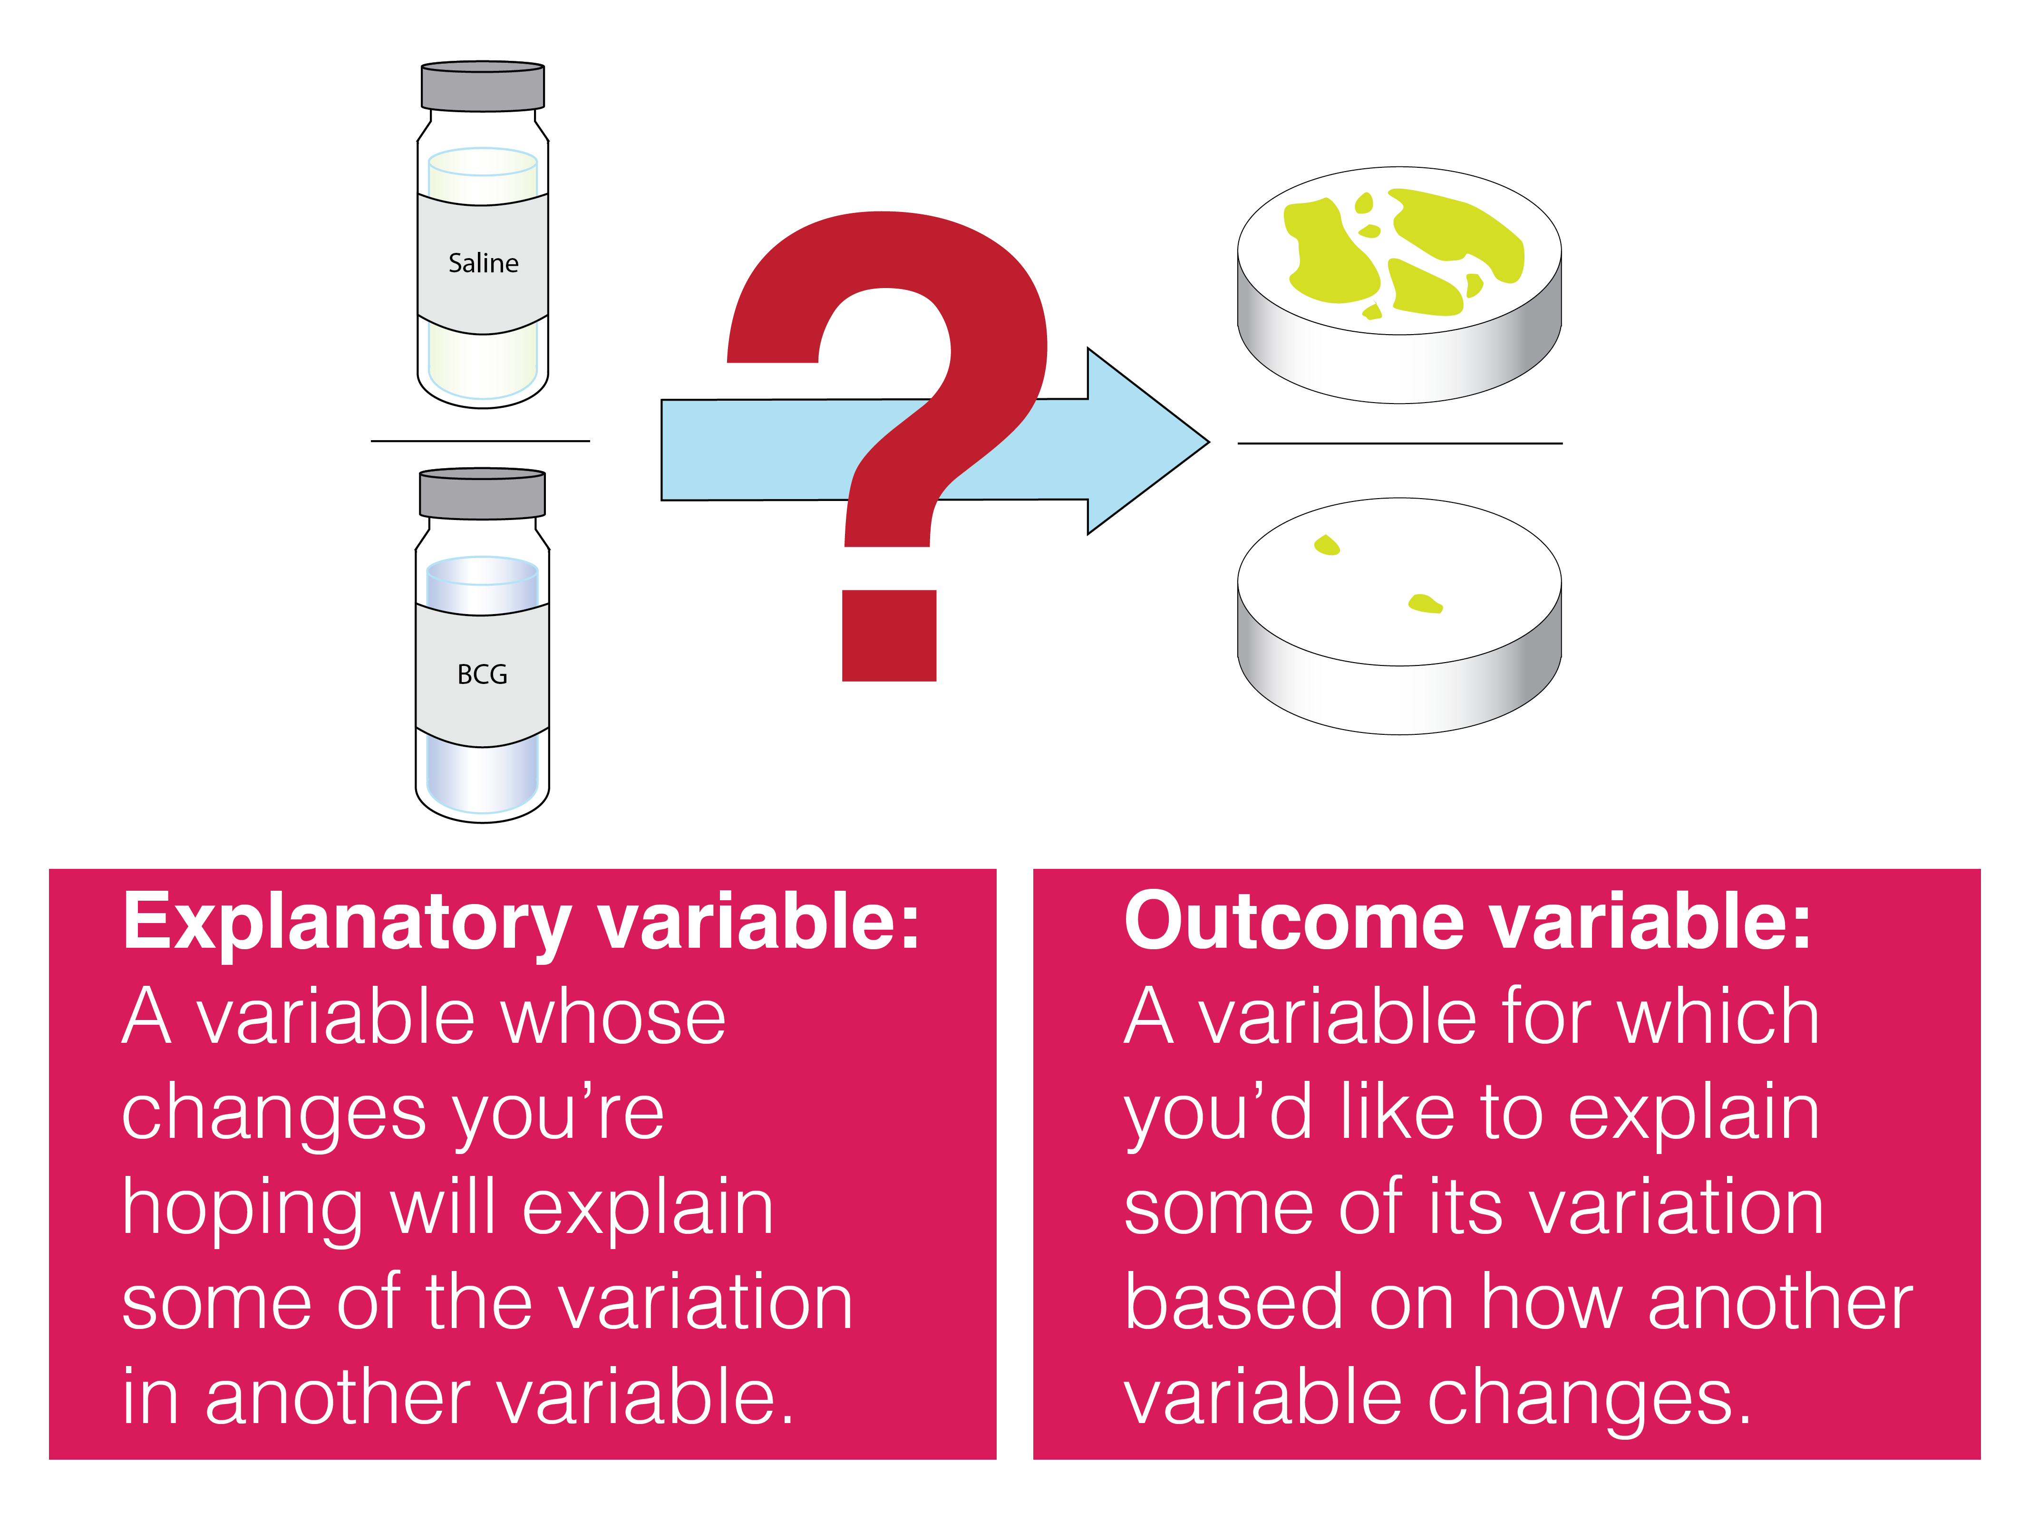

Slide 17
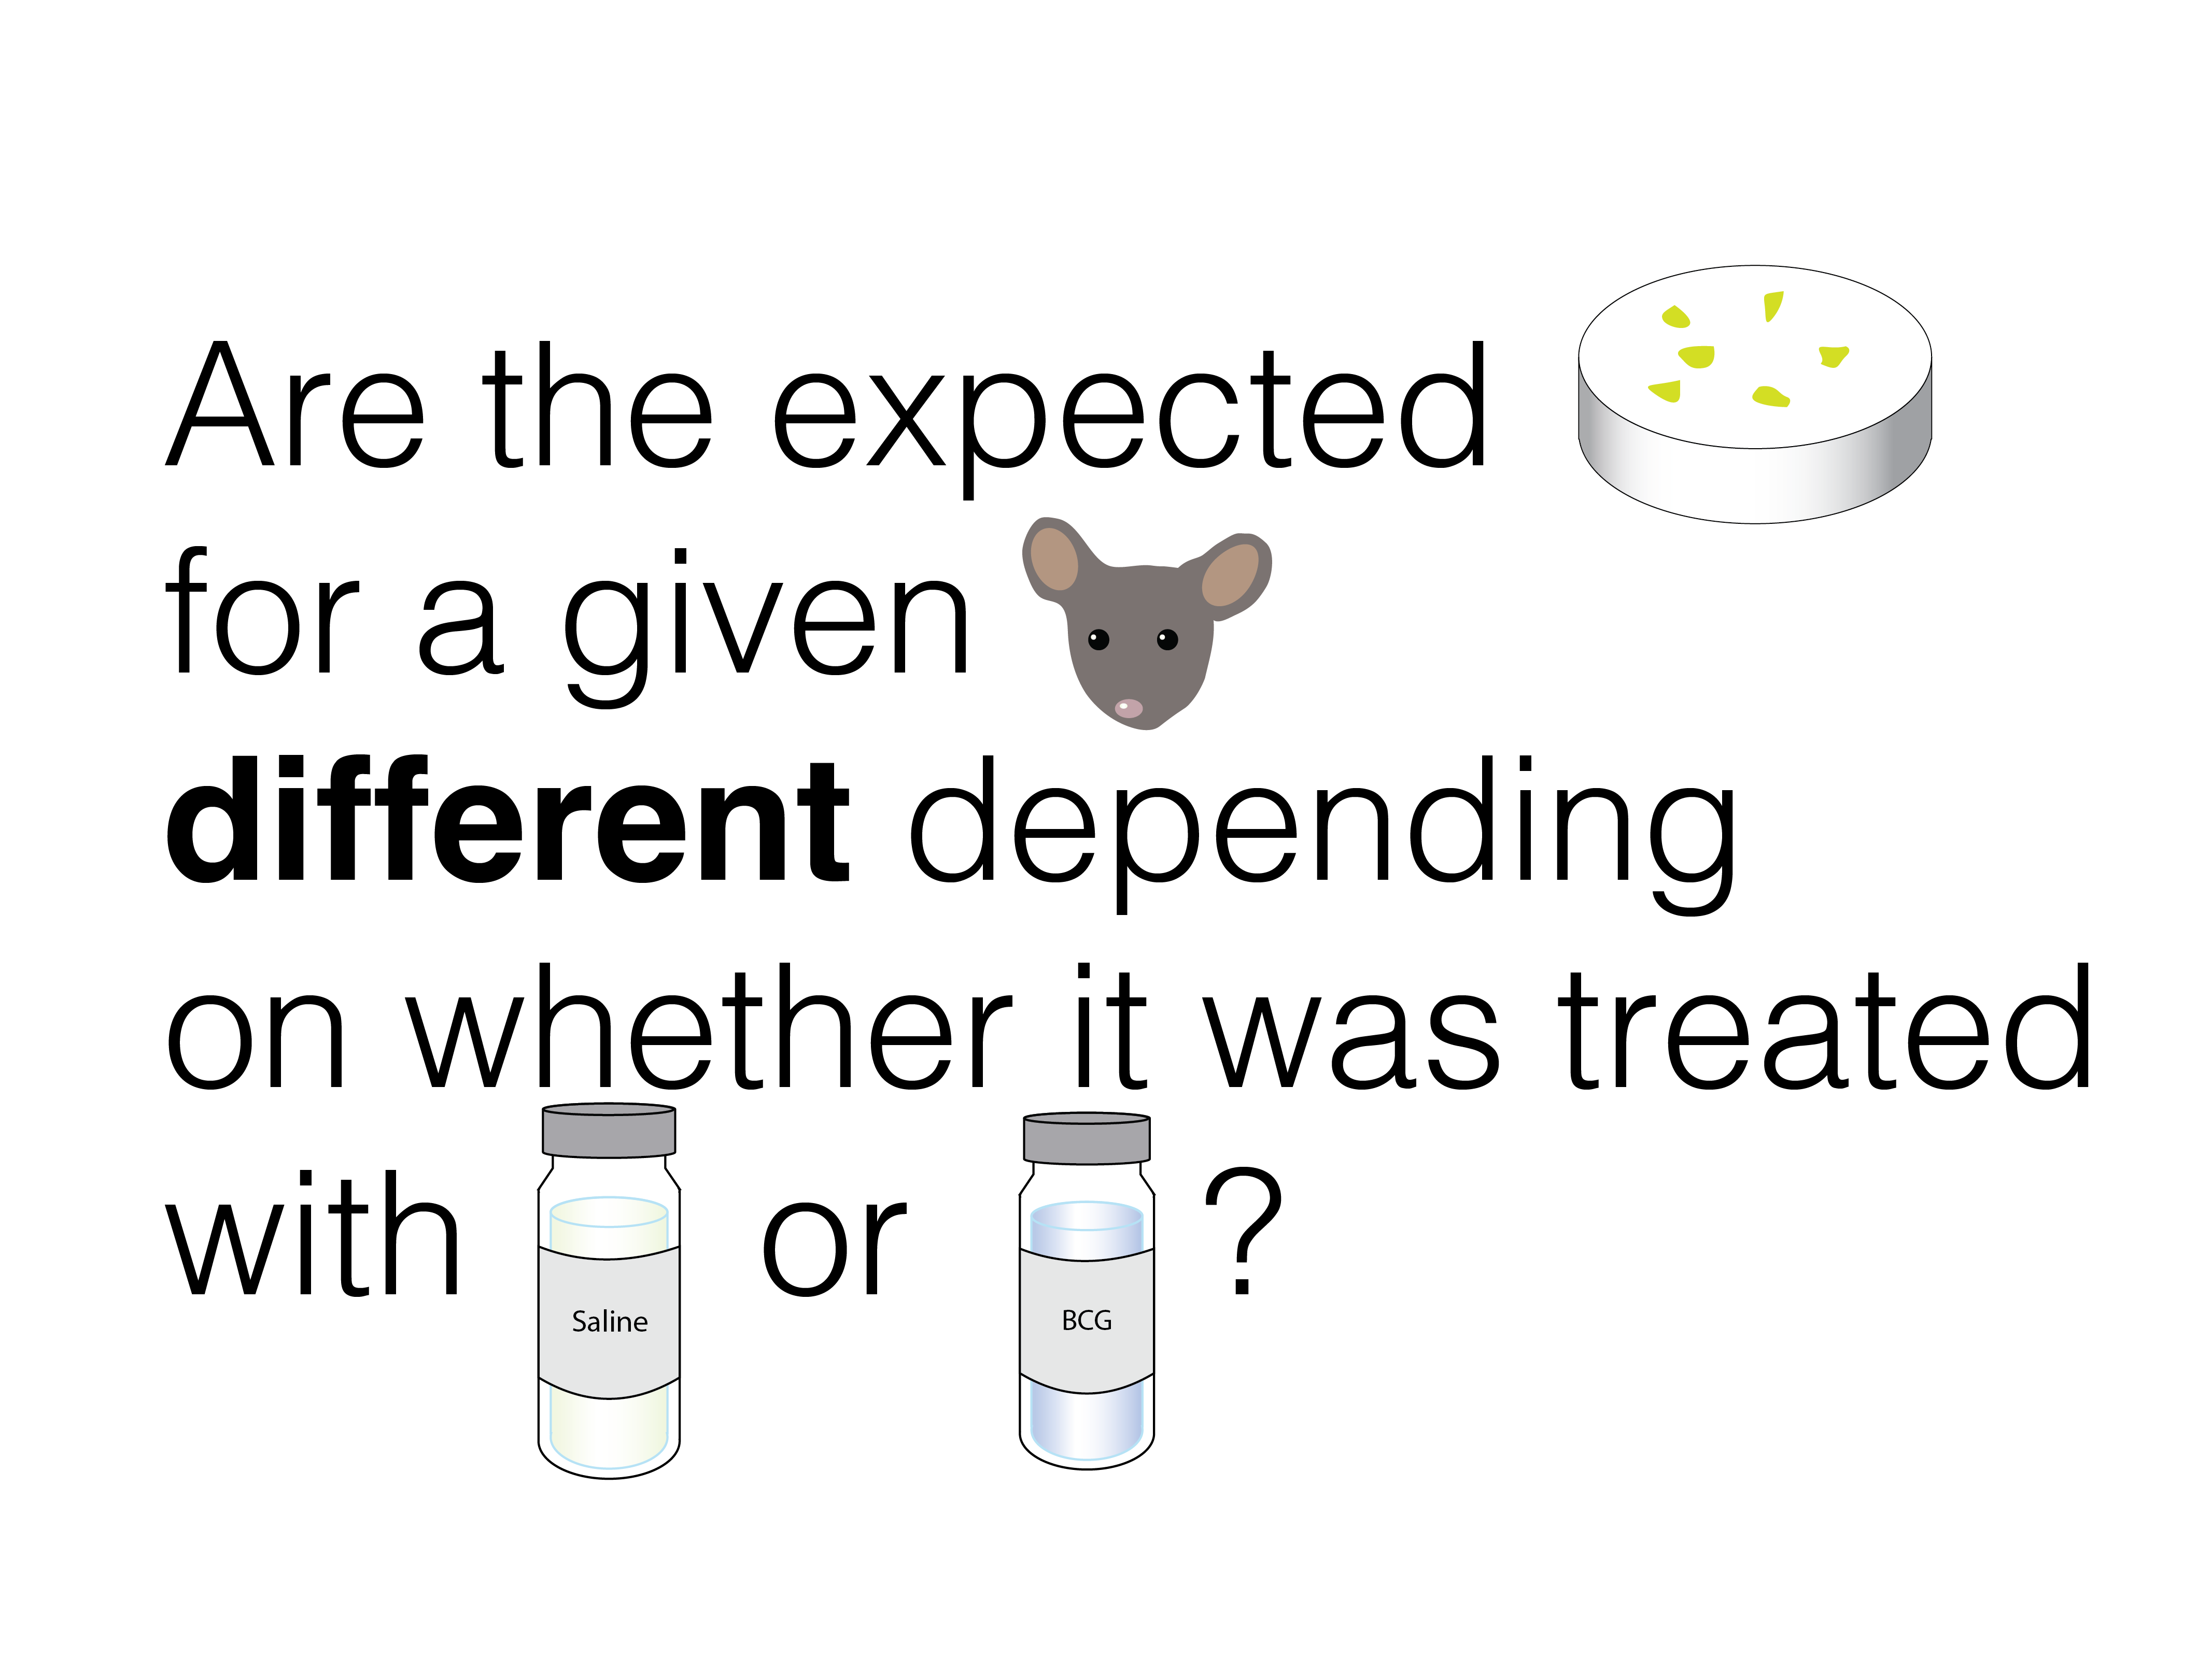

Slide 18
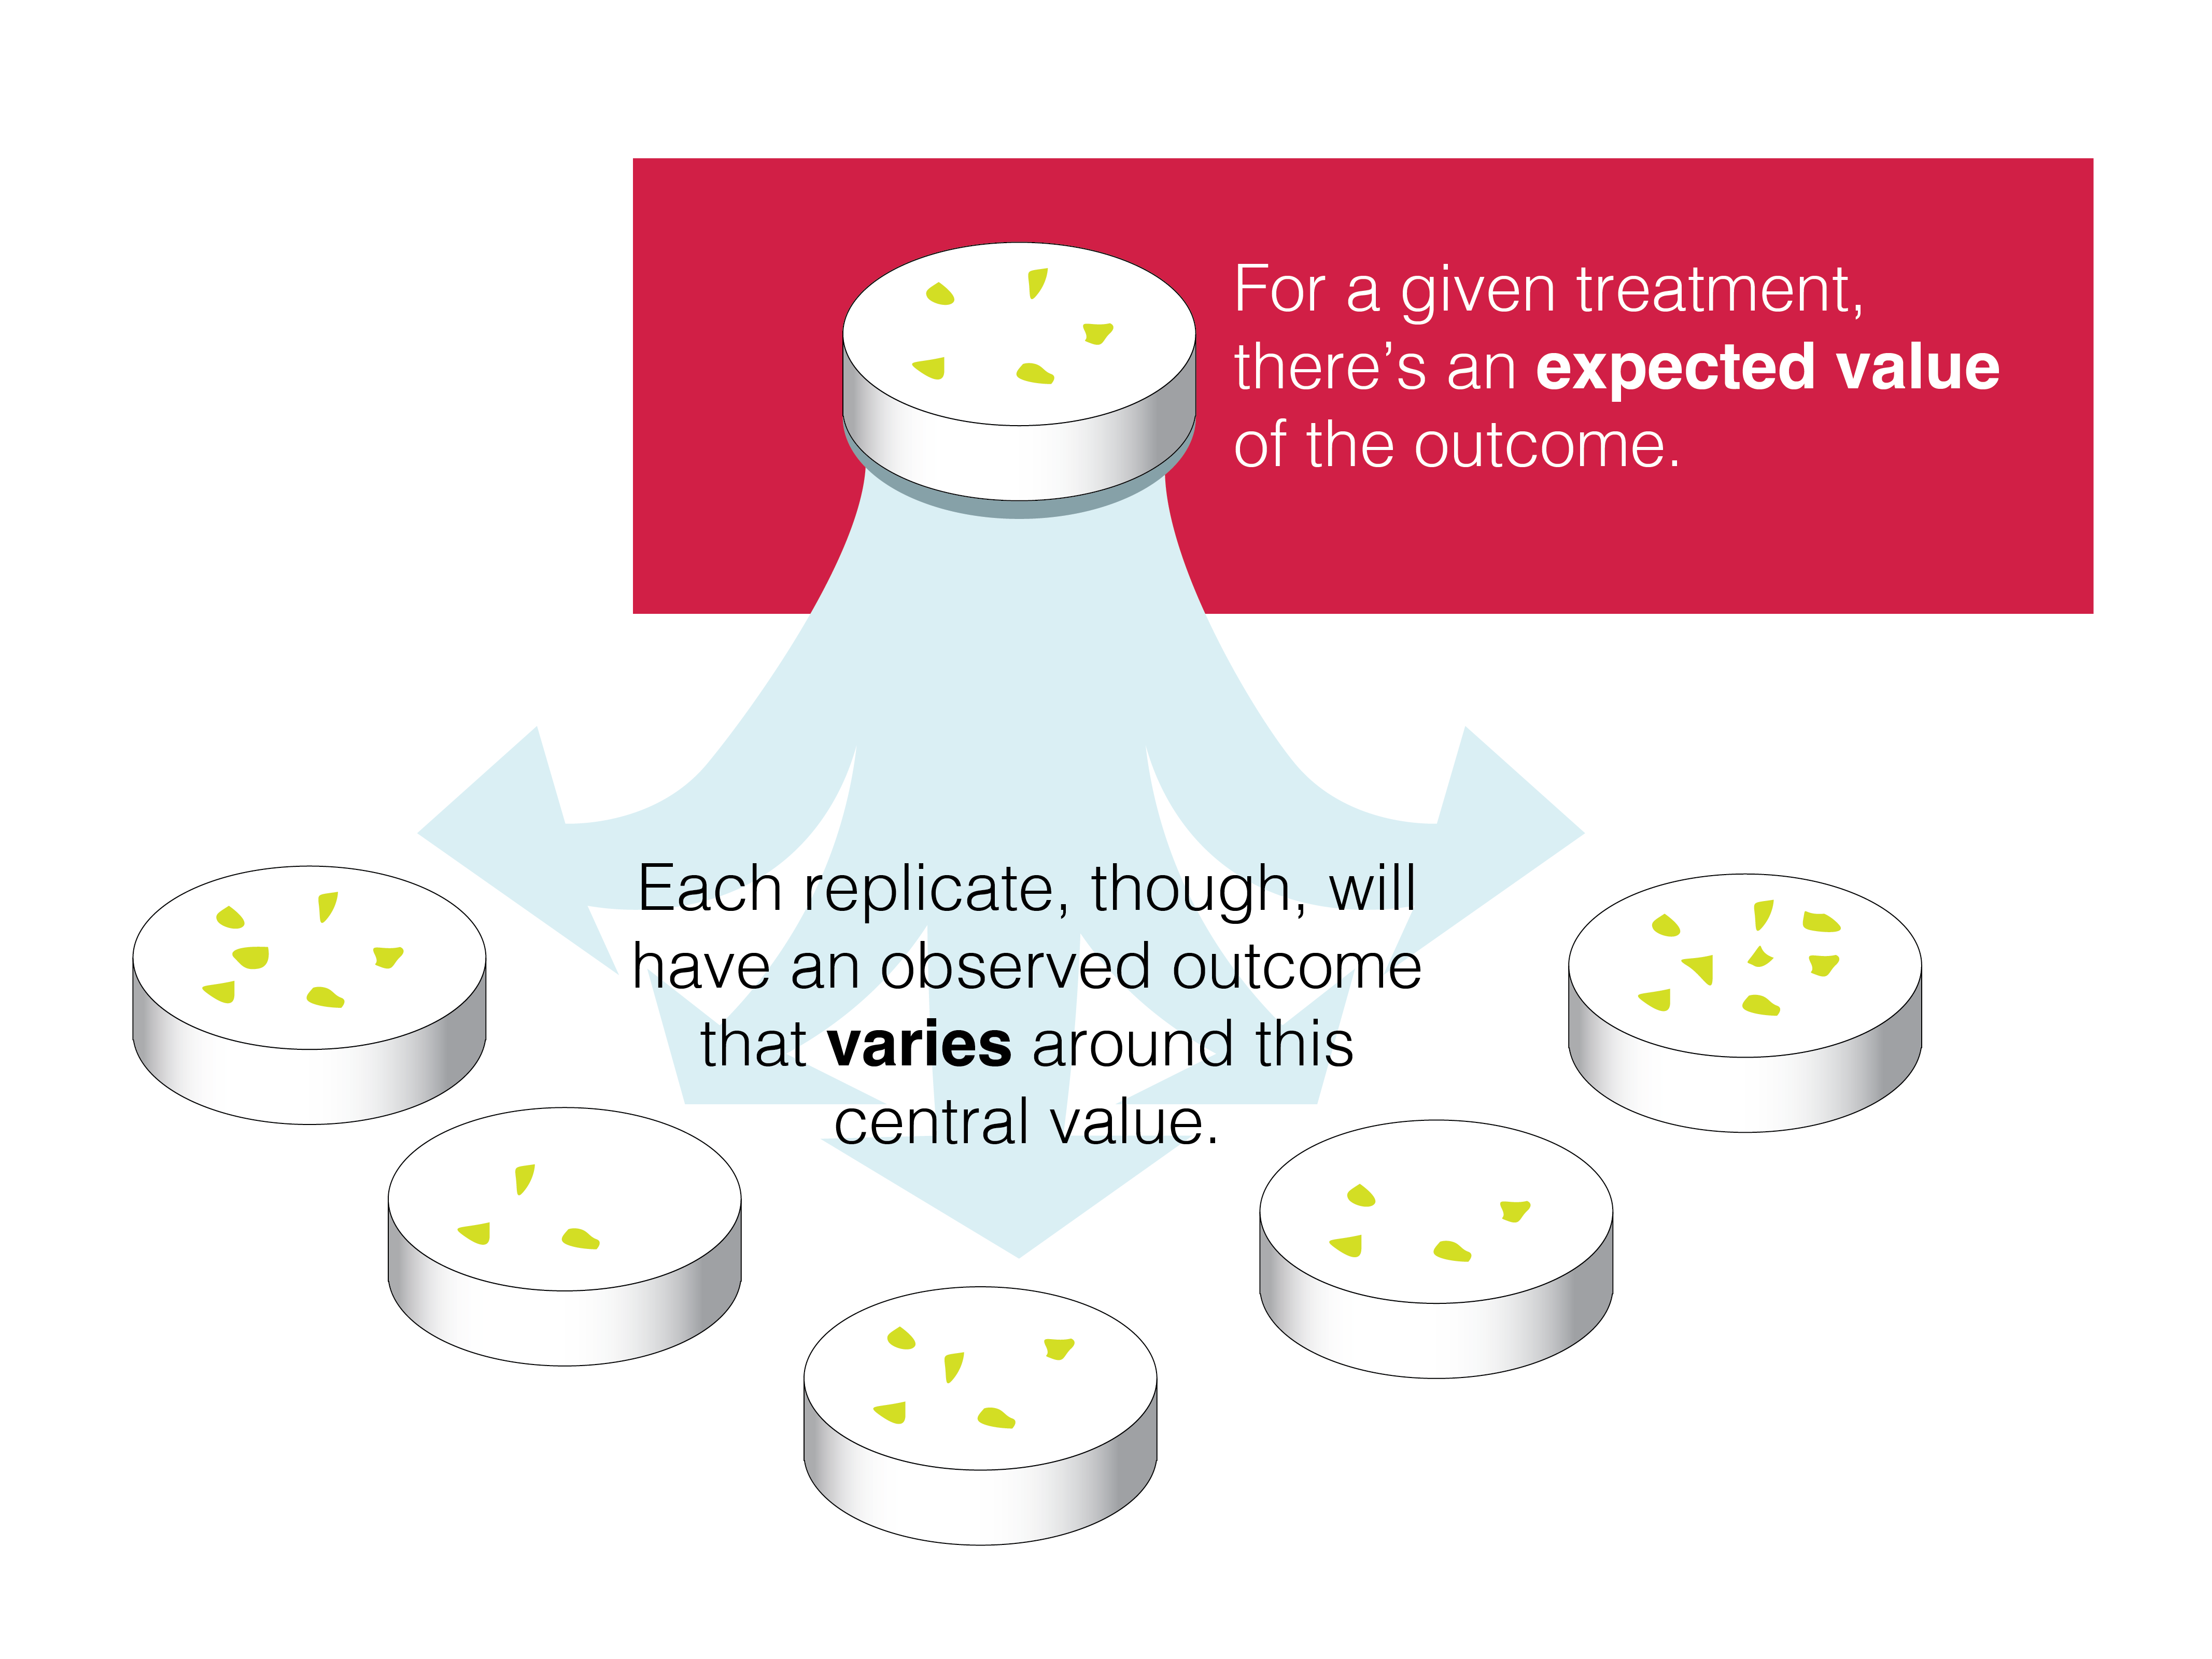

Slide 19
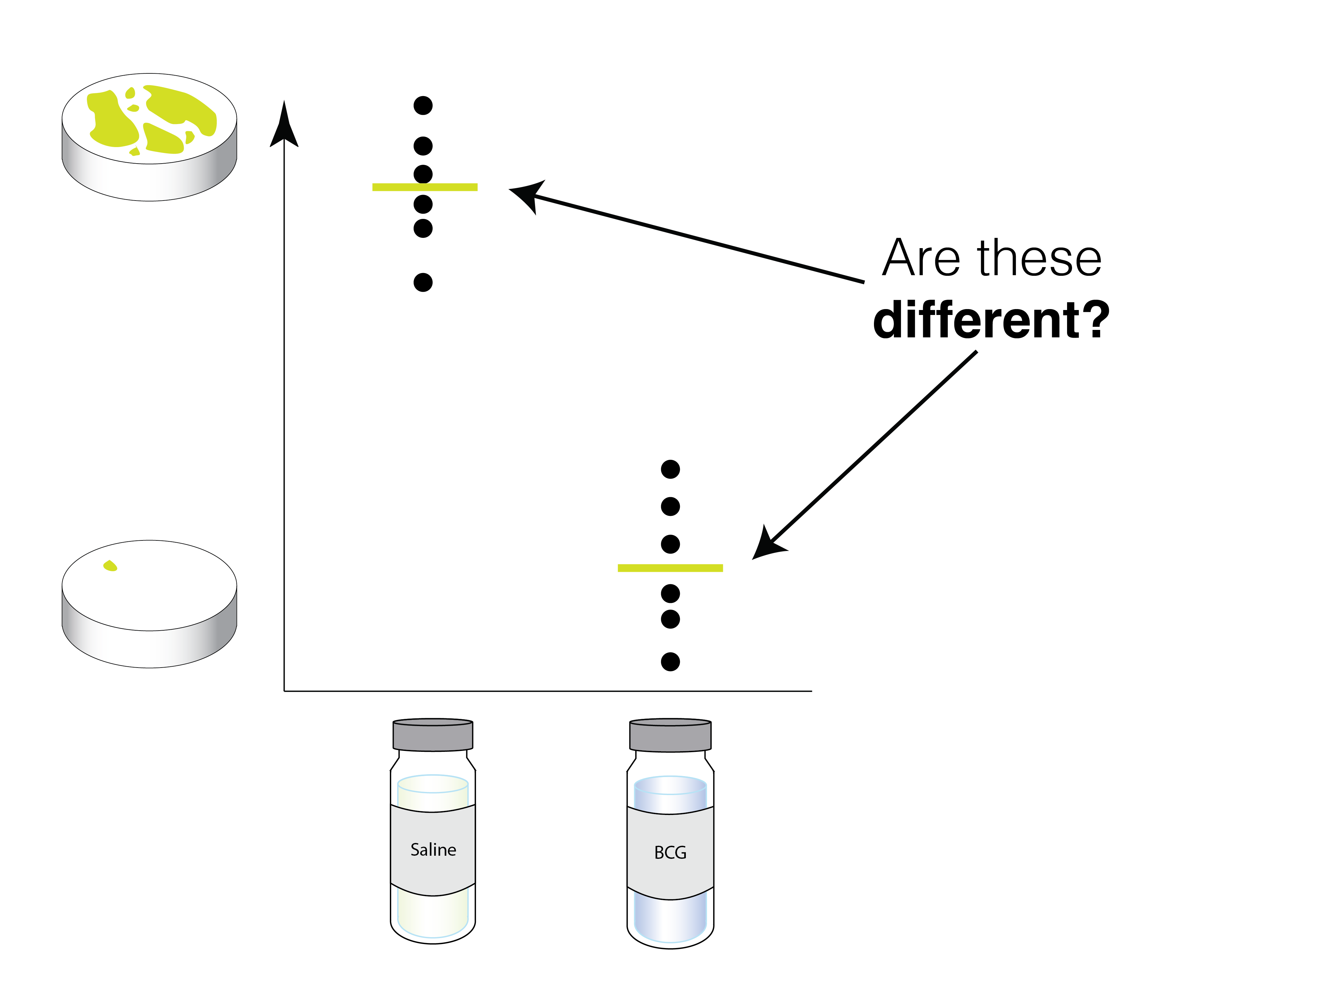

Slide 20
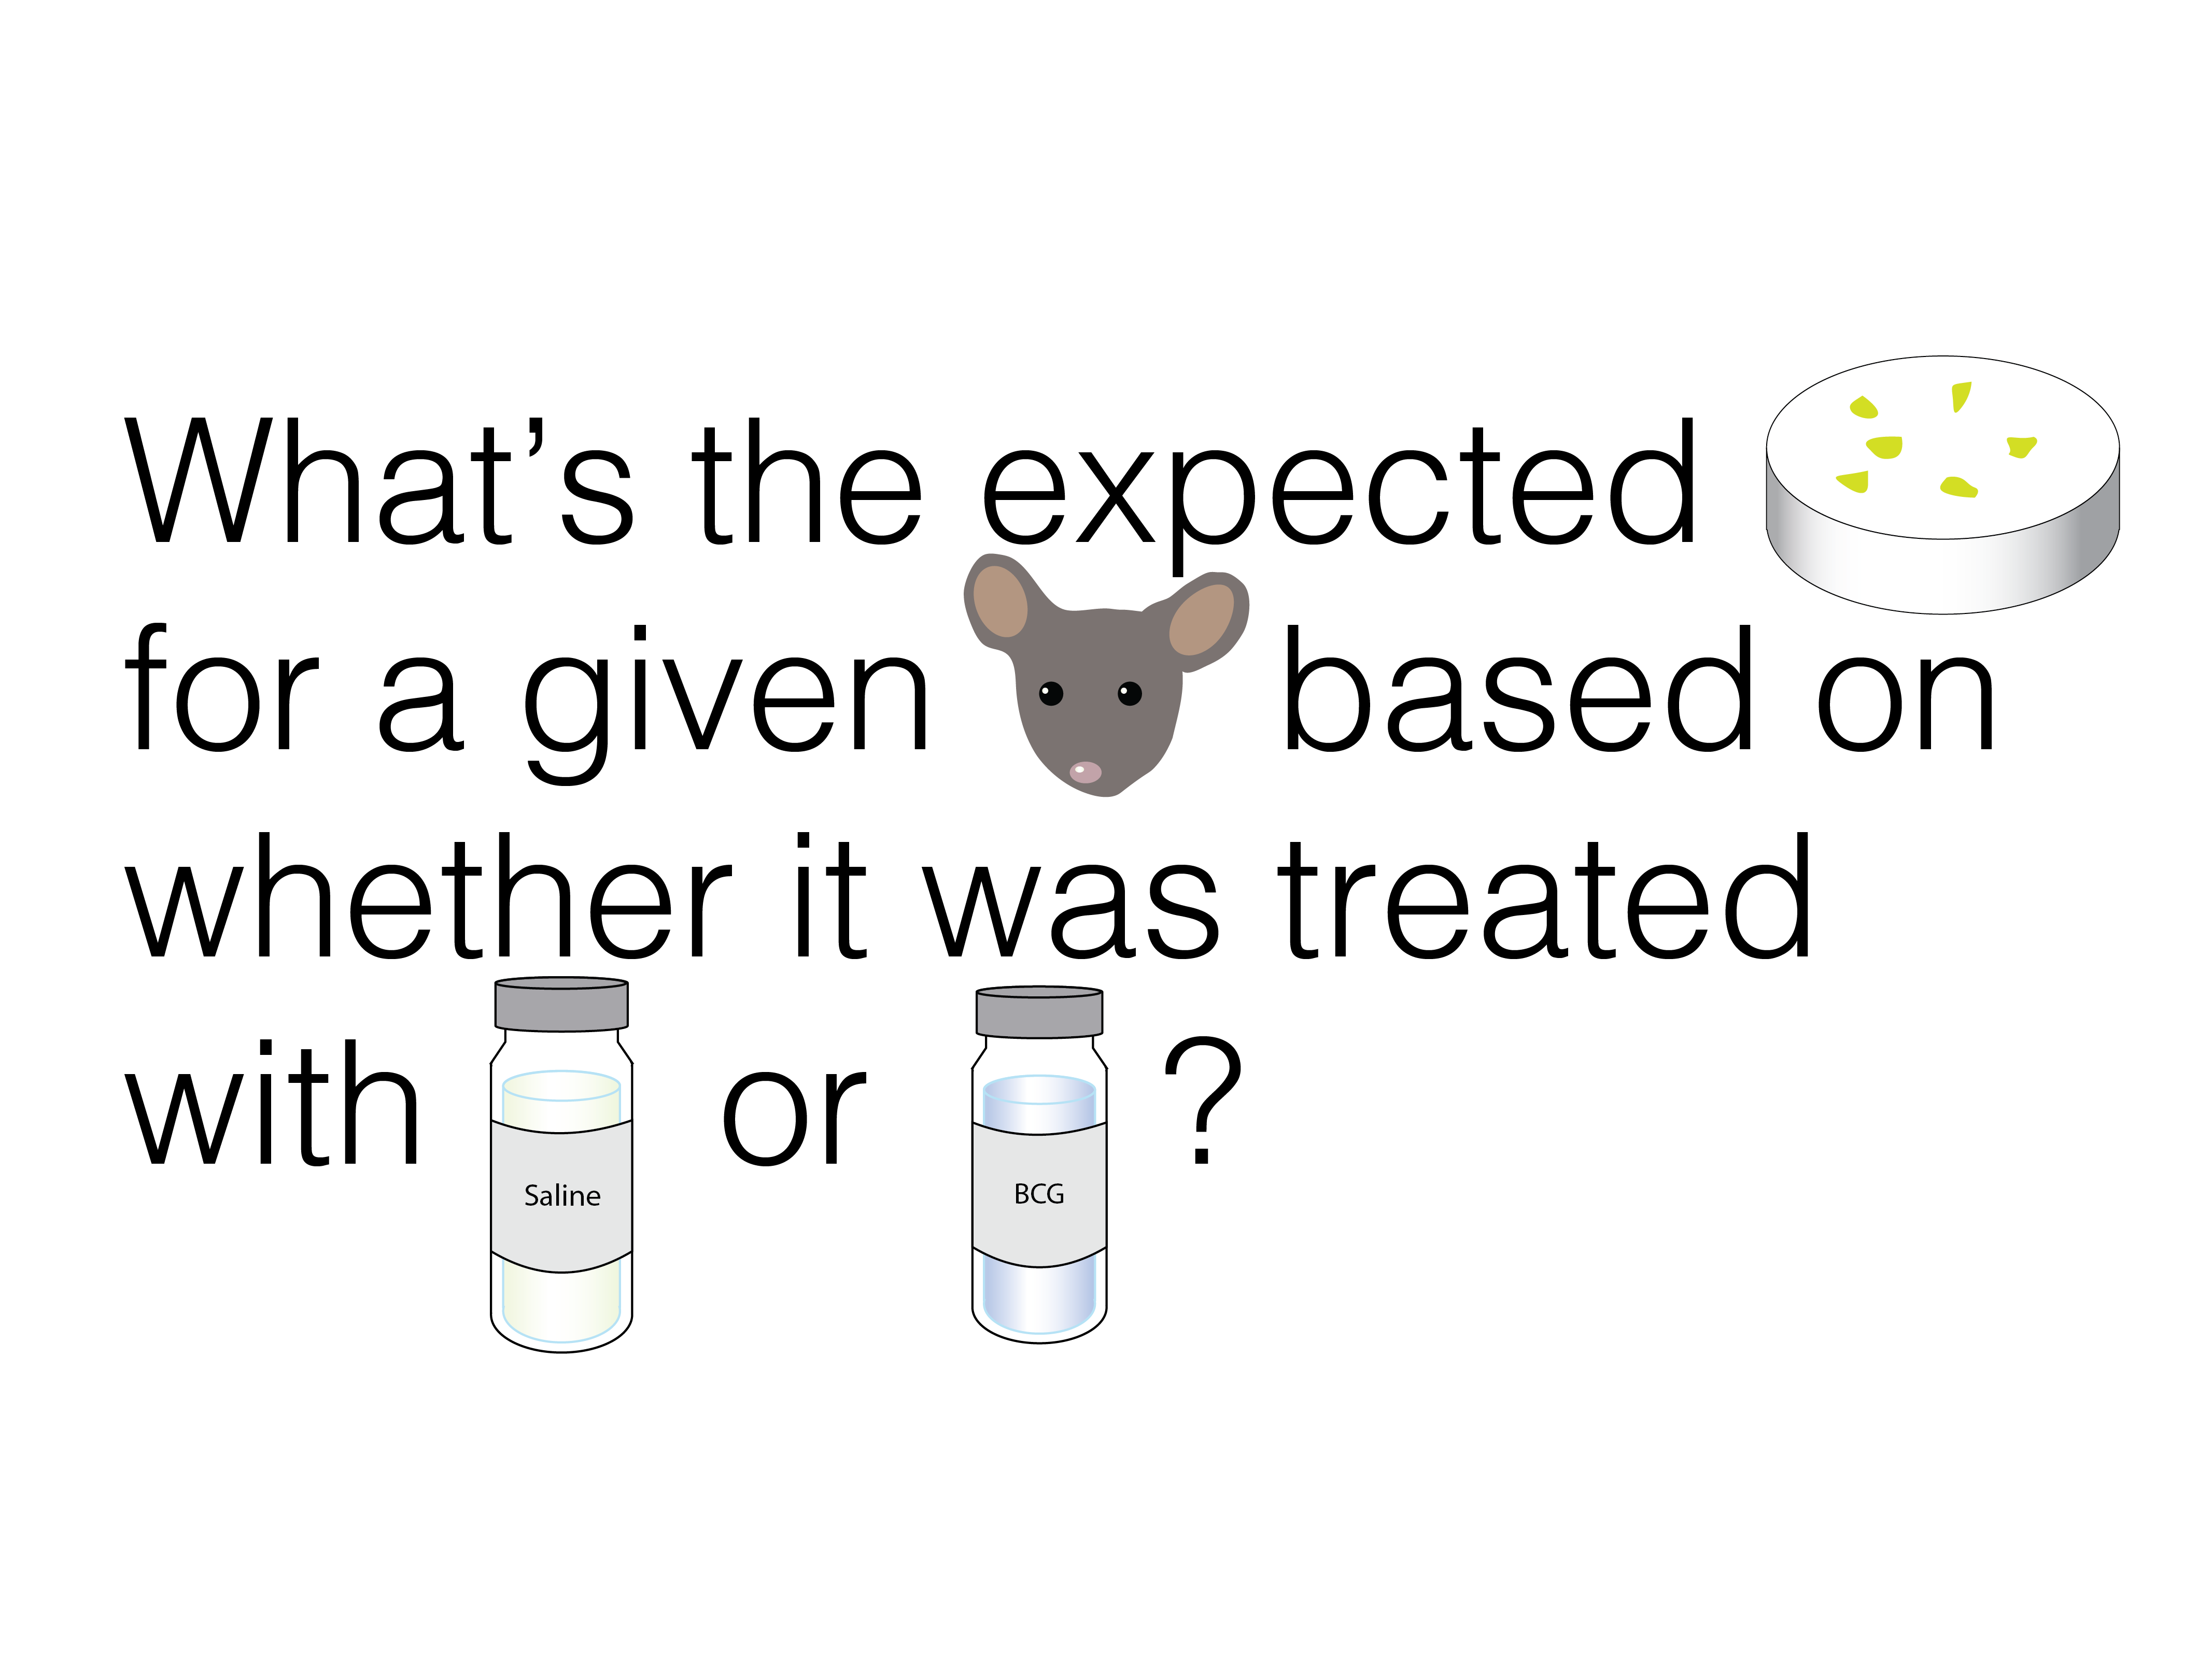

Slide 21
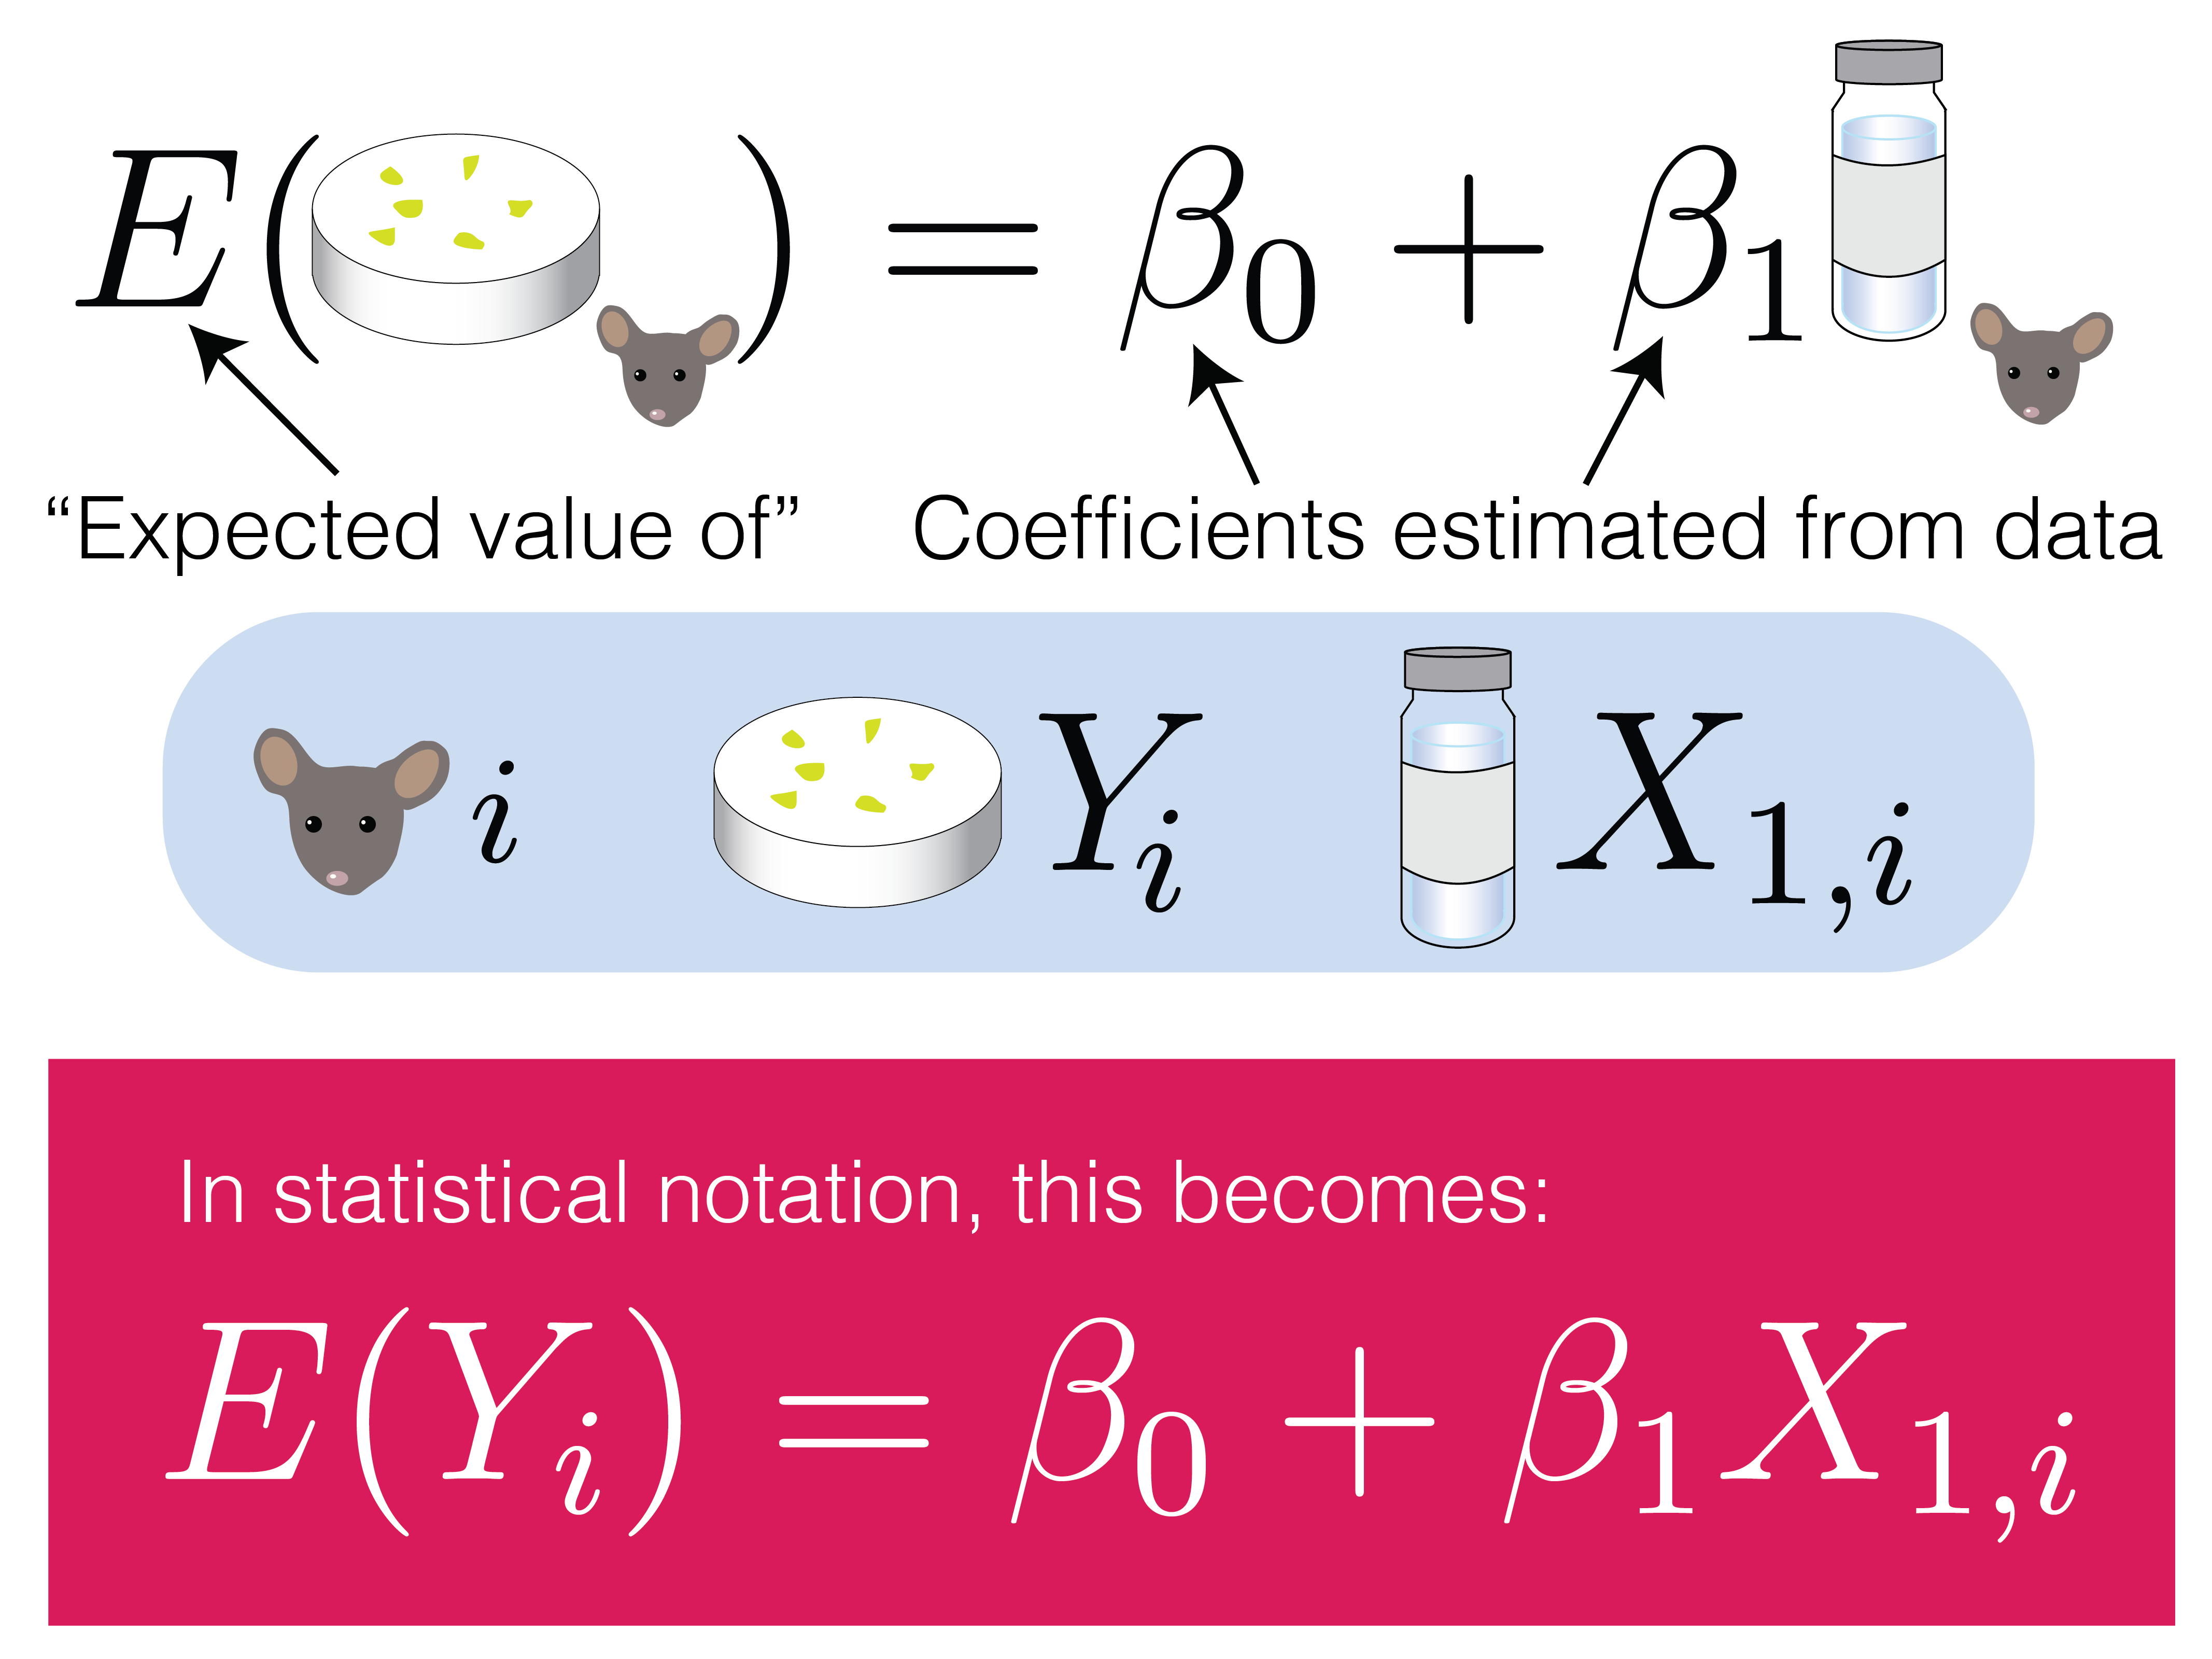

Slide 24
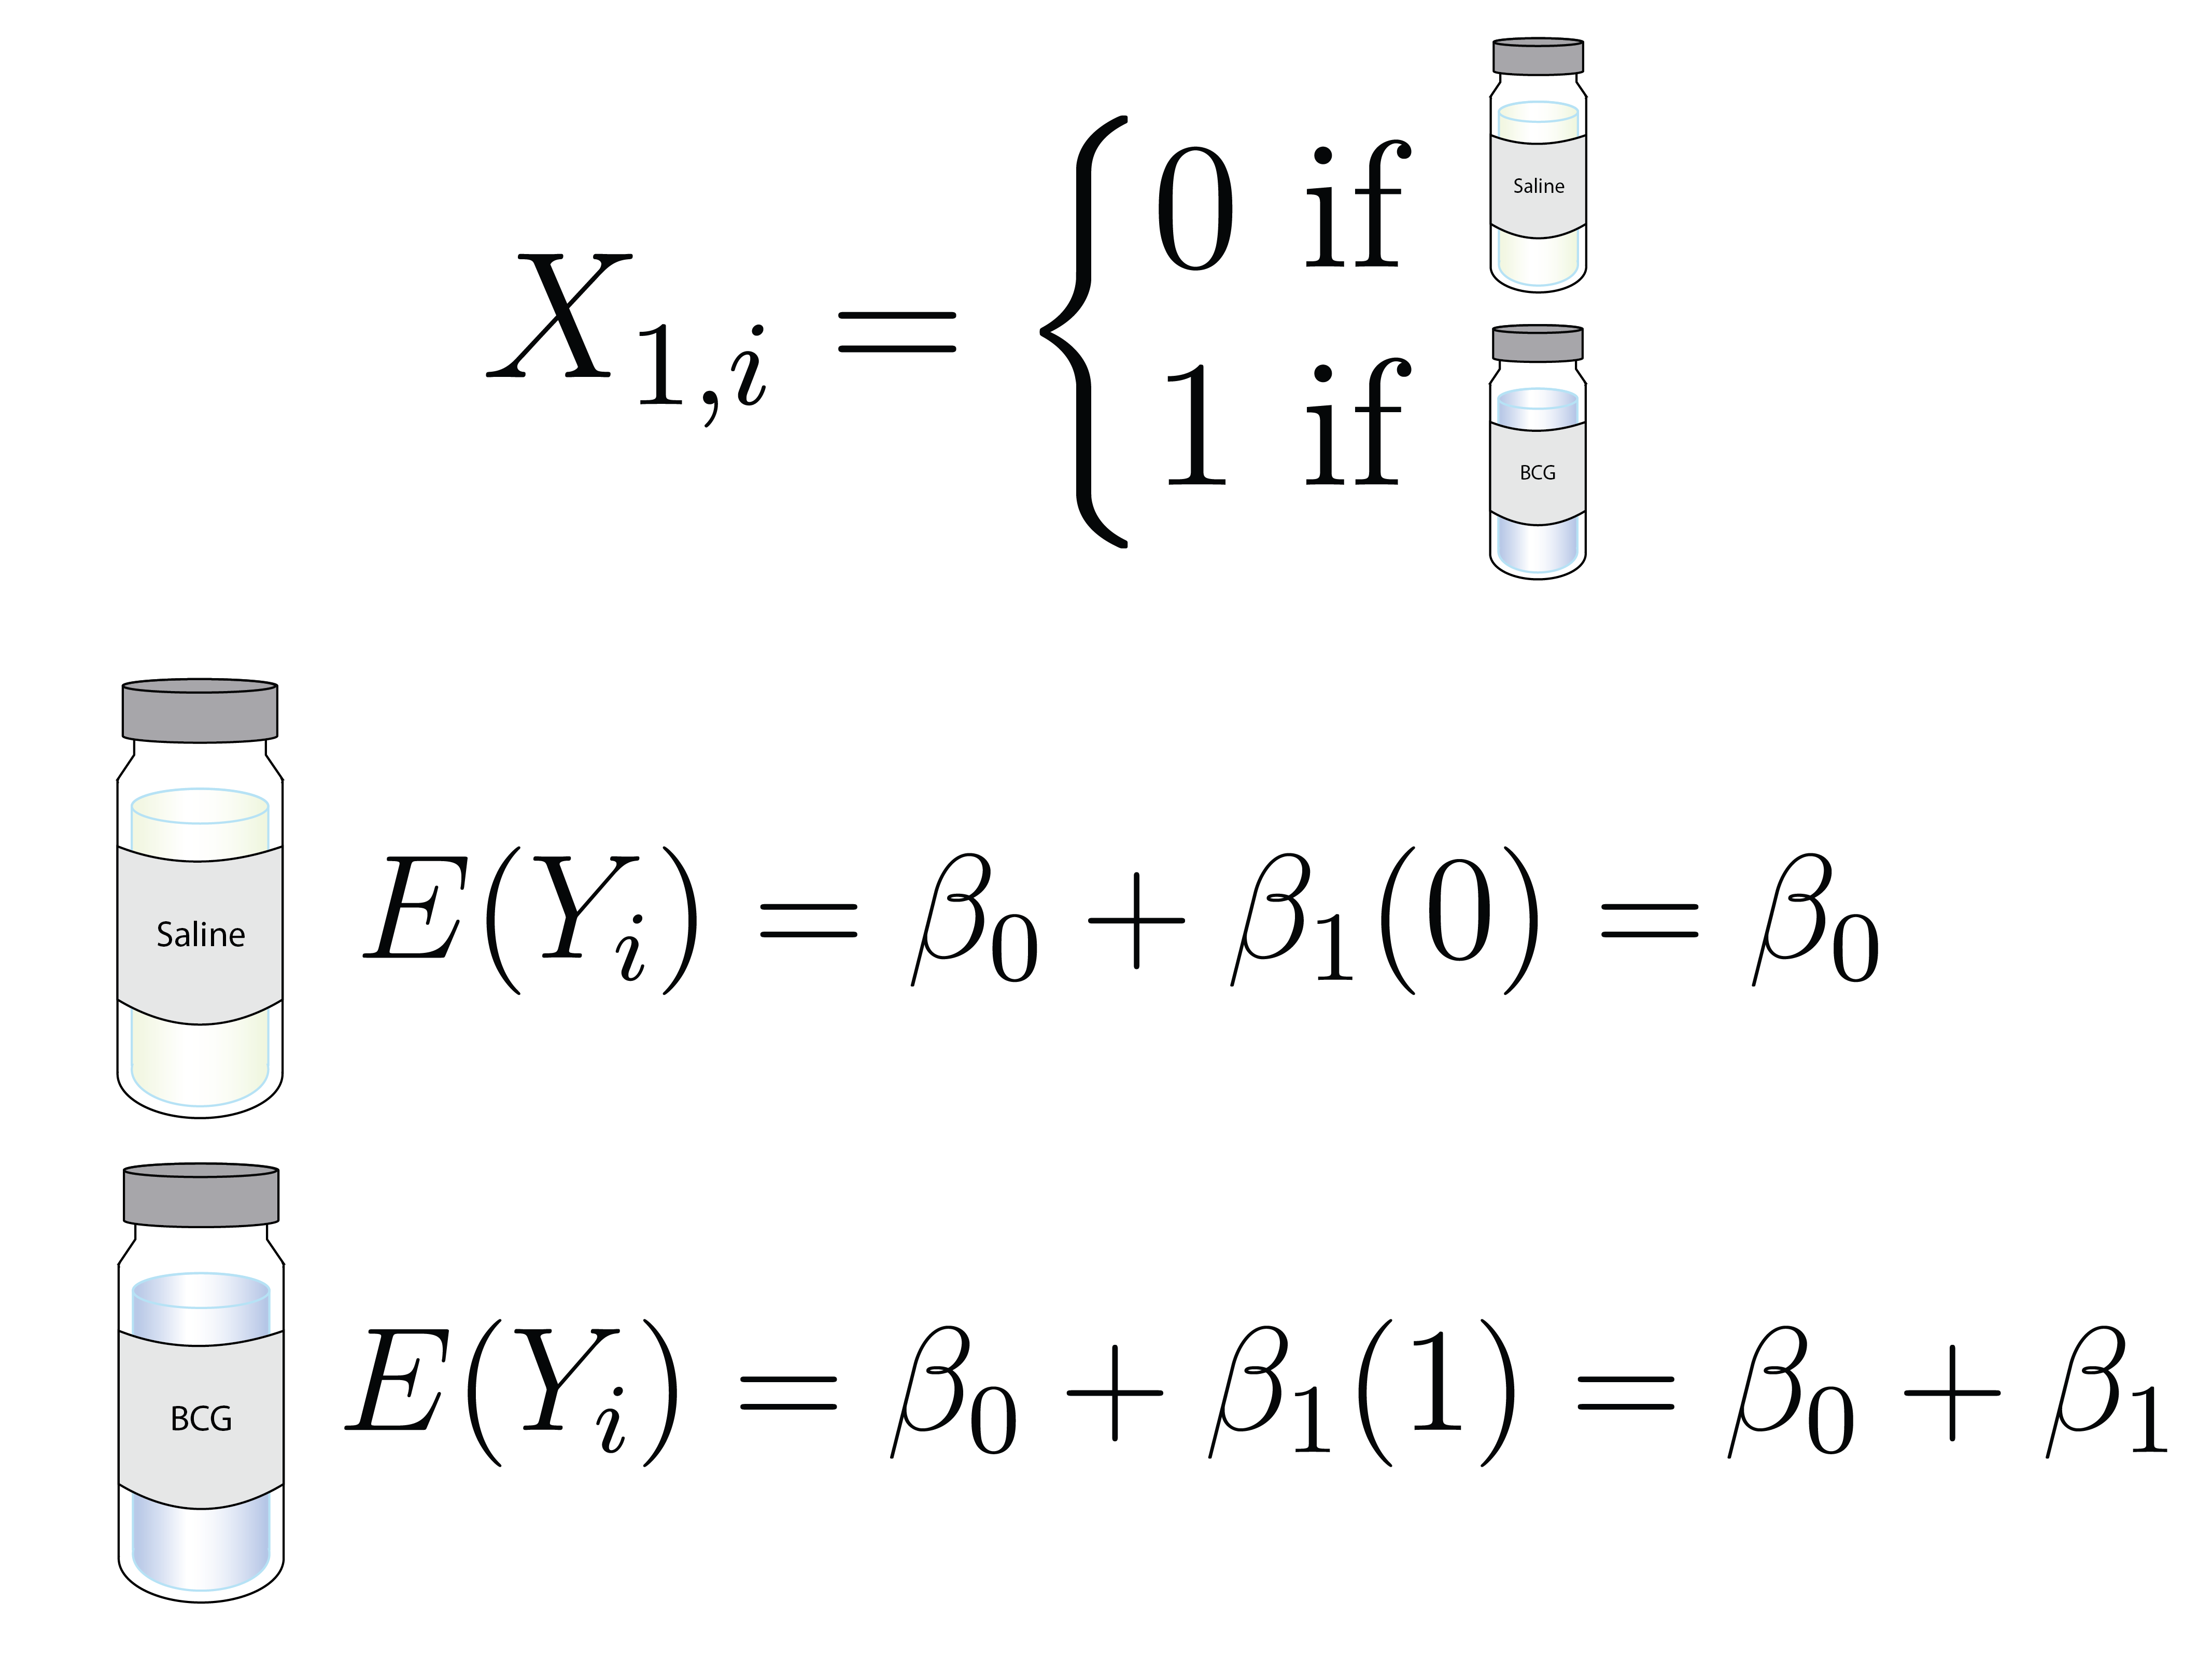

Slide 25
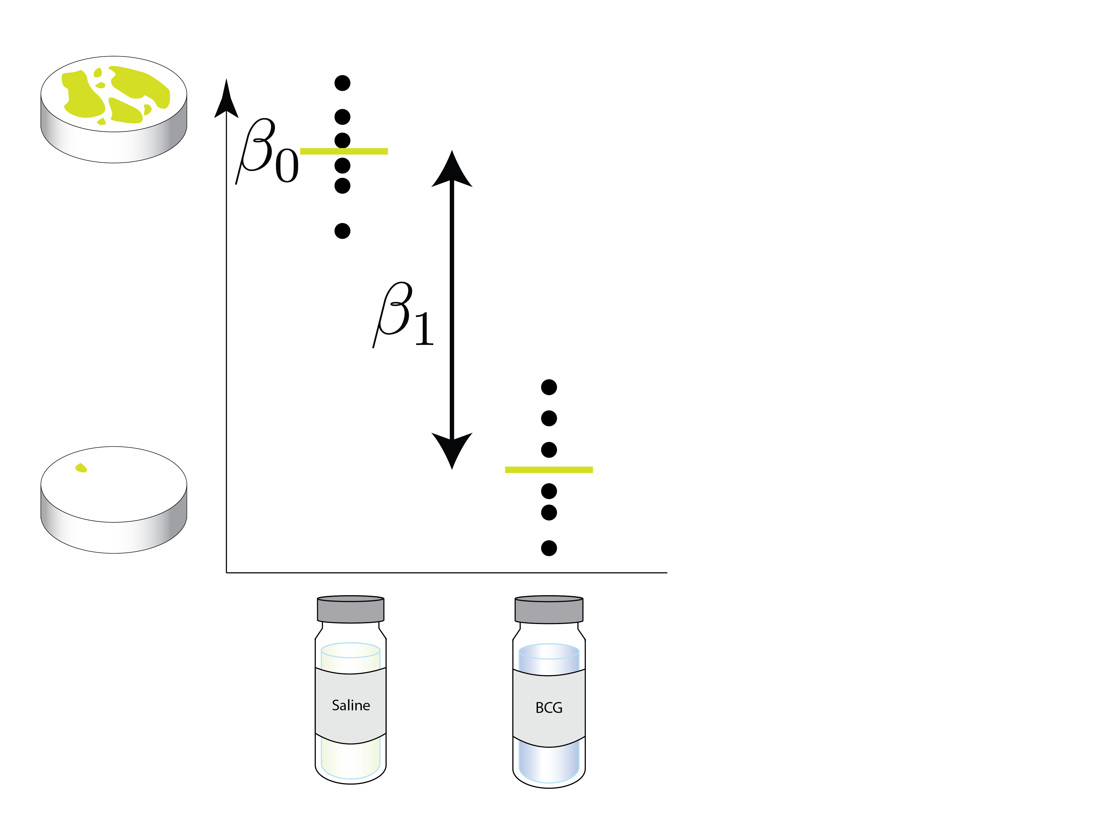

Slide 26
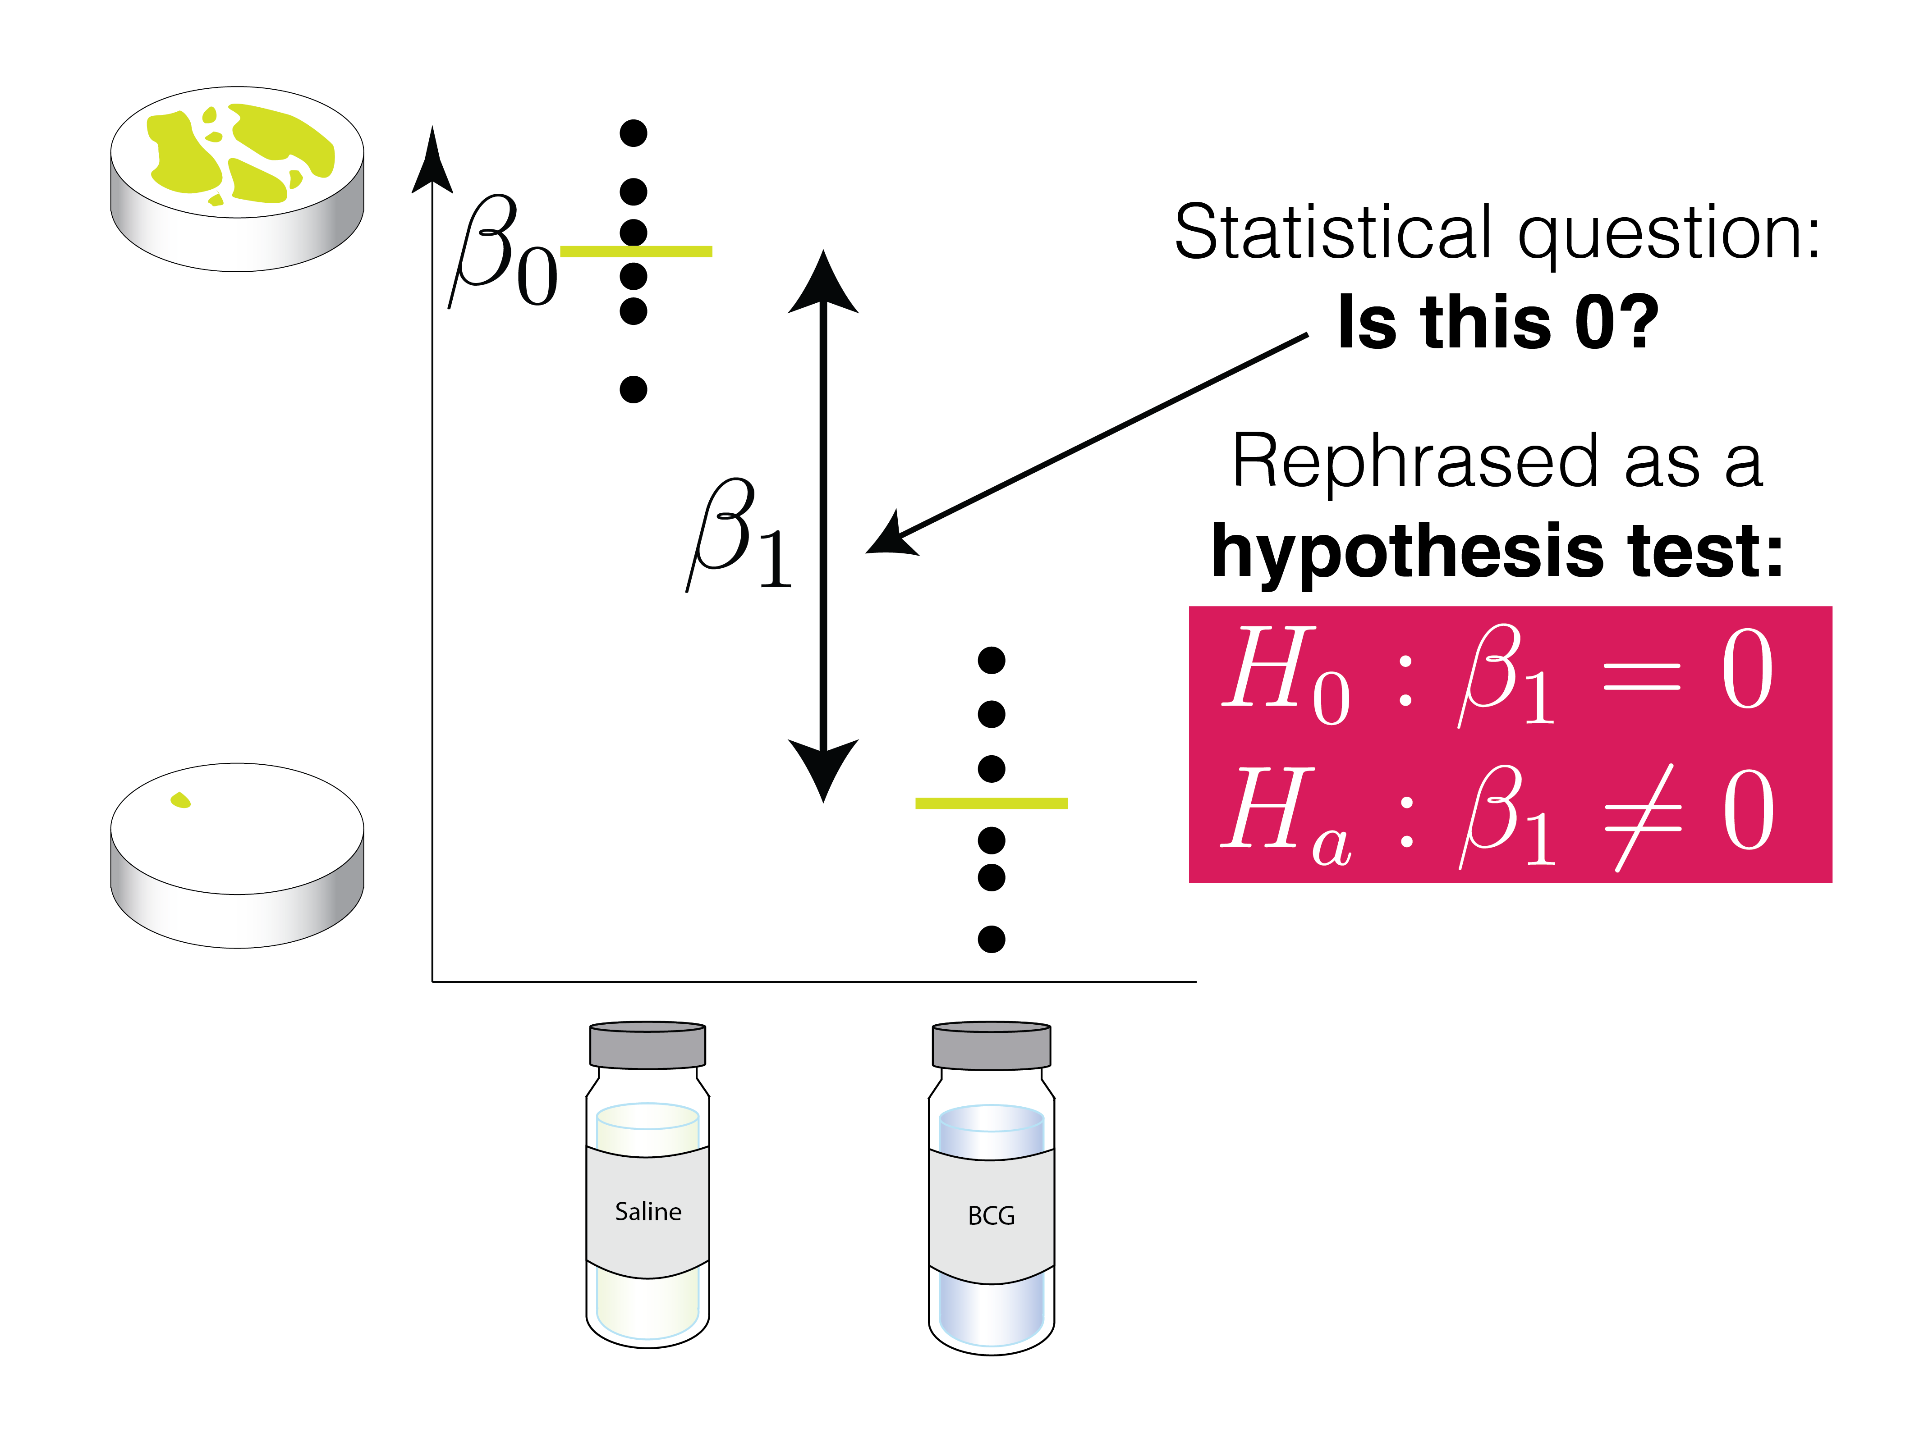

Slide 27
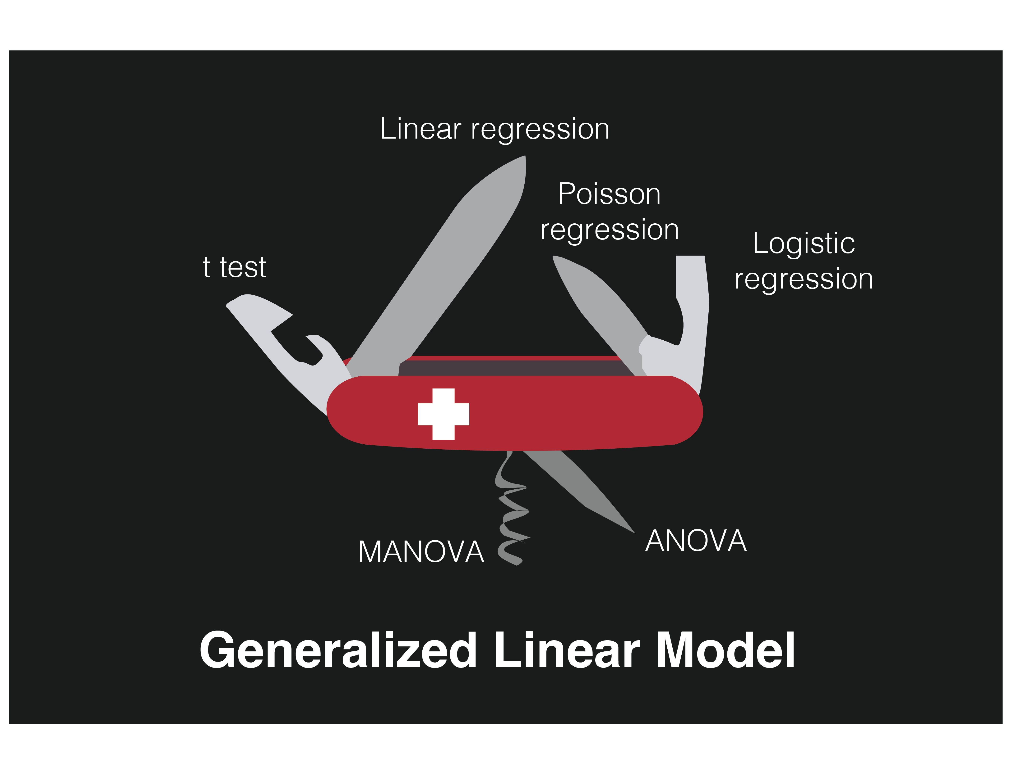

Slide 28
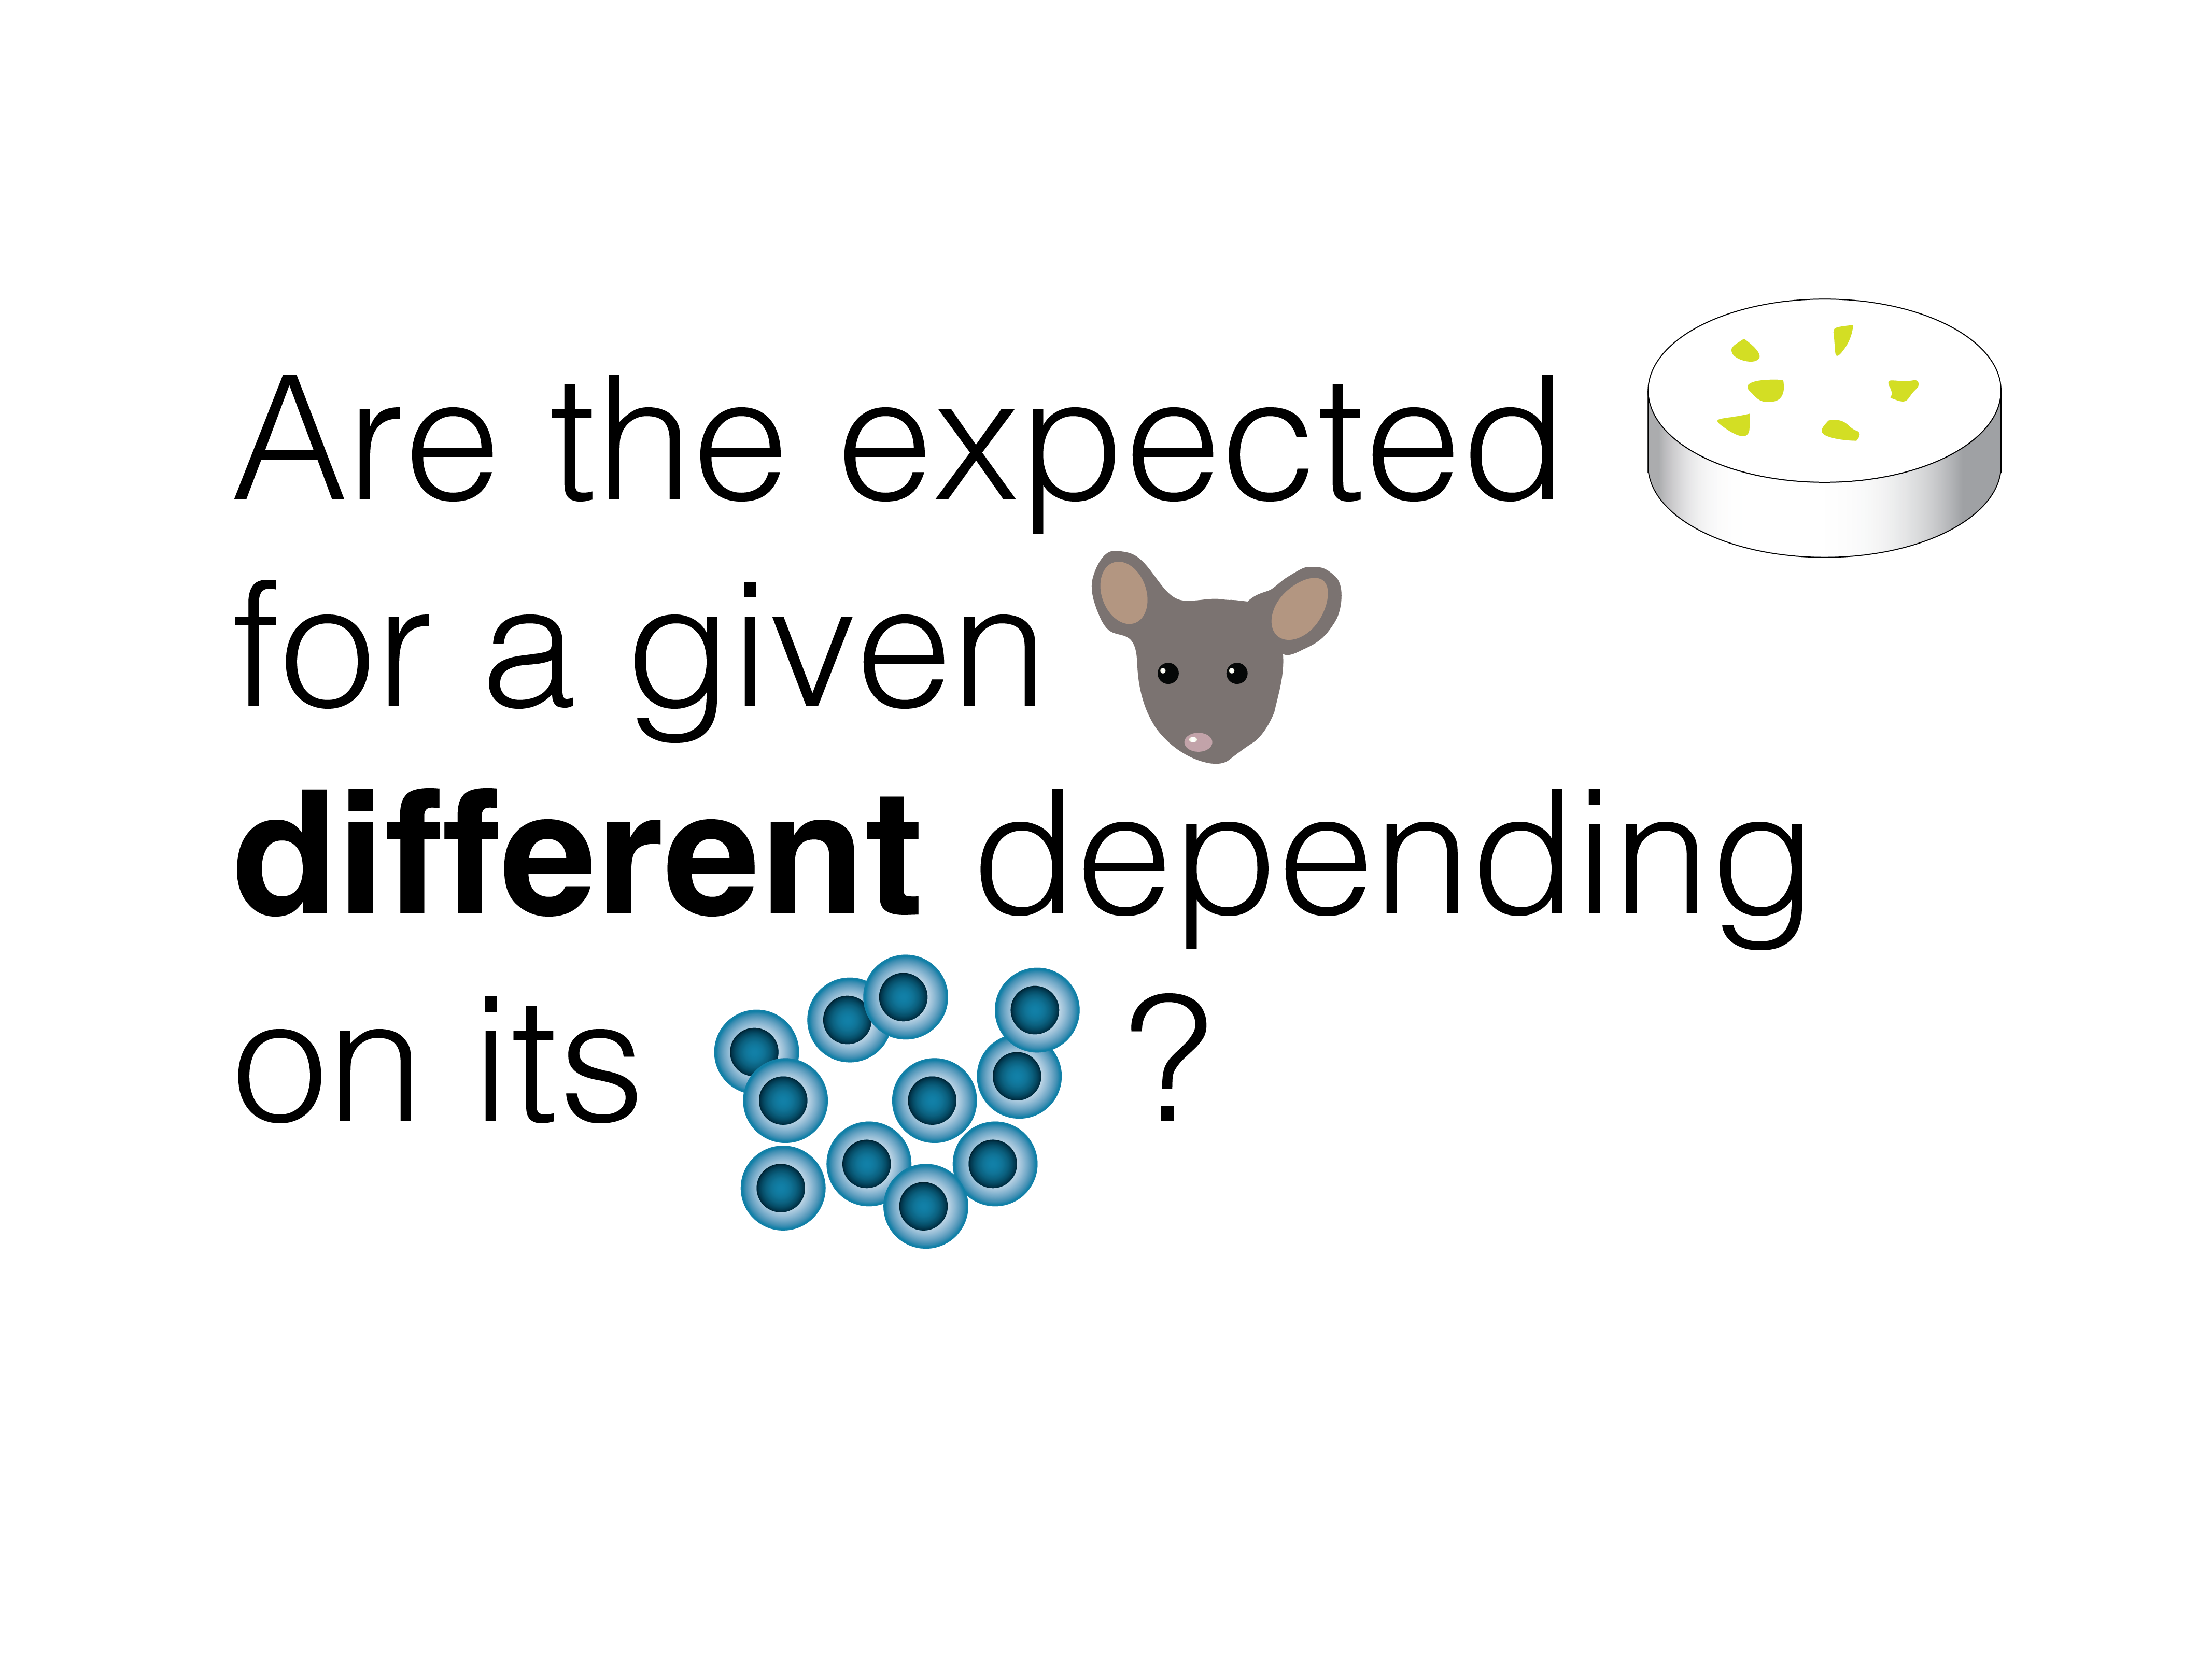

Slide 29
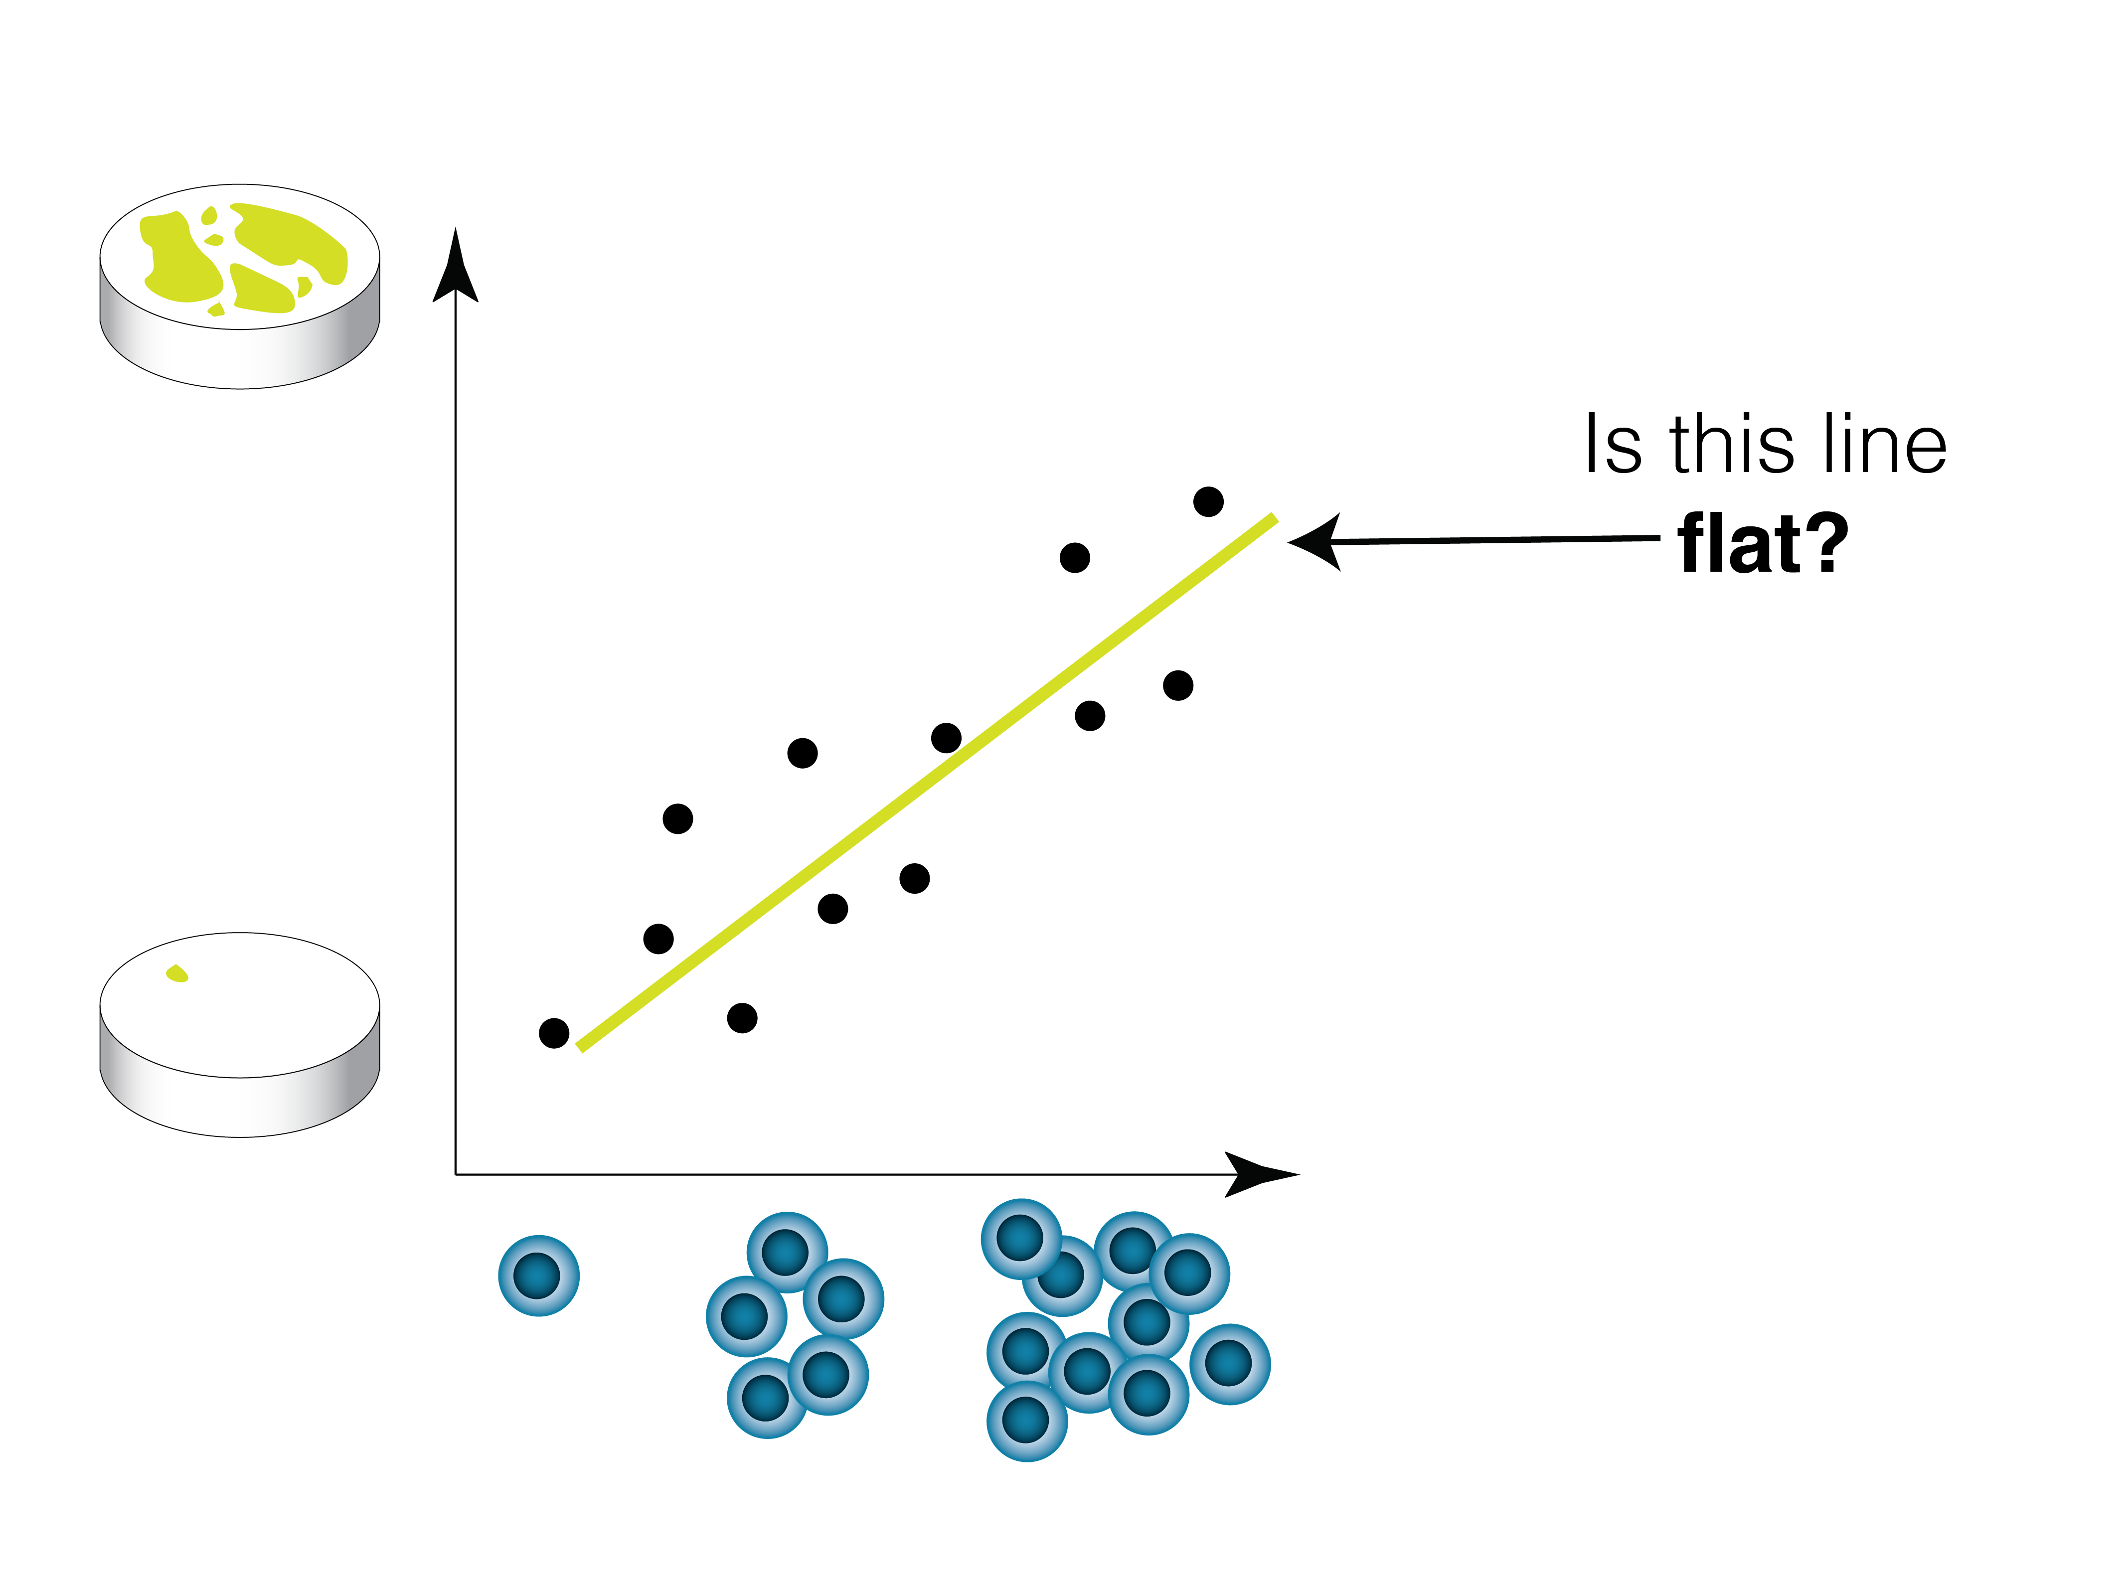

Slide 30
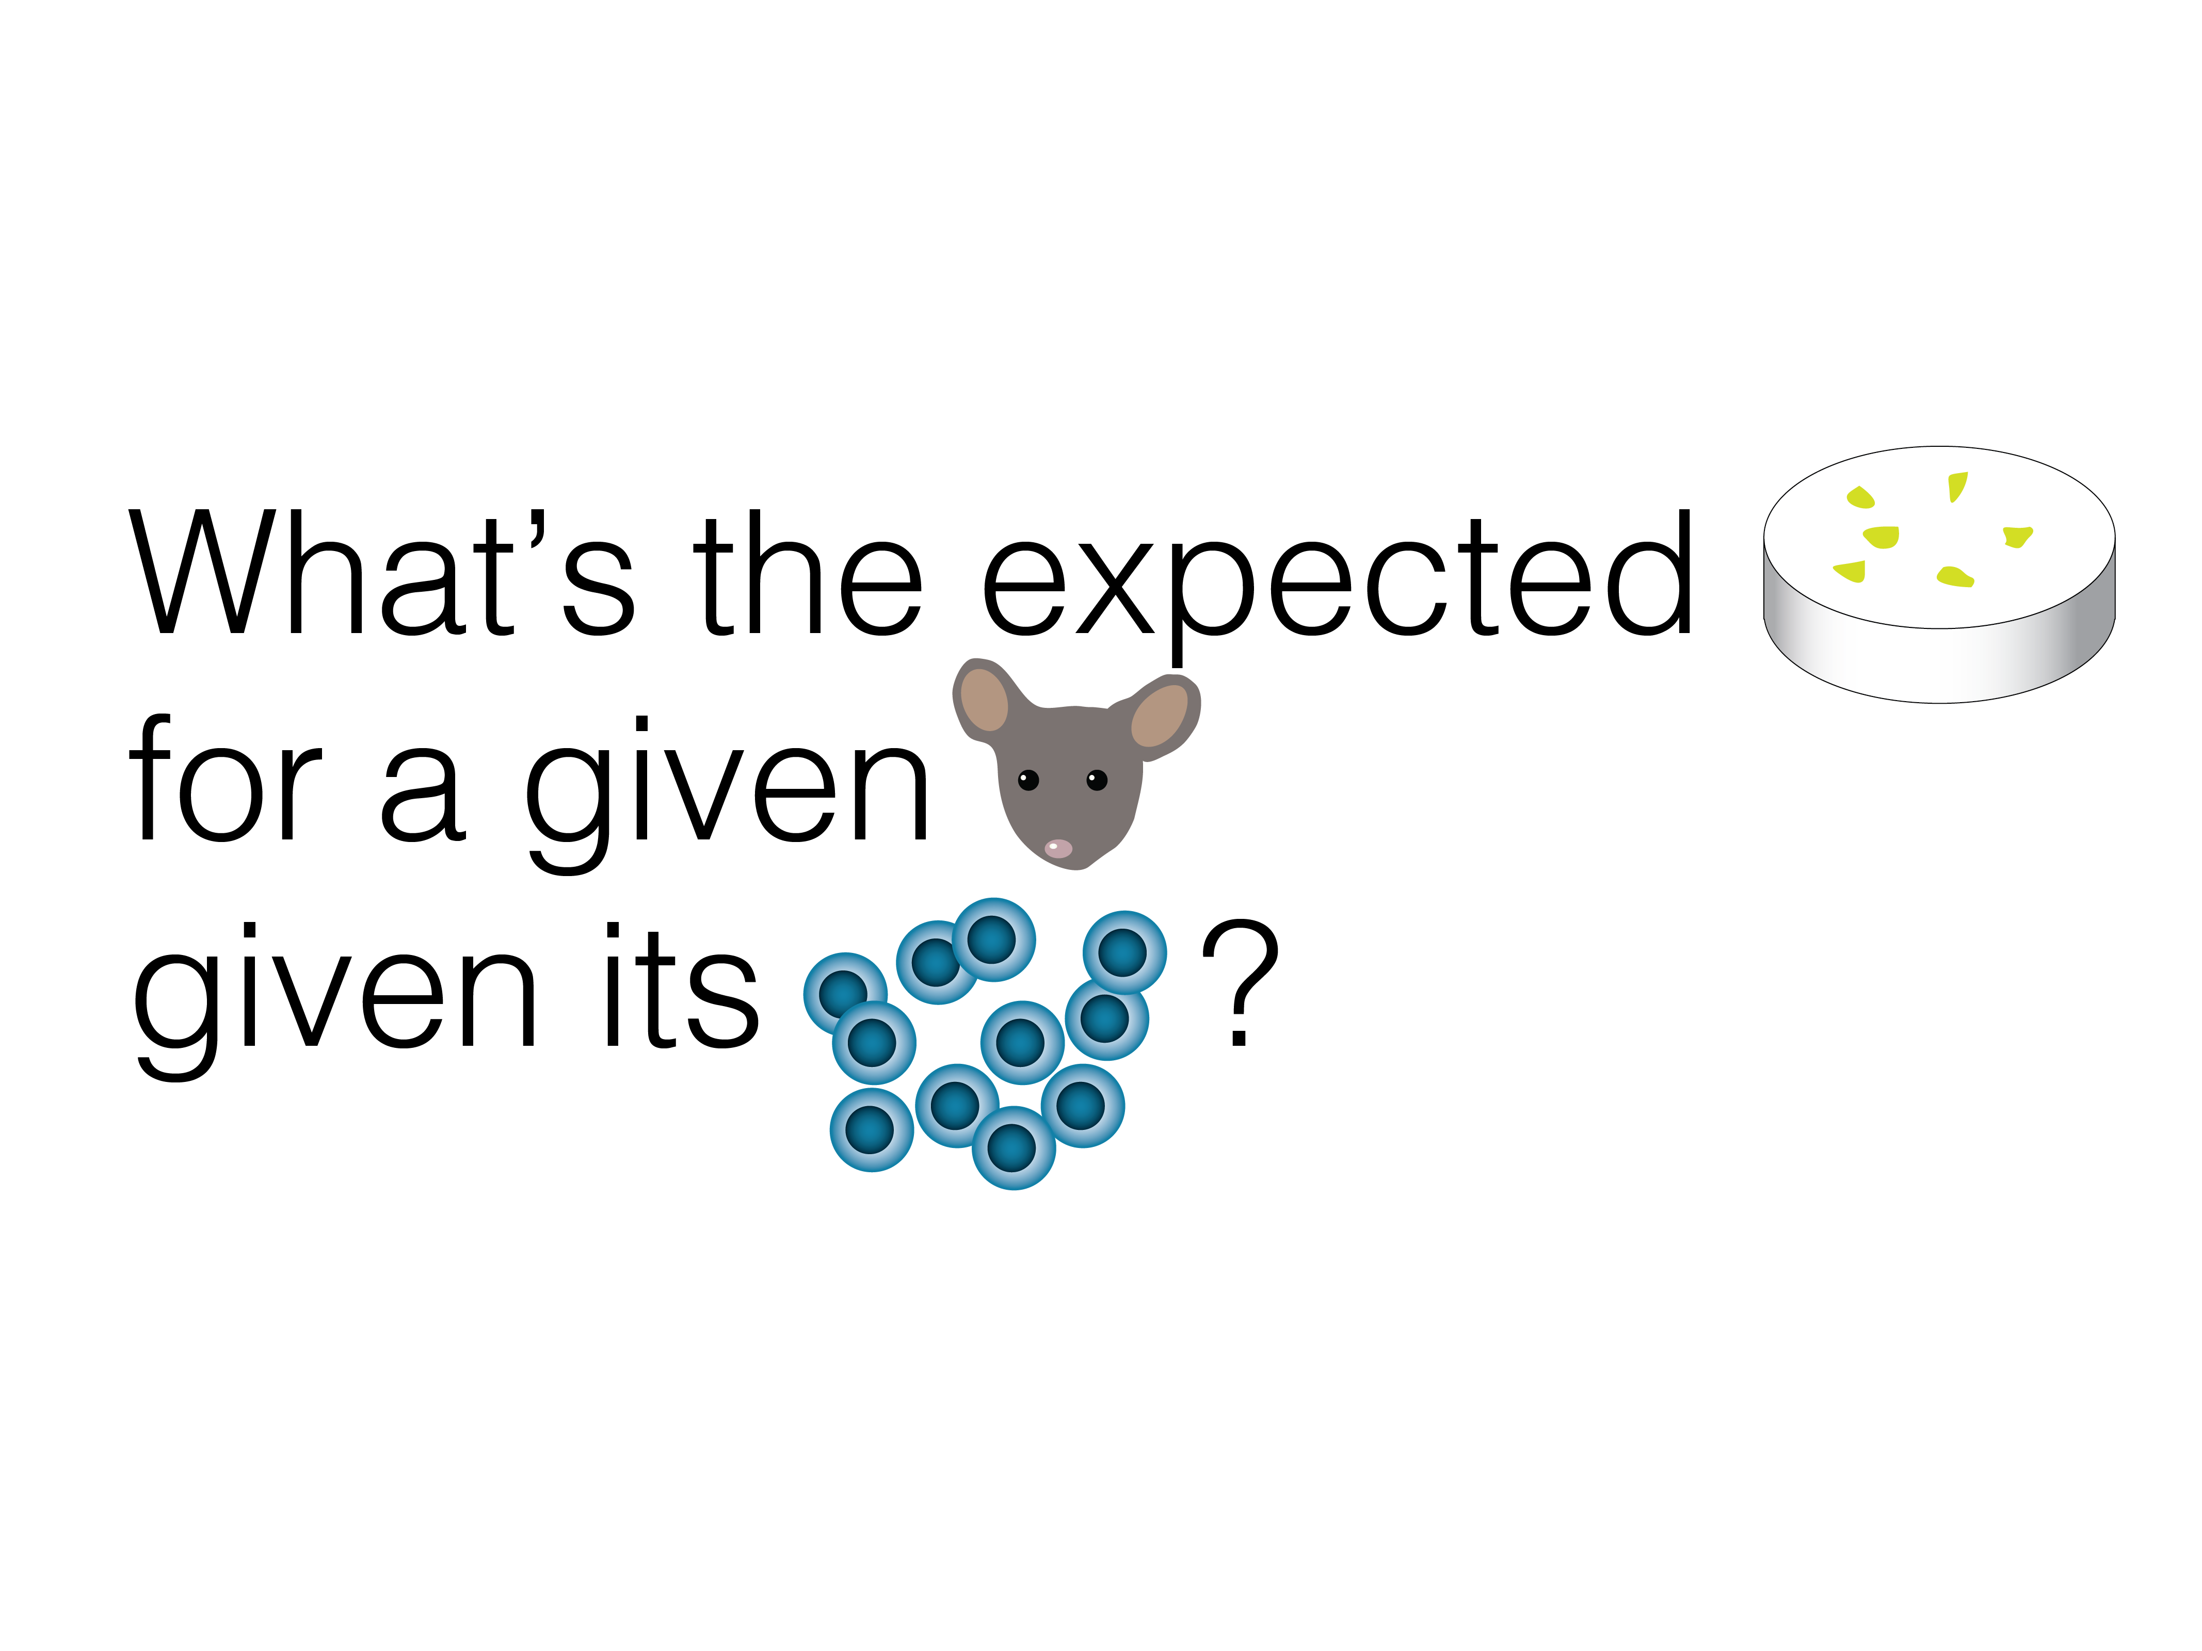

Slide 31
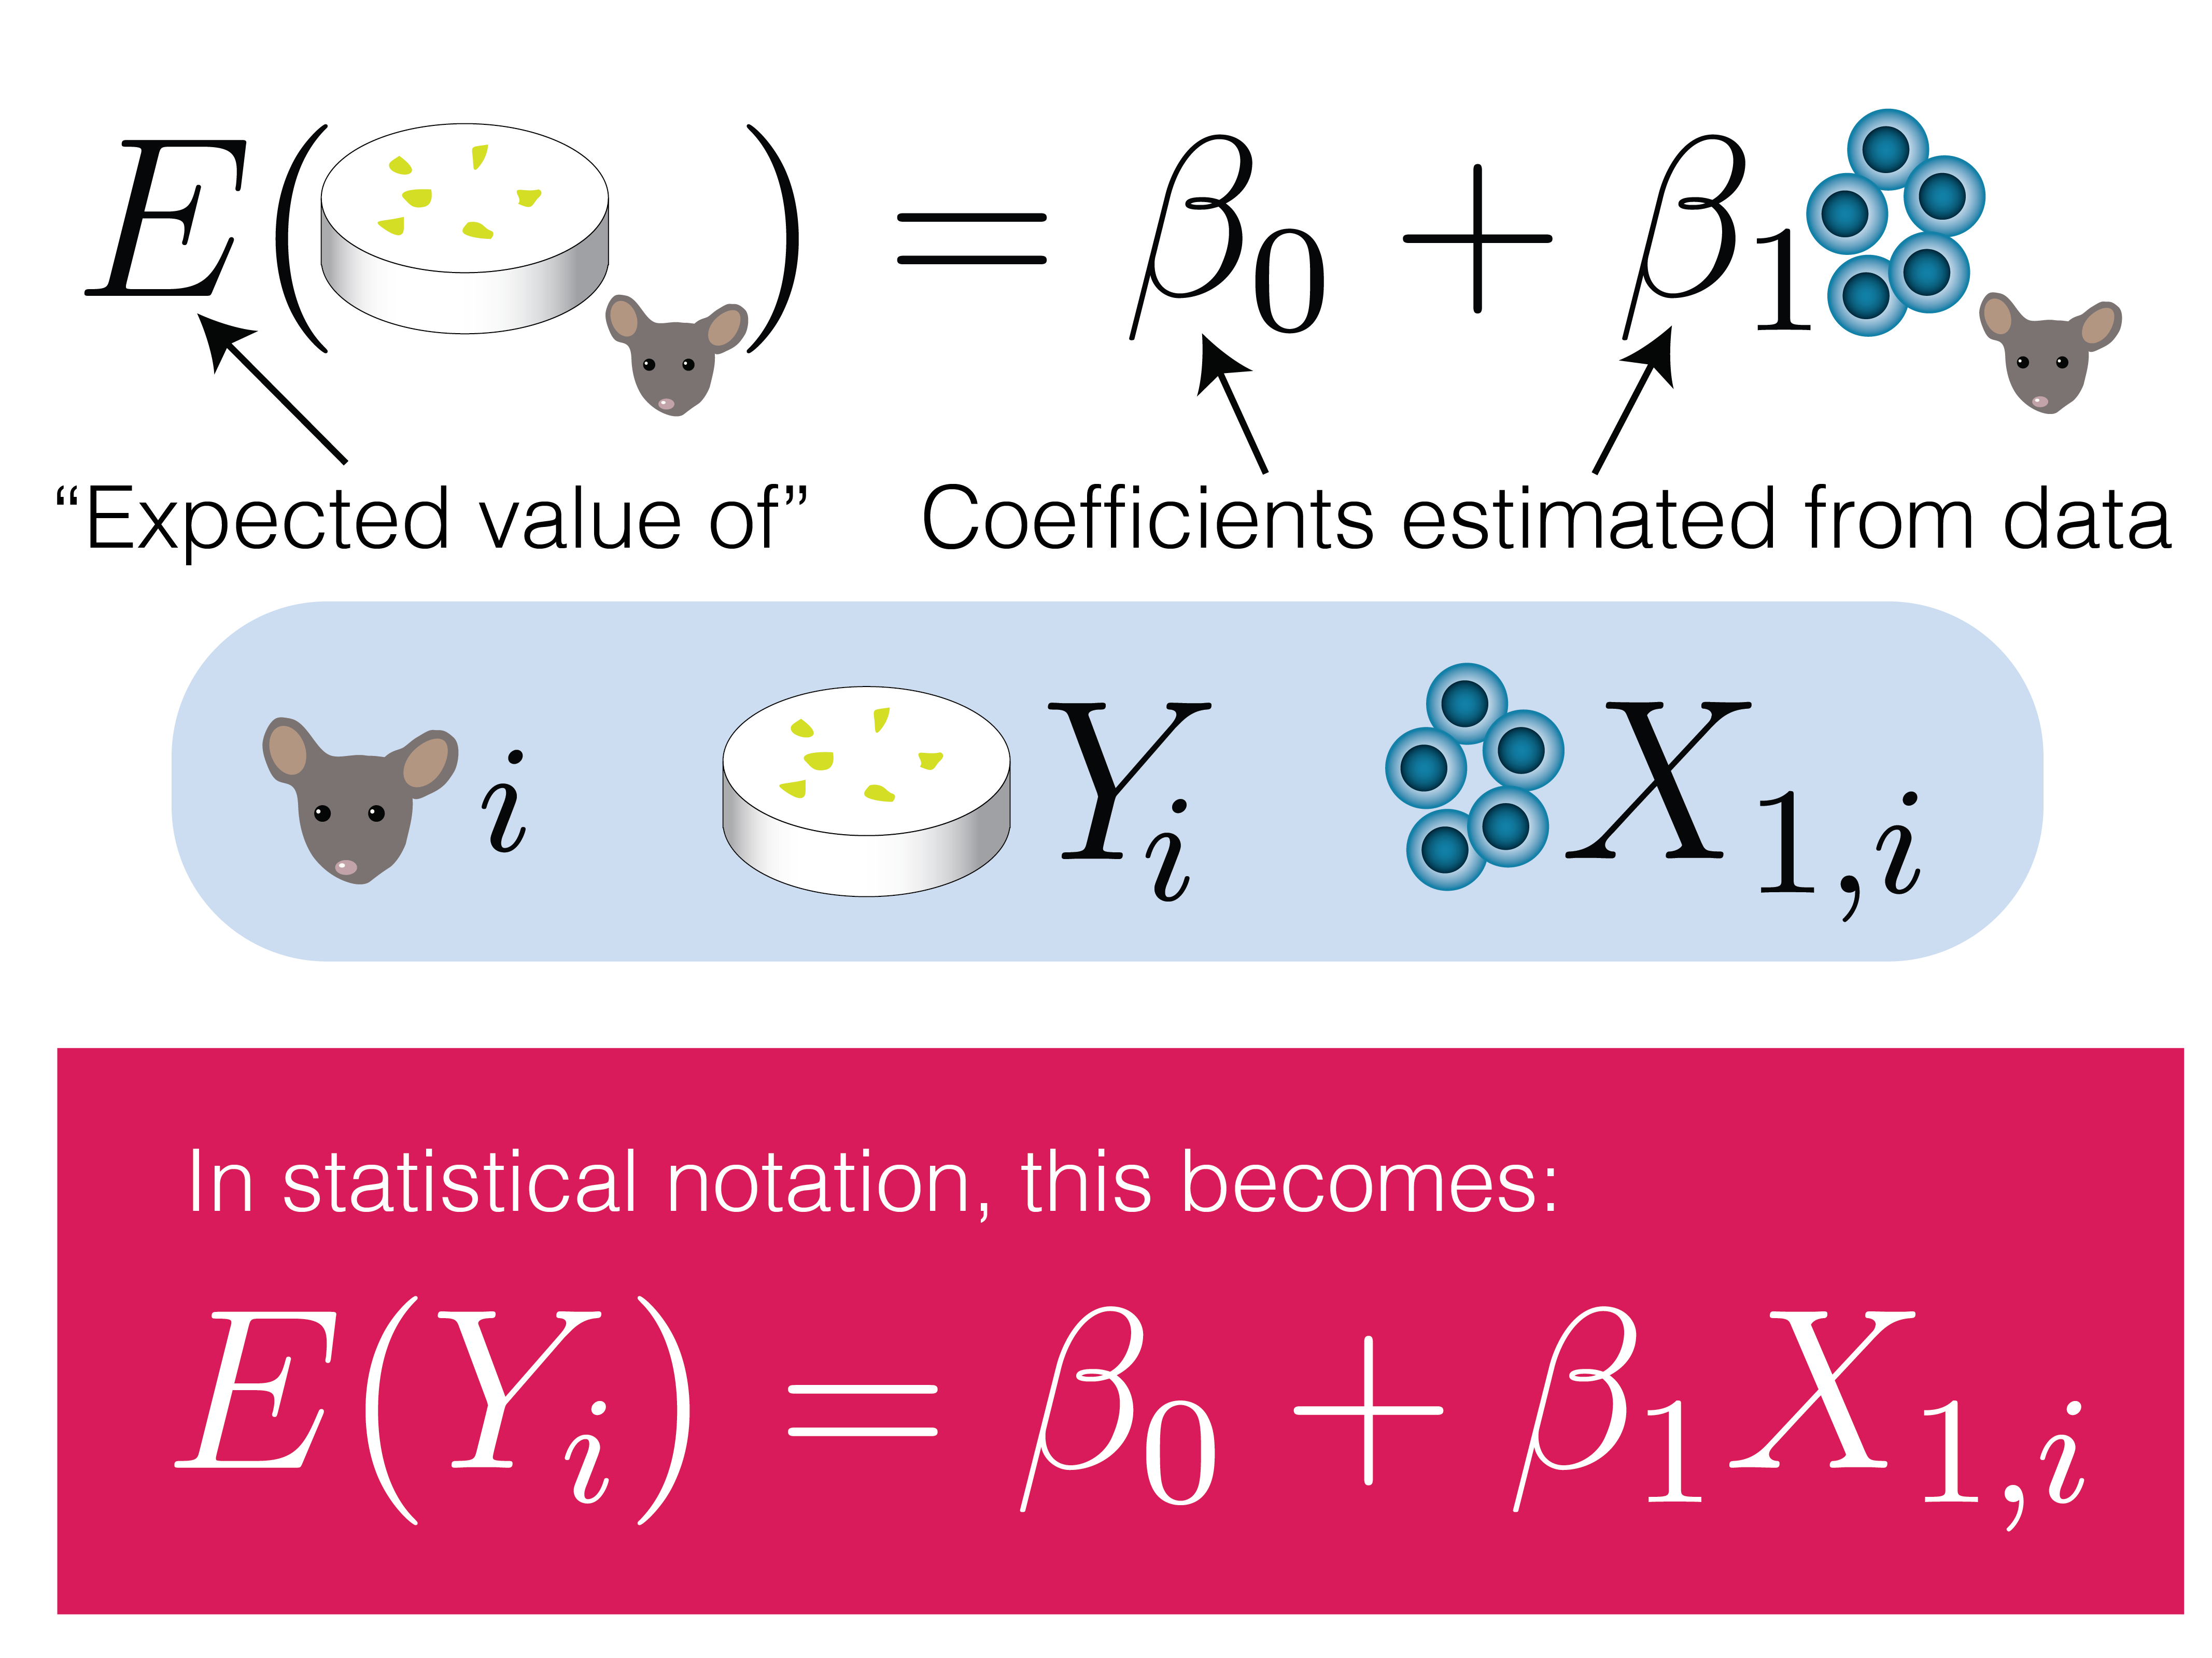

Slide 32
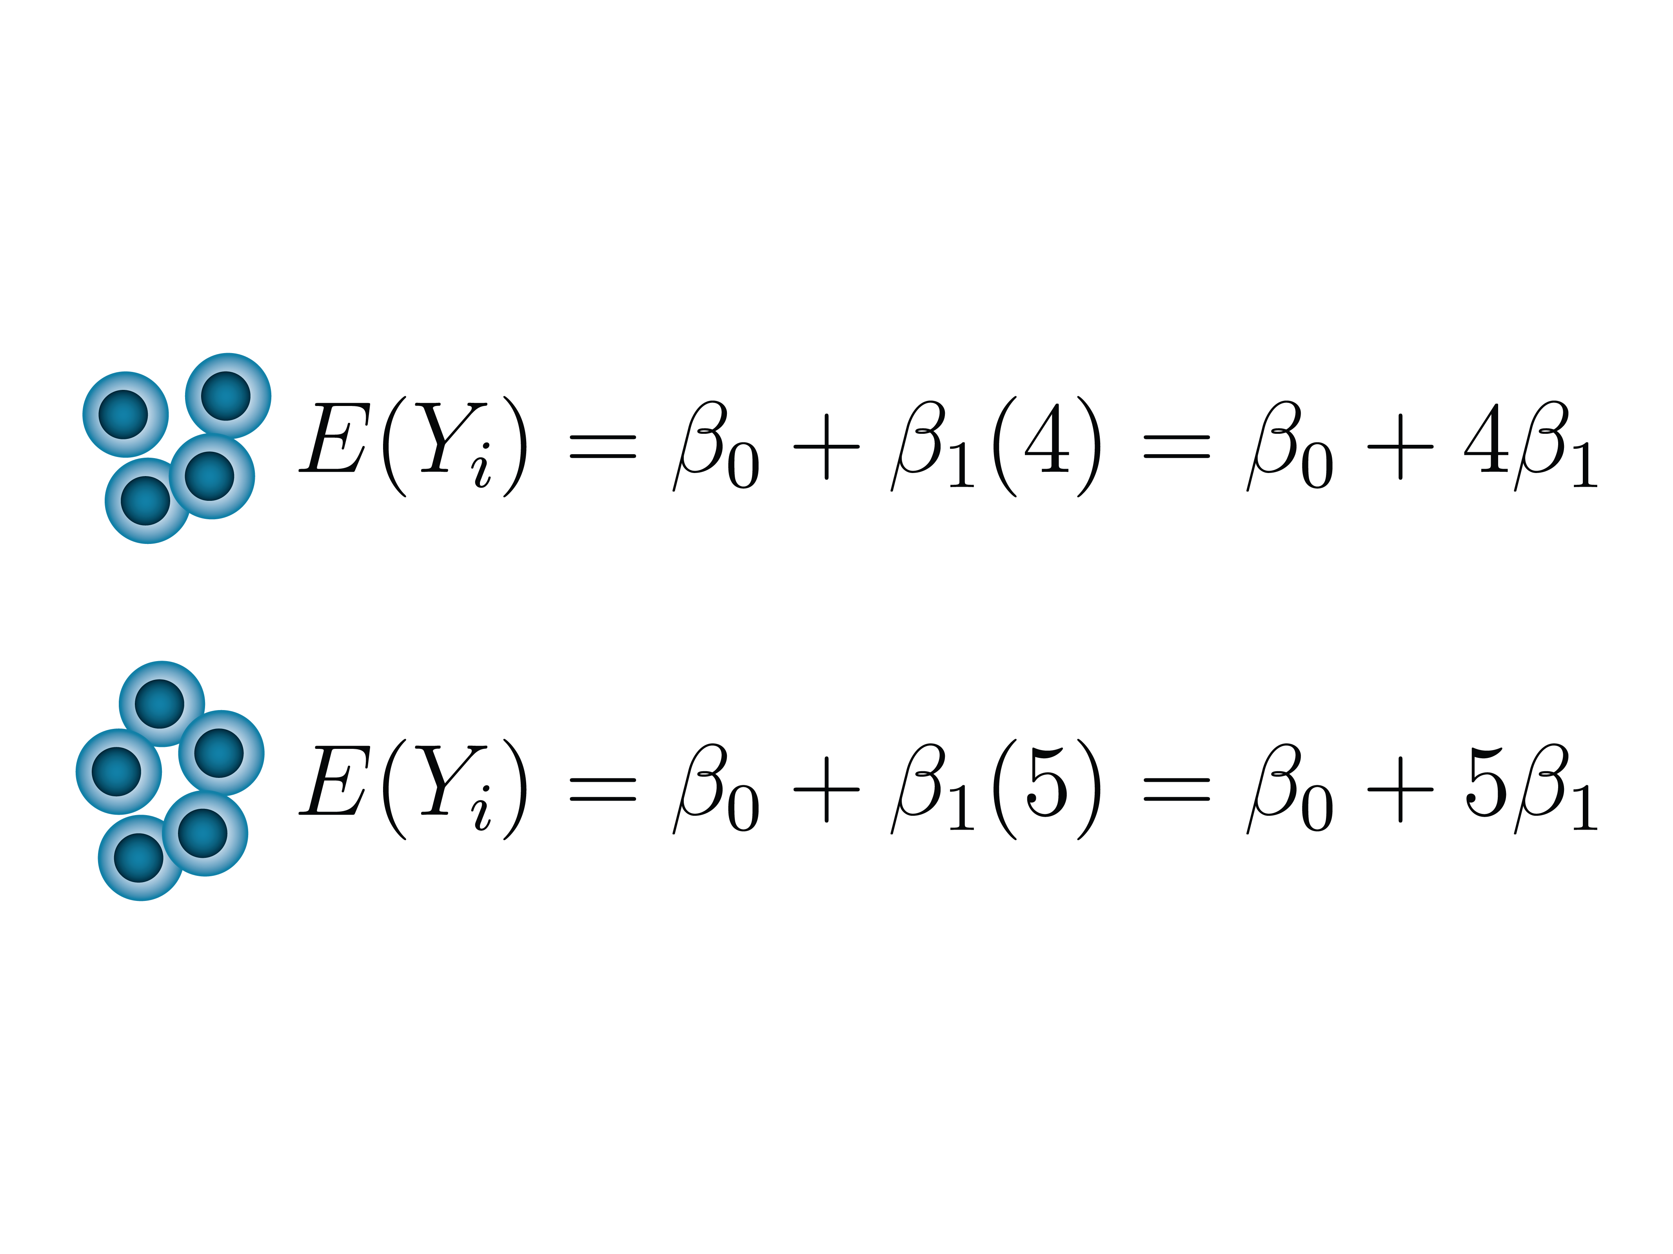

Slide 33
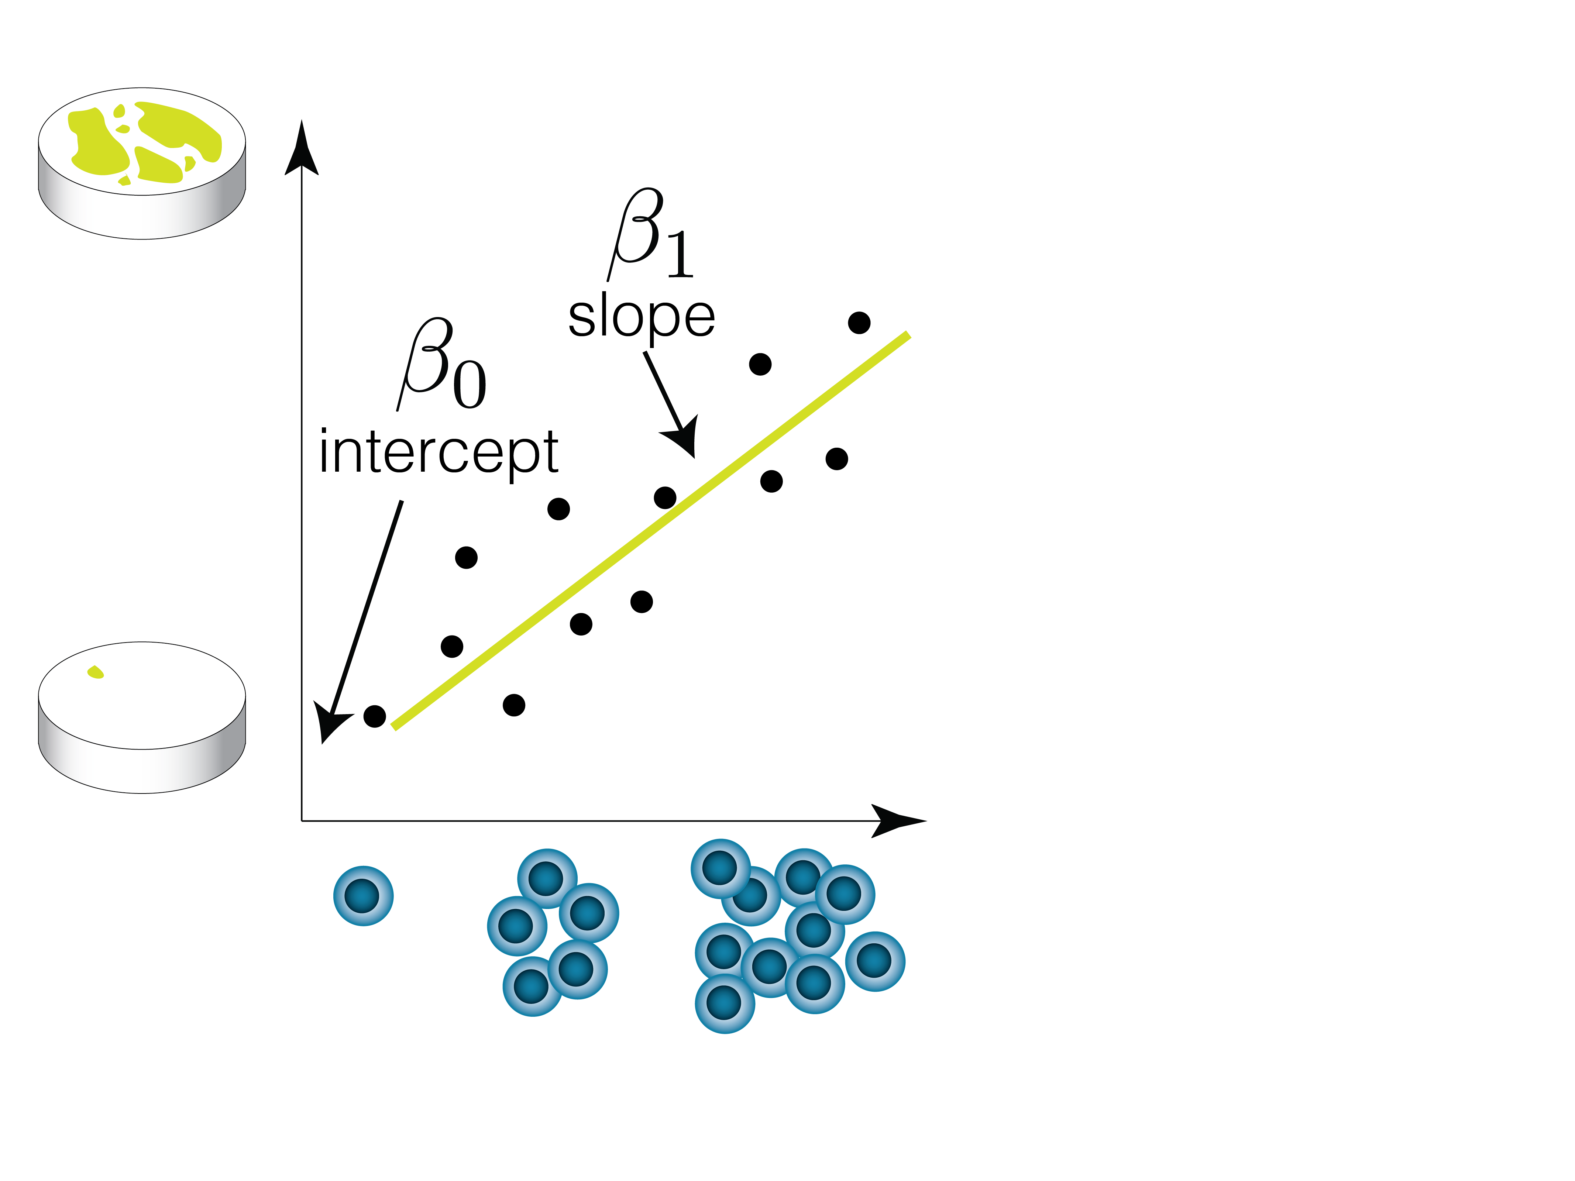

Slide 34
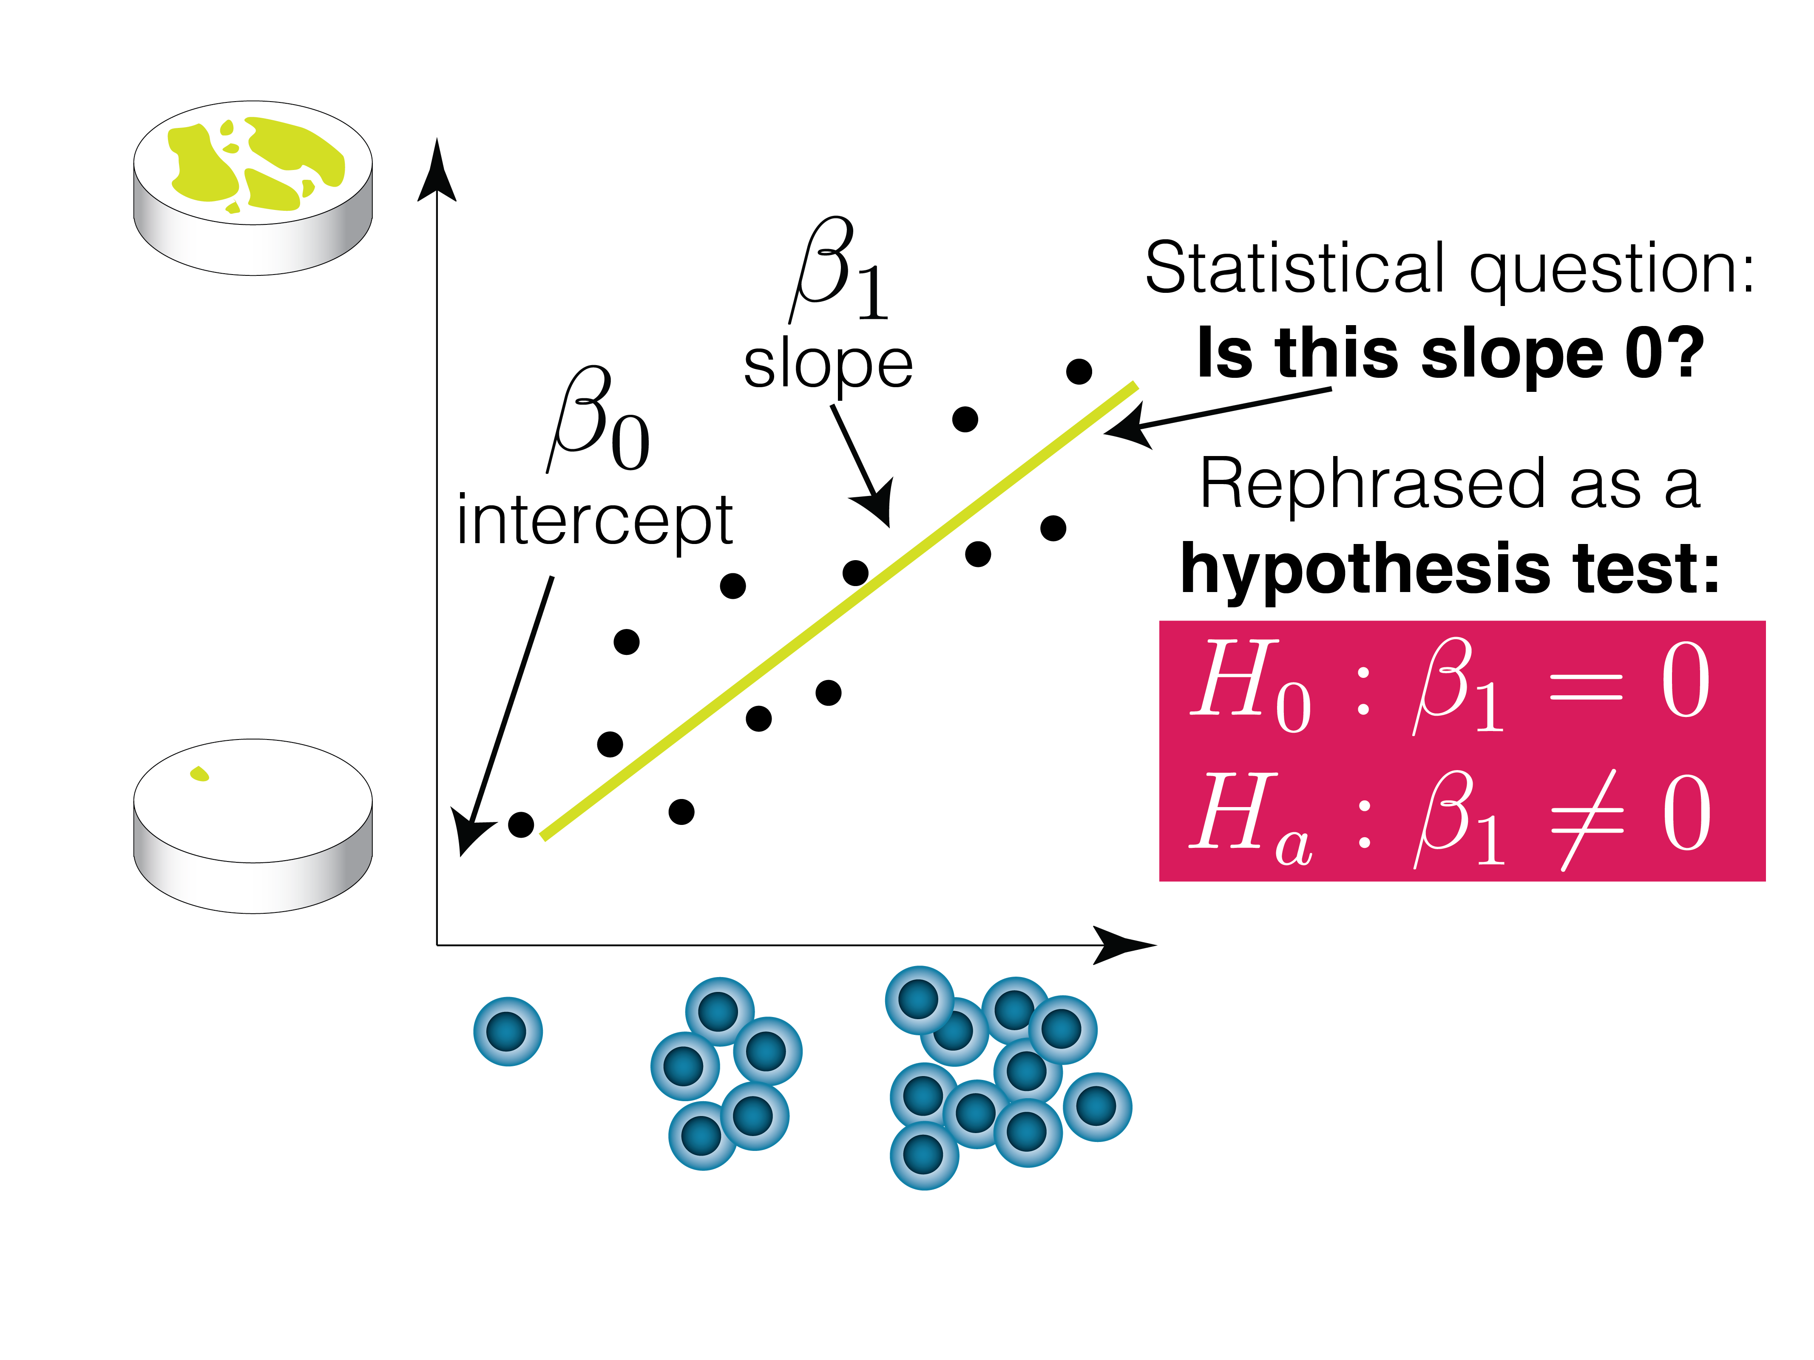

Slide 35
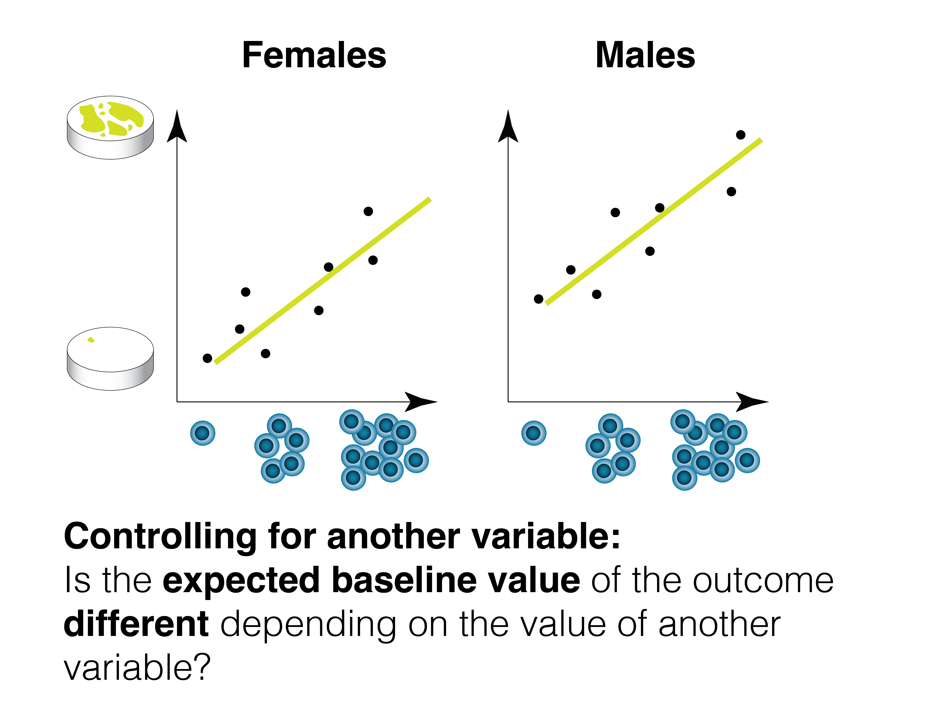

Slide 36
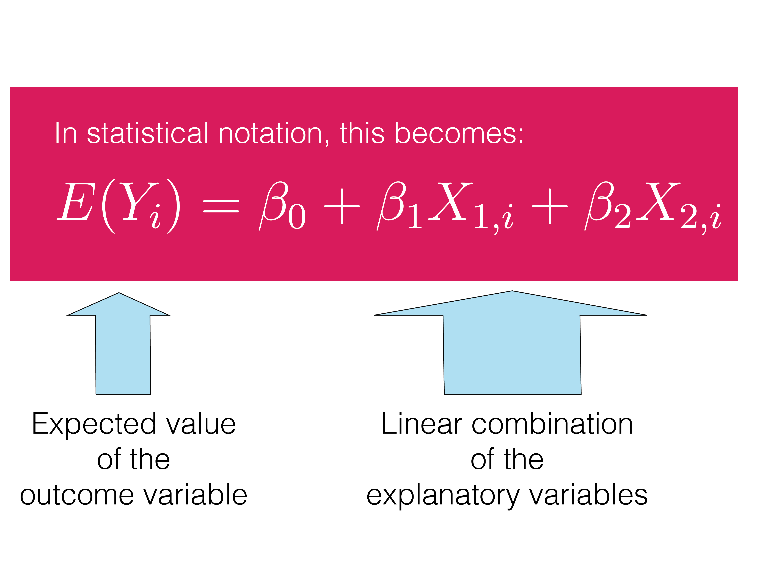

Slide 37
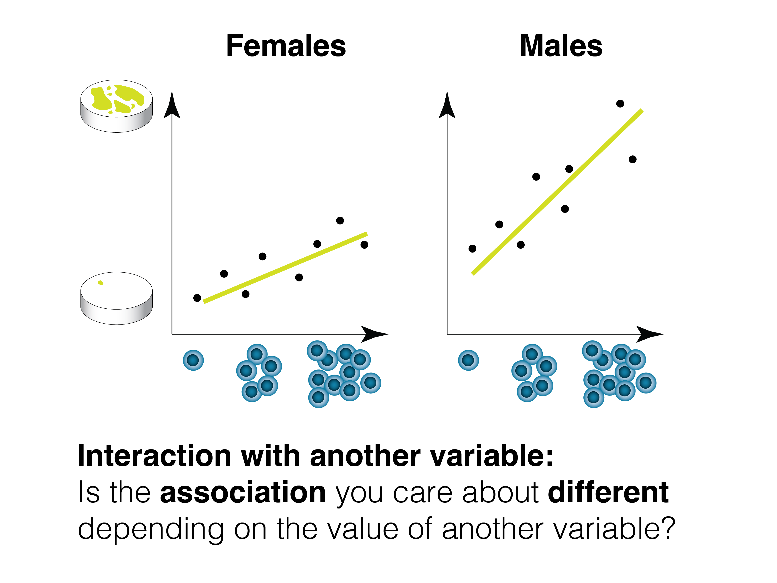

Slide 38
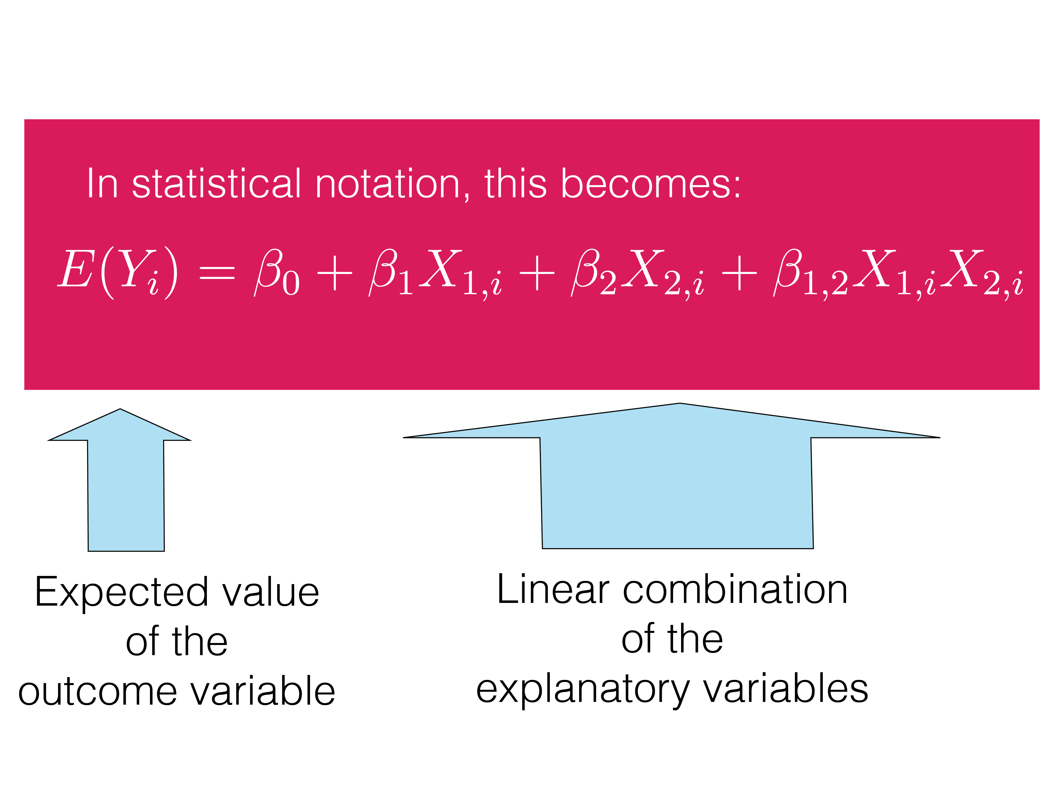

Slide 40
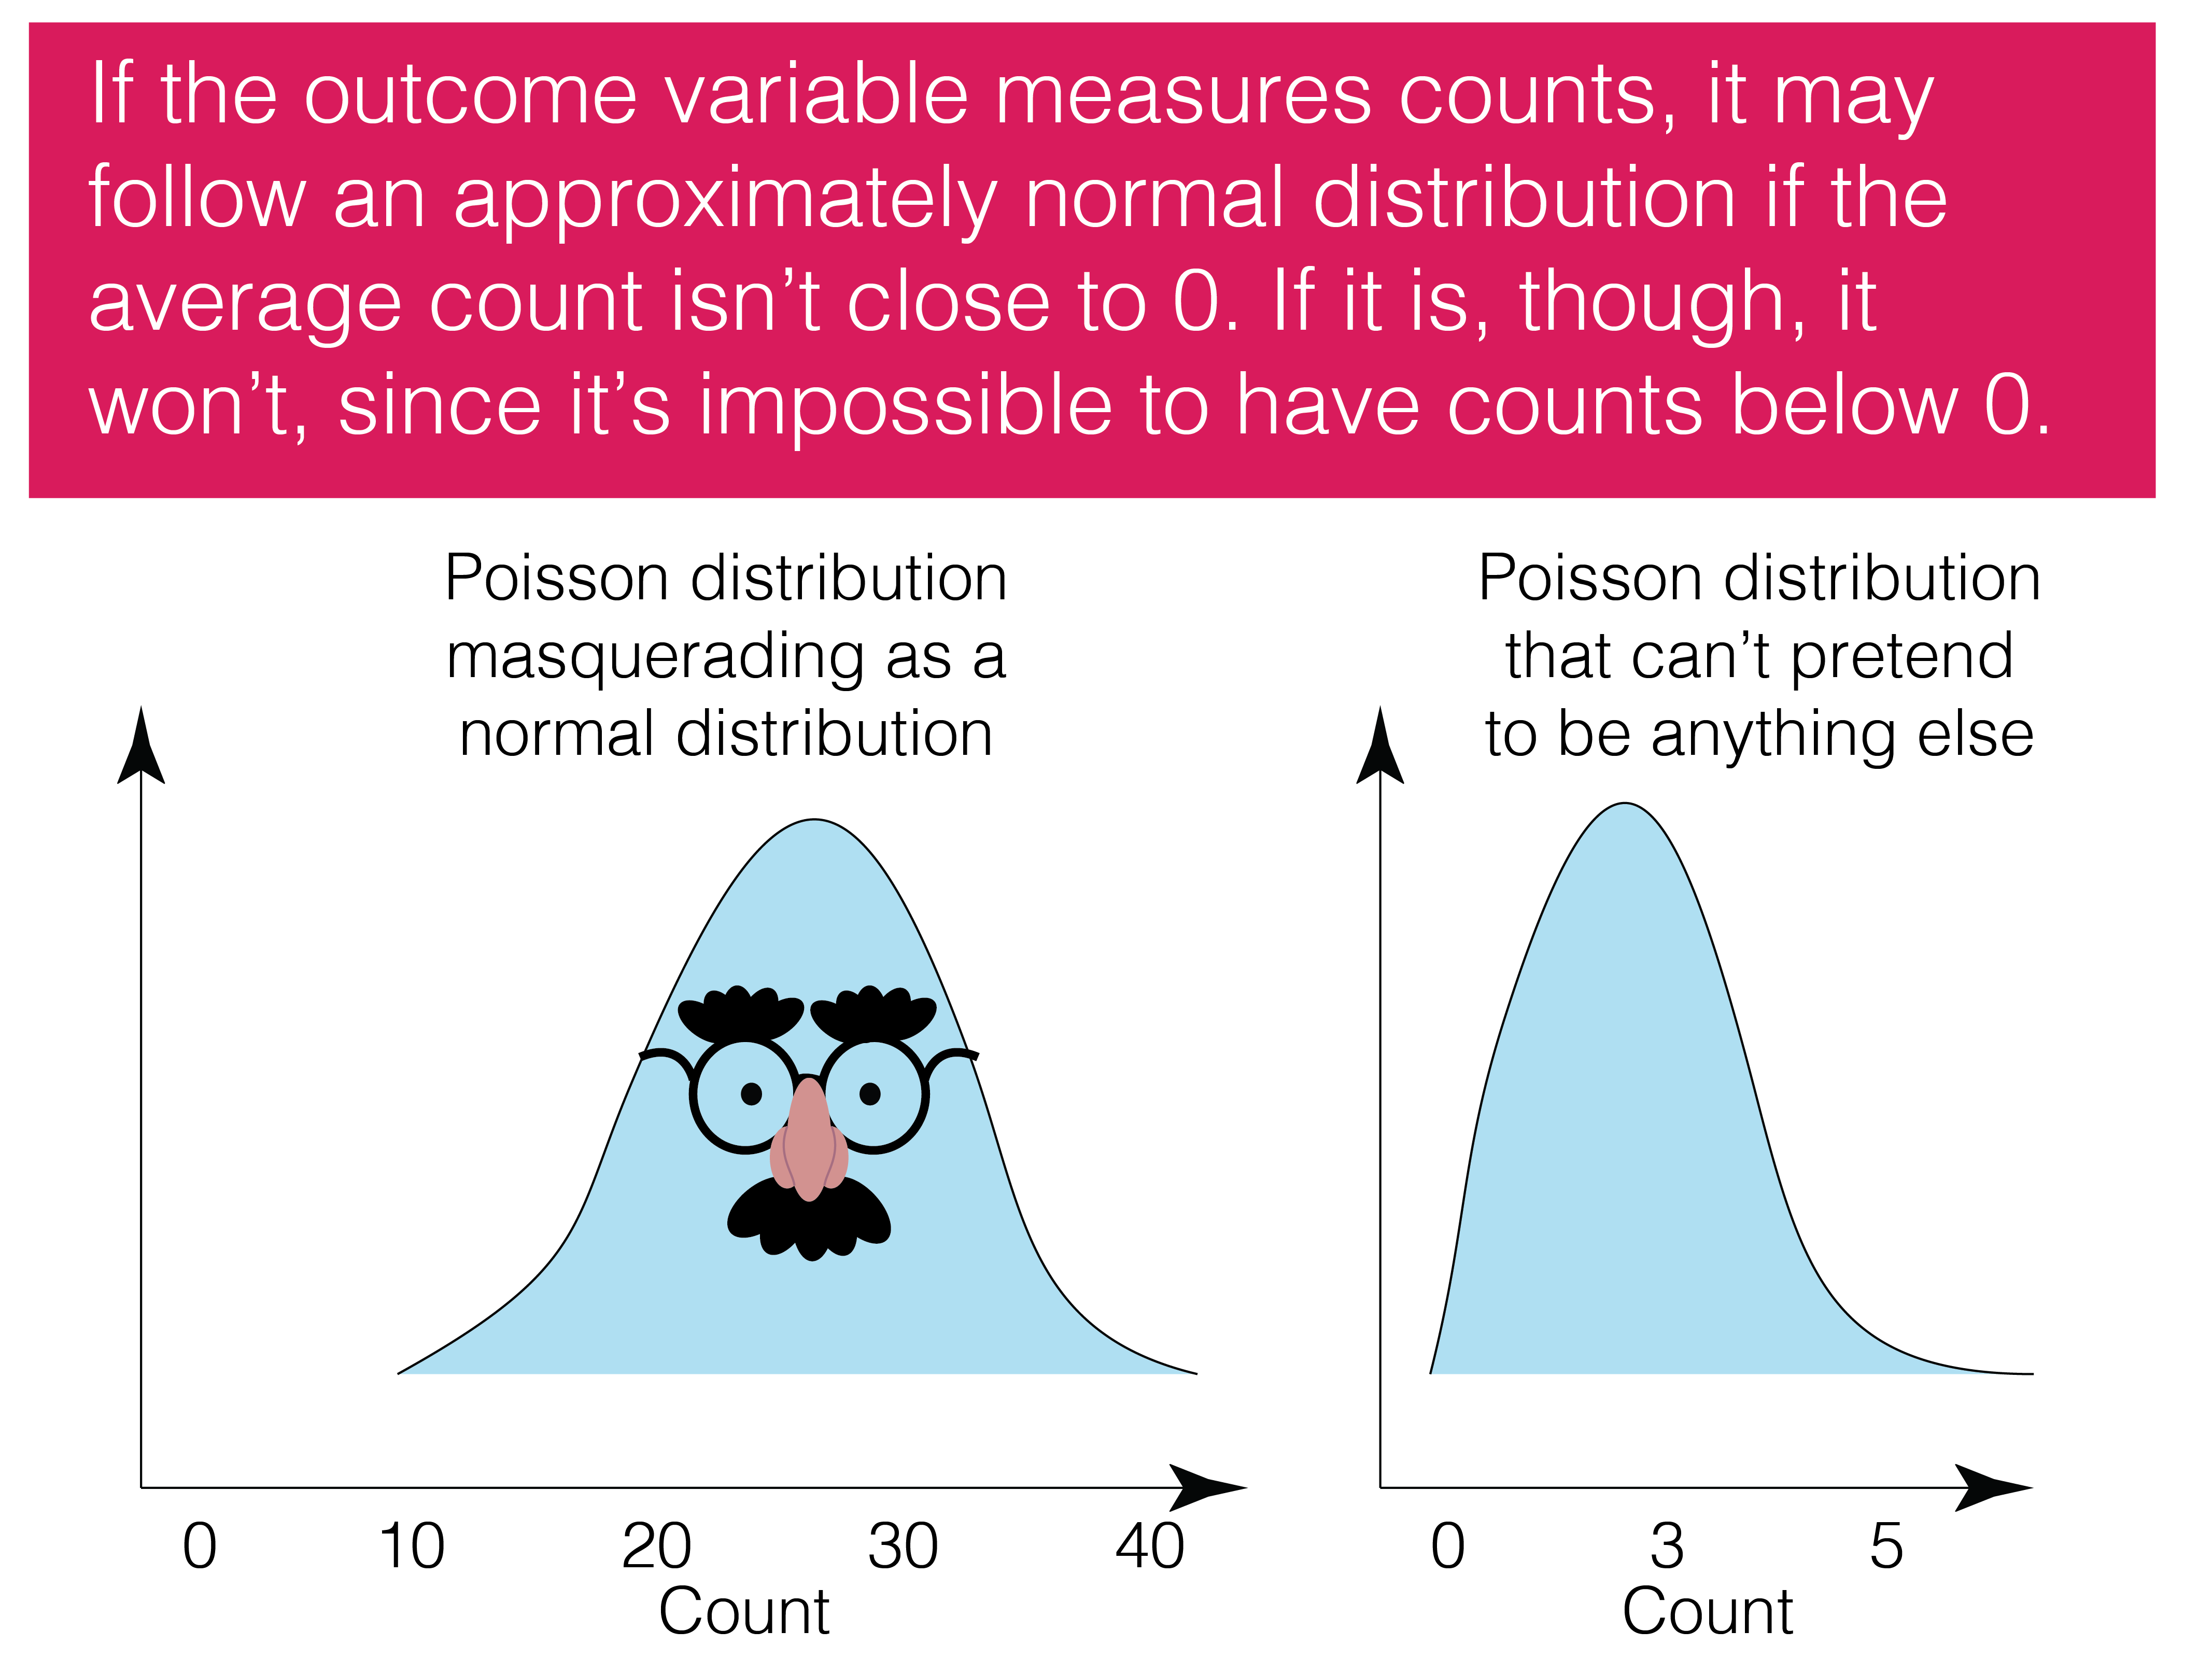

Slide 41
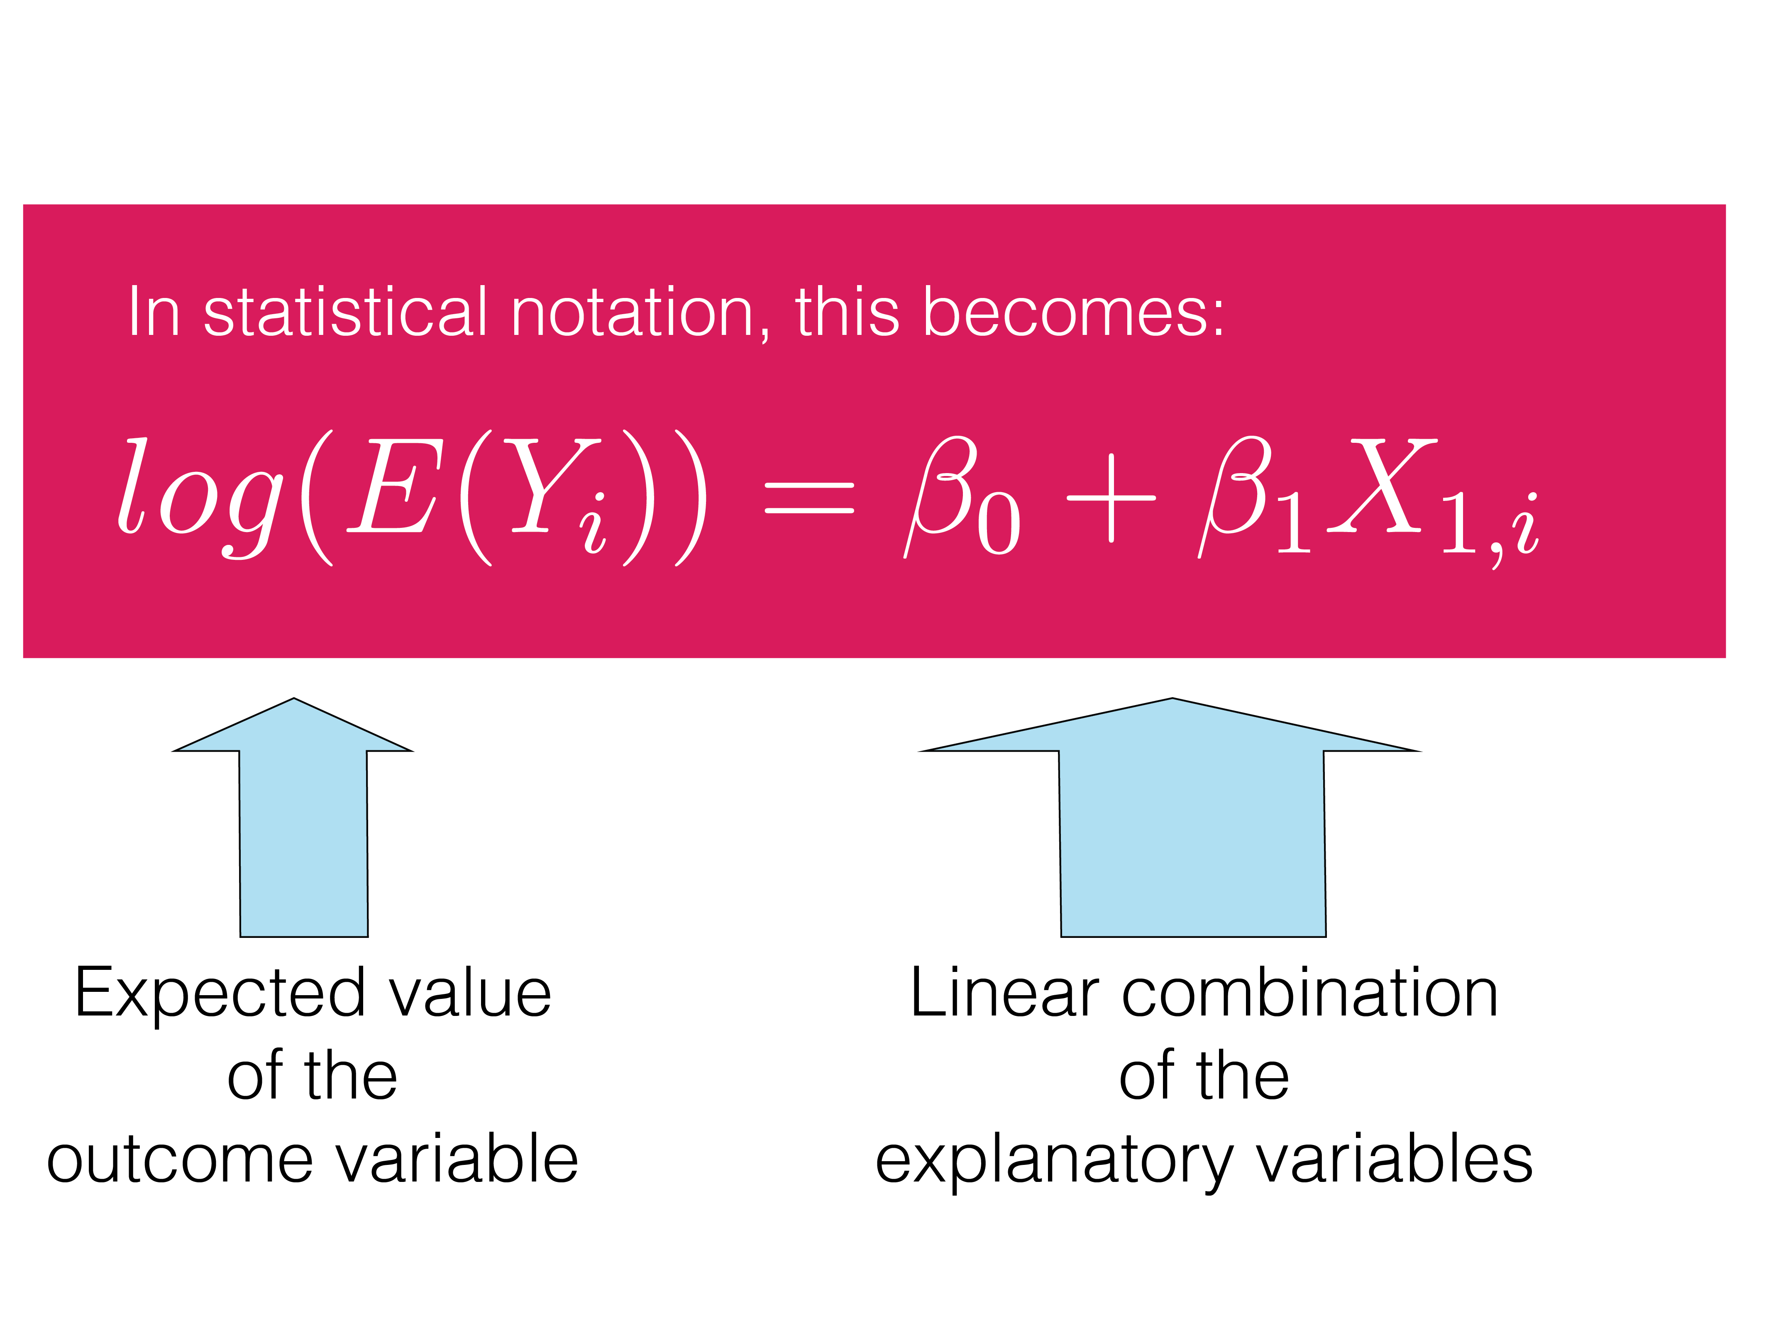

Slide 42
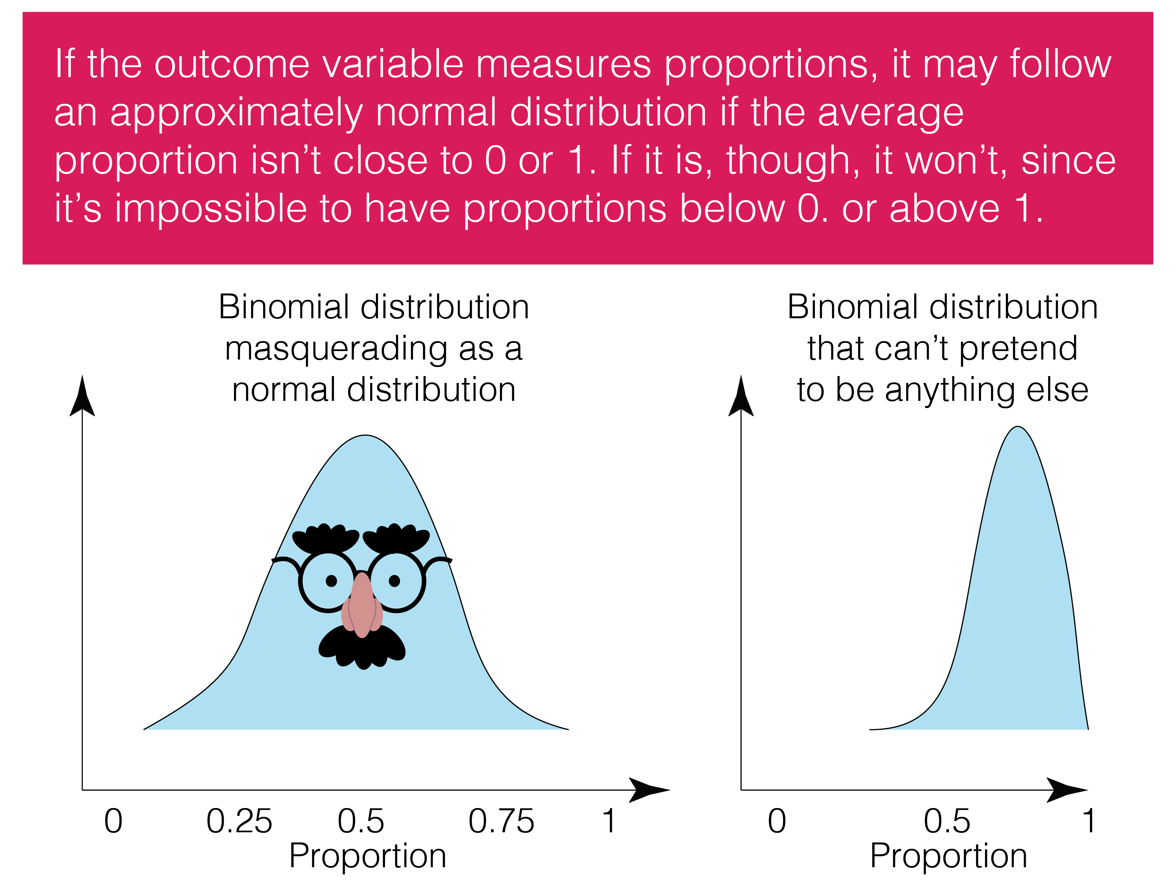

Slide 43
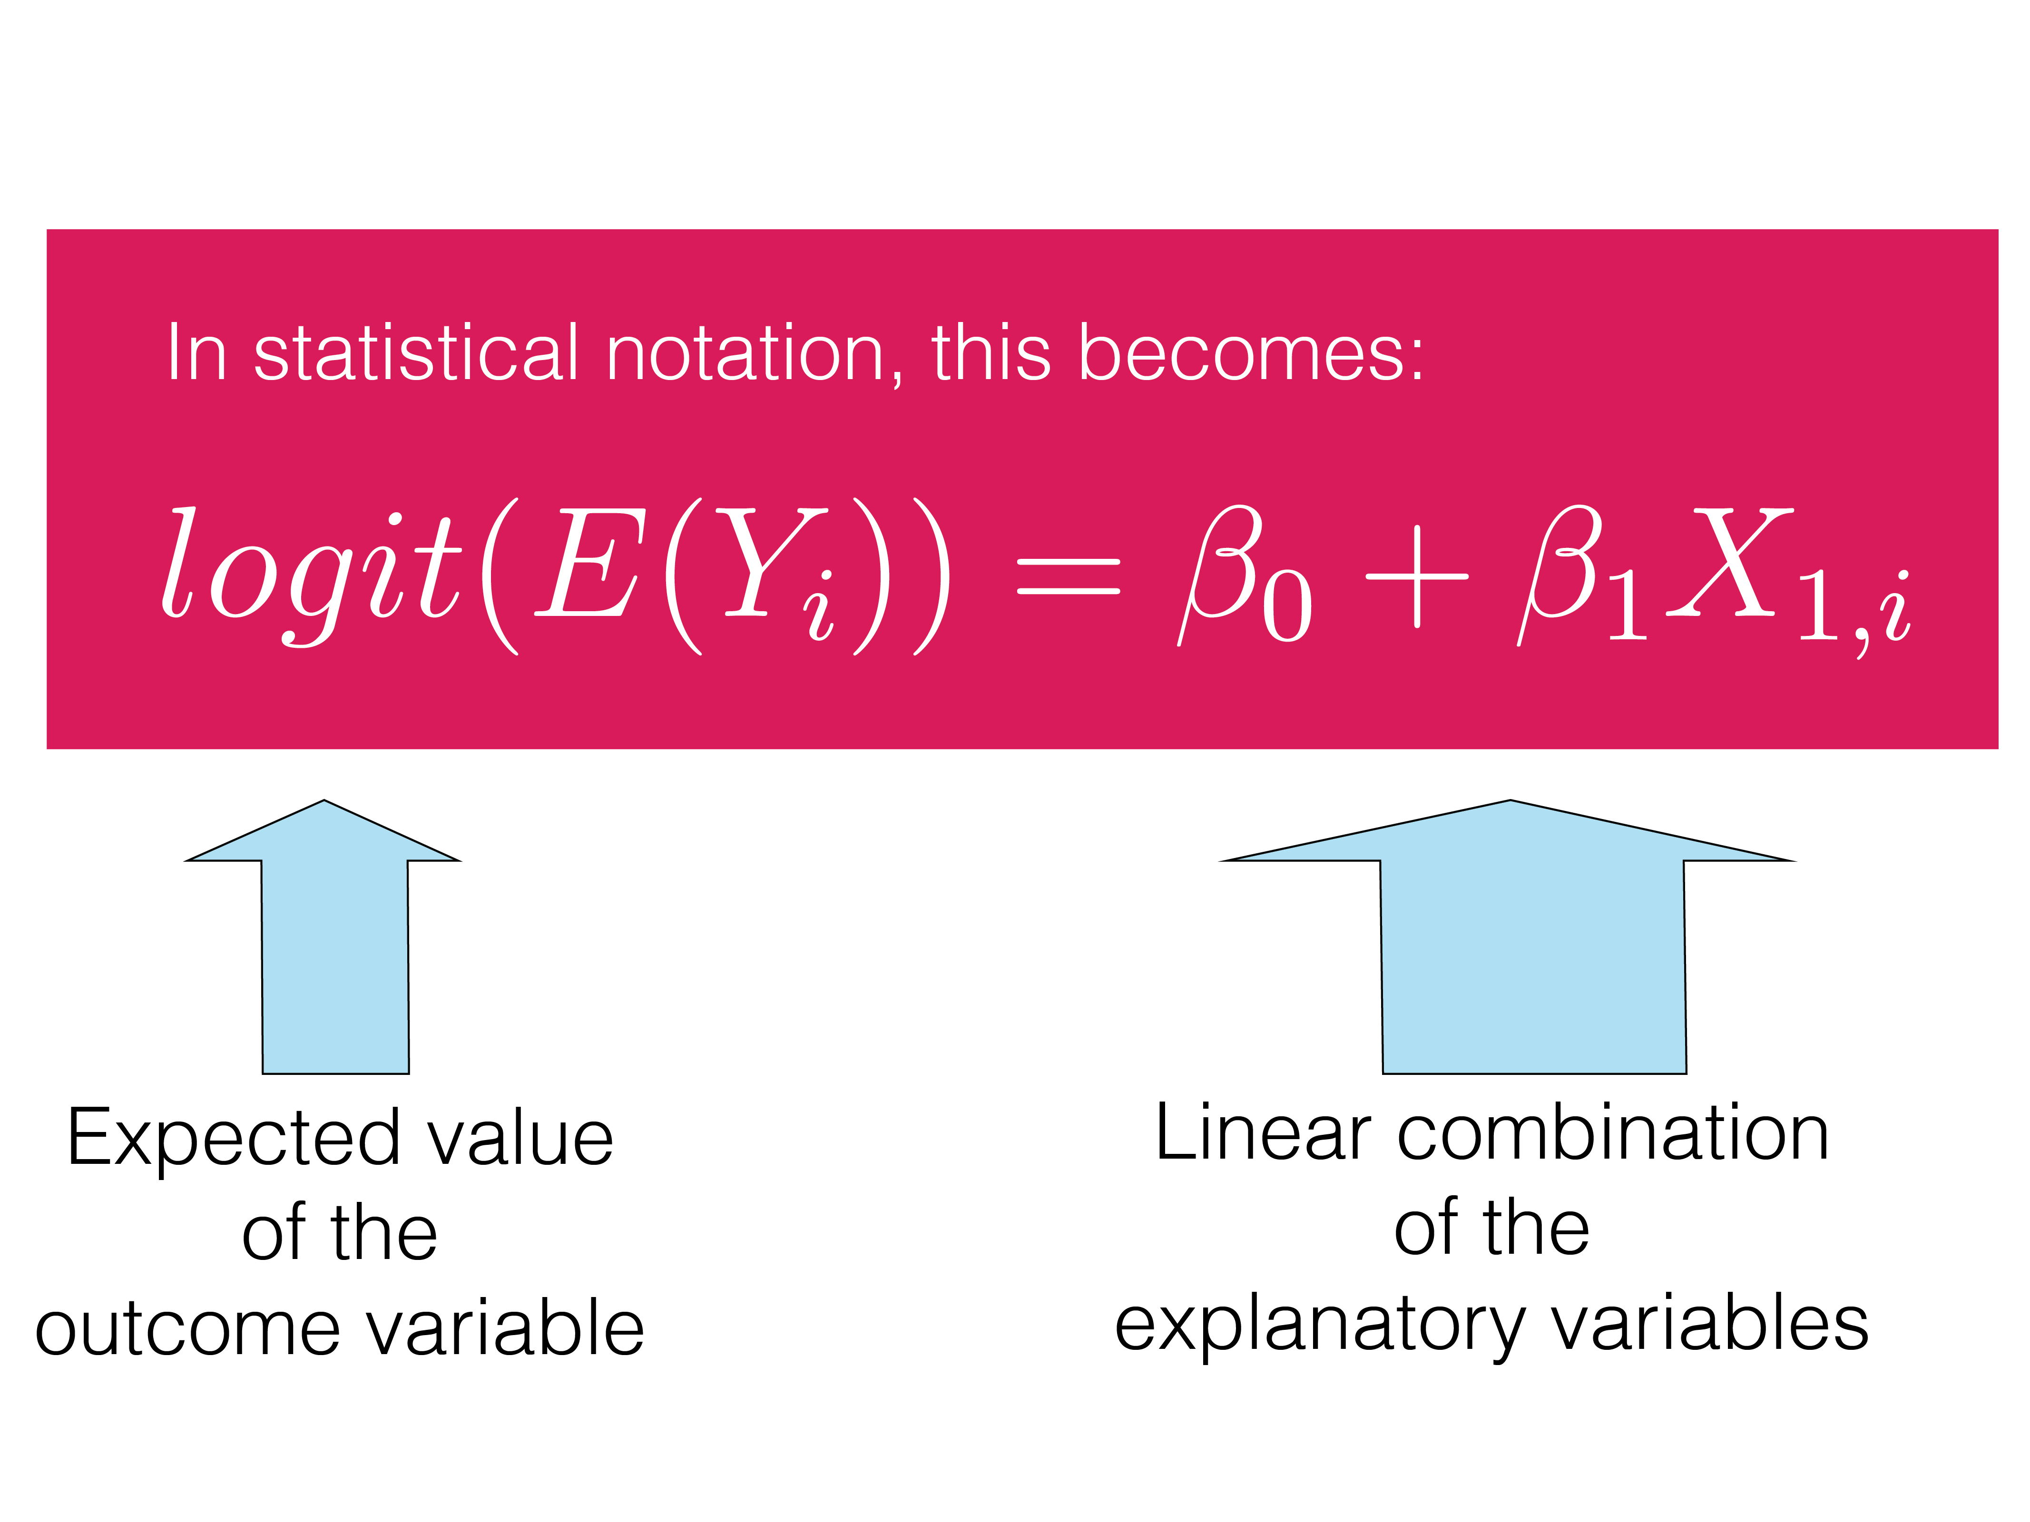

Slide 44
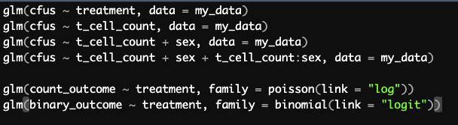

Slide 45
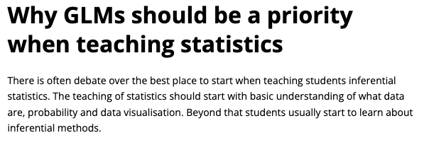
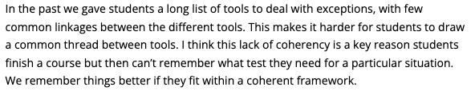
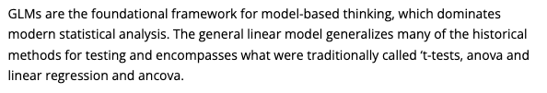
Dr. Chris Brown

Slide 46
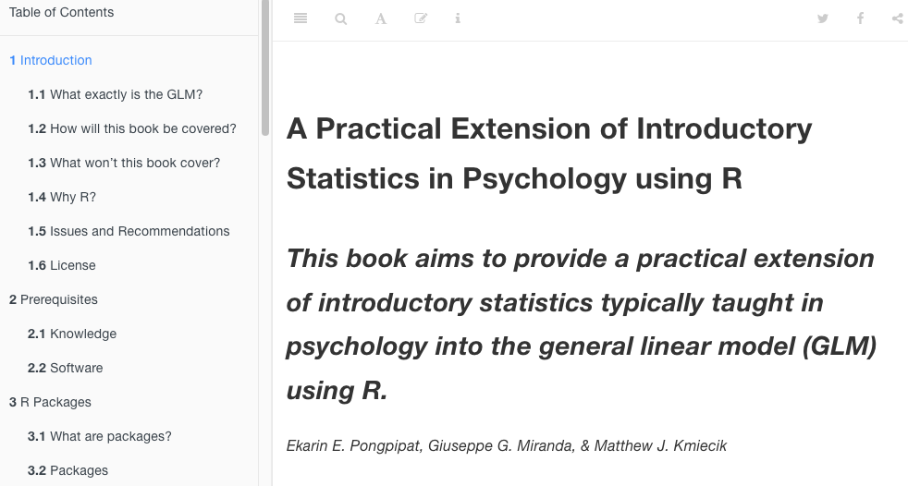

Slide 47

Extensions of GLMs
Generalized estimating equations
Generalized linear mixed models
Generalized additive models
Non-parametric regression models
Bayesian generalized linear models

Slide 48
Resources for GLMs
CSU Courses:
STAR 513: Regression Models for Researchers
STAR 531: Generalized Regression Models for Researchers
Online text book: A Practical Extension of Introductory Statistics in Psychology using R https://rpsystats.com/
Extensive resources through online tutorials, books, and courses

Slide 49
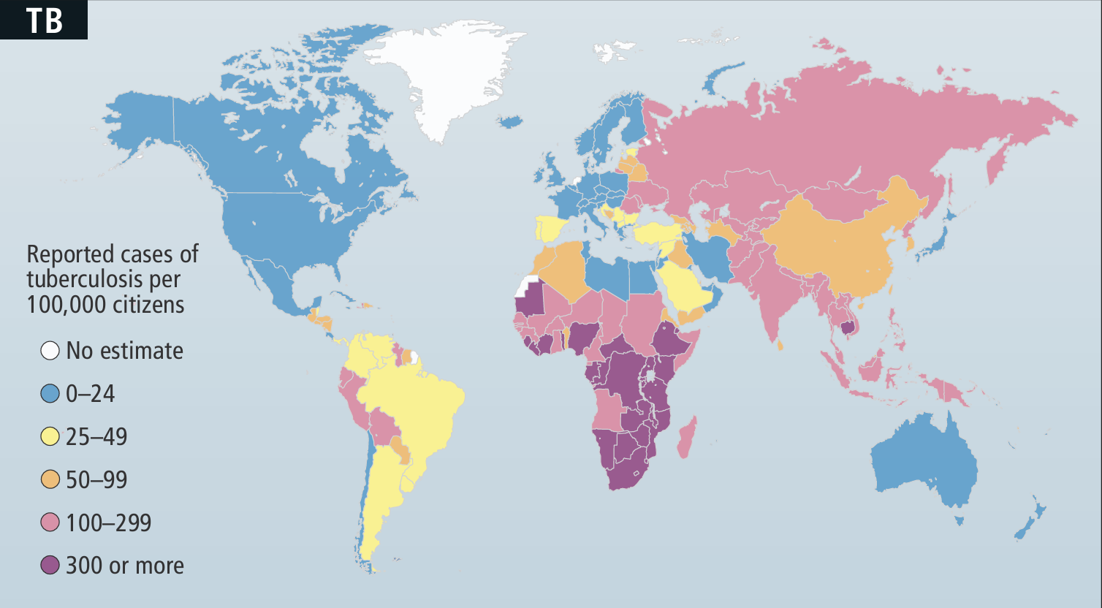
Worldwide distribution of tuberculosis
Source: Barry and Cheung, 2009. Scientific American.

Slide 50
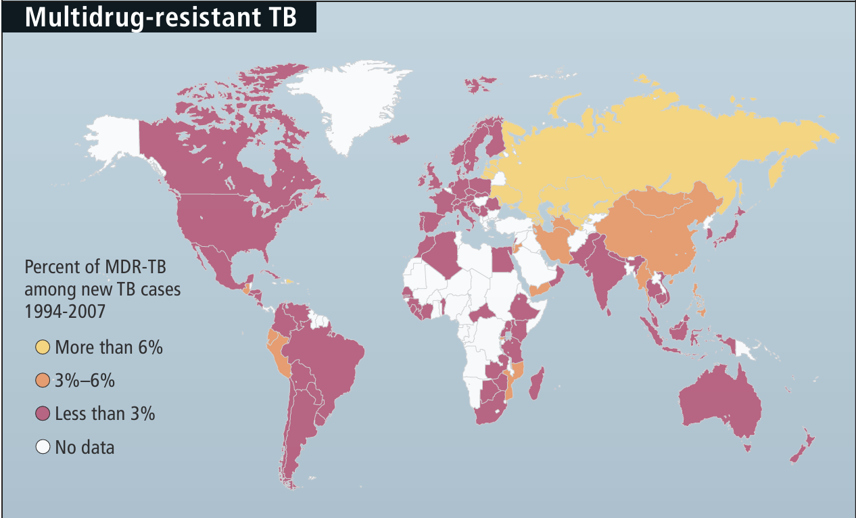
Worldwide distribution of drug-resistant TB
Source: Barry and Cheung, 2009. Scientific American.

Slide 51
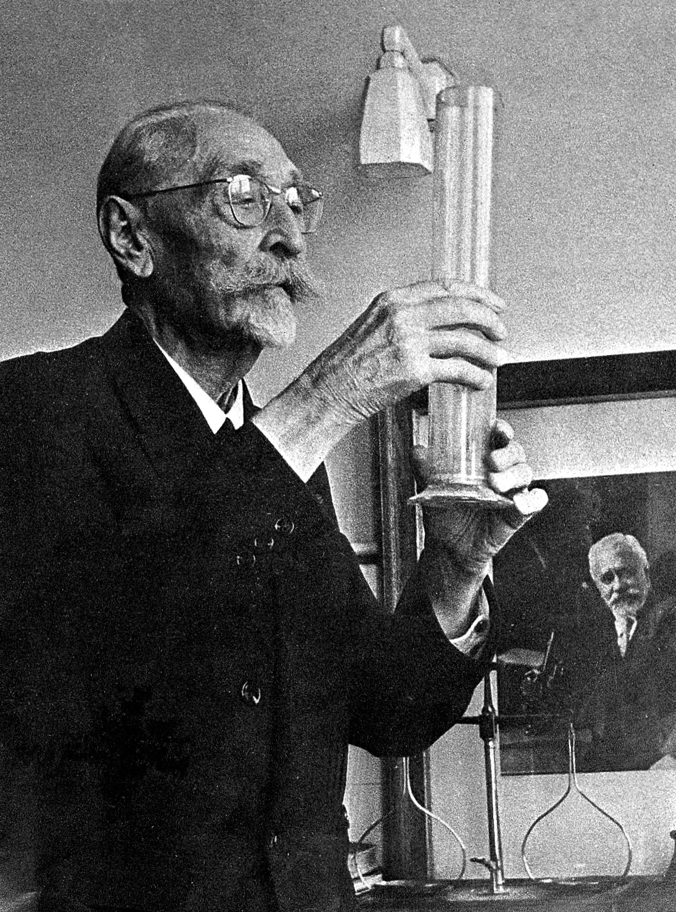
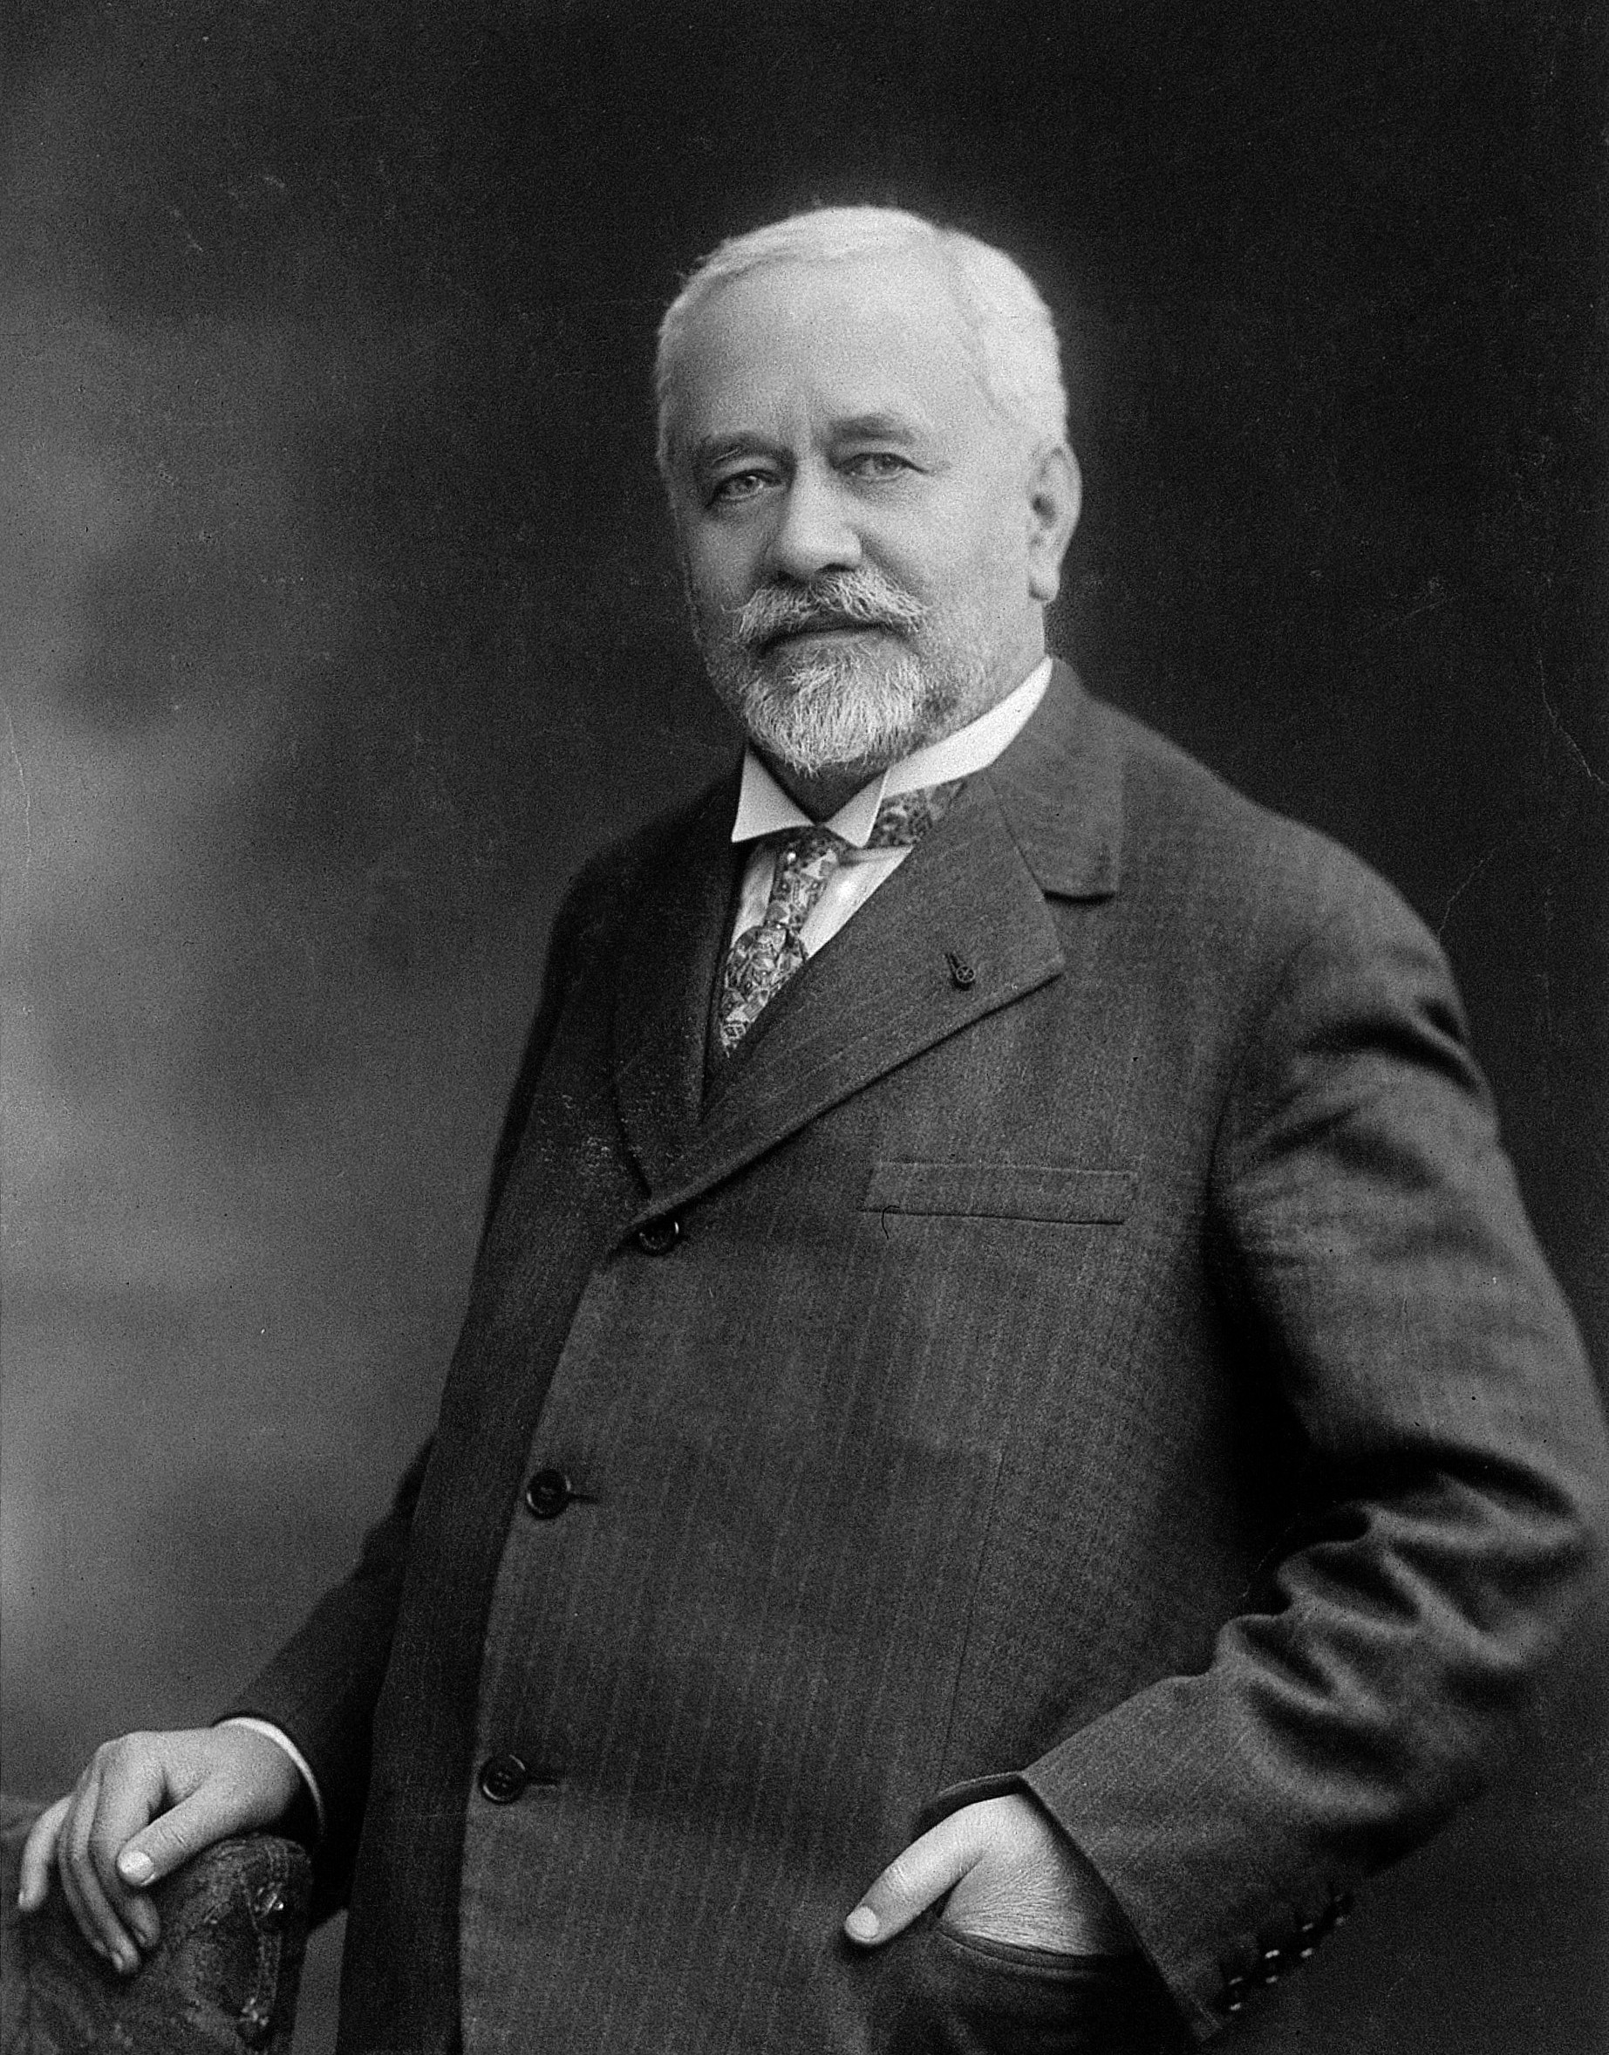
Current vaccine: BCG
Source: Wellcome

Slide 52
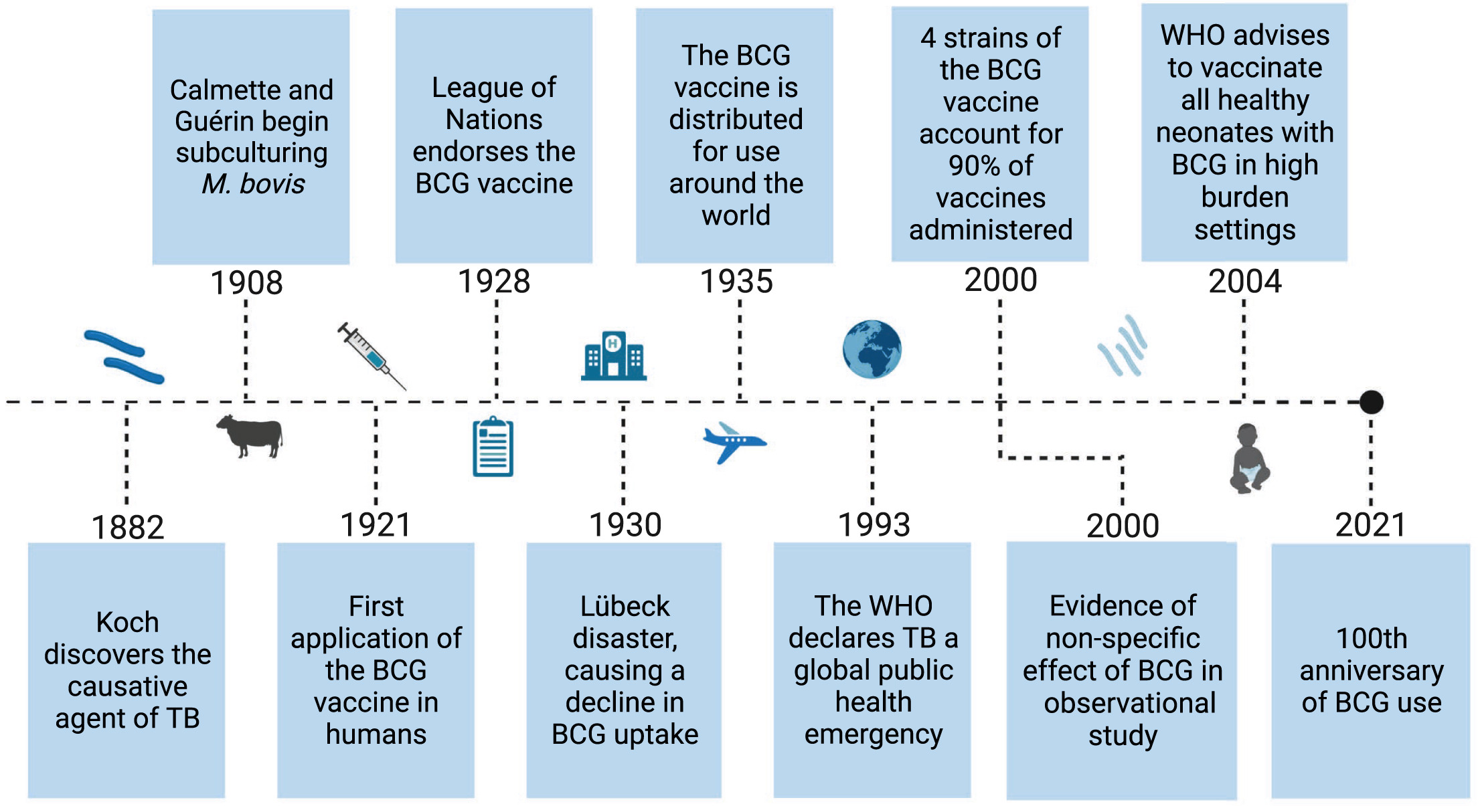
Current vaccine: BCG
Source: Setiabudiawan, 2022. Med.

Slide 53

Source: Ramakrishnan, 2012. Nature Reviews Immunology.

Slide 54


Slide 55

Source: Cooper et al., 2024. Frontiers in Immunology.

Slide 56

Source: Cooper et al., 2024. Frontiers in Immunology.

Slide 57

Source: Cooper et al., 2024. Frontiers in Immunology.

Slide 58

Source: Cooper et al., 2024. Frontiers in Immunology.

Slide 59

Source: Cooper et al., 2024. Frontiers in Immunology.

Slide 60

Source: Cooper et al., 2024. Frontiers in Immunology.

